Slide 1

Emrich Database
Adding Heirs and sending out Letters

Slide 2
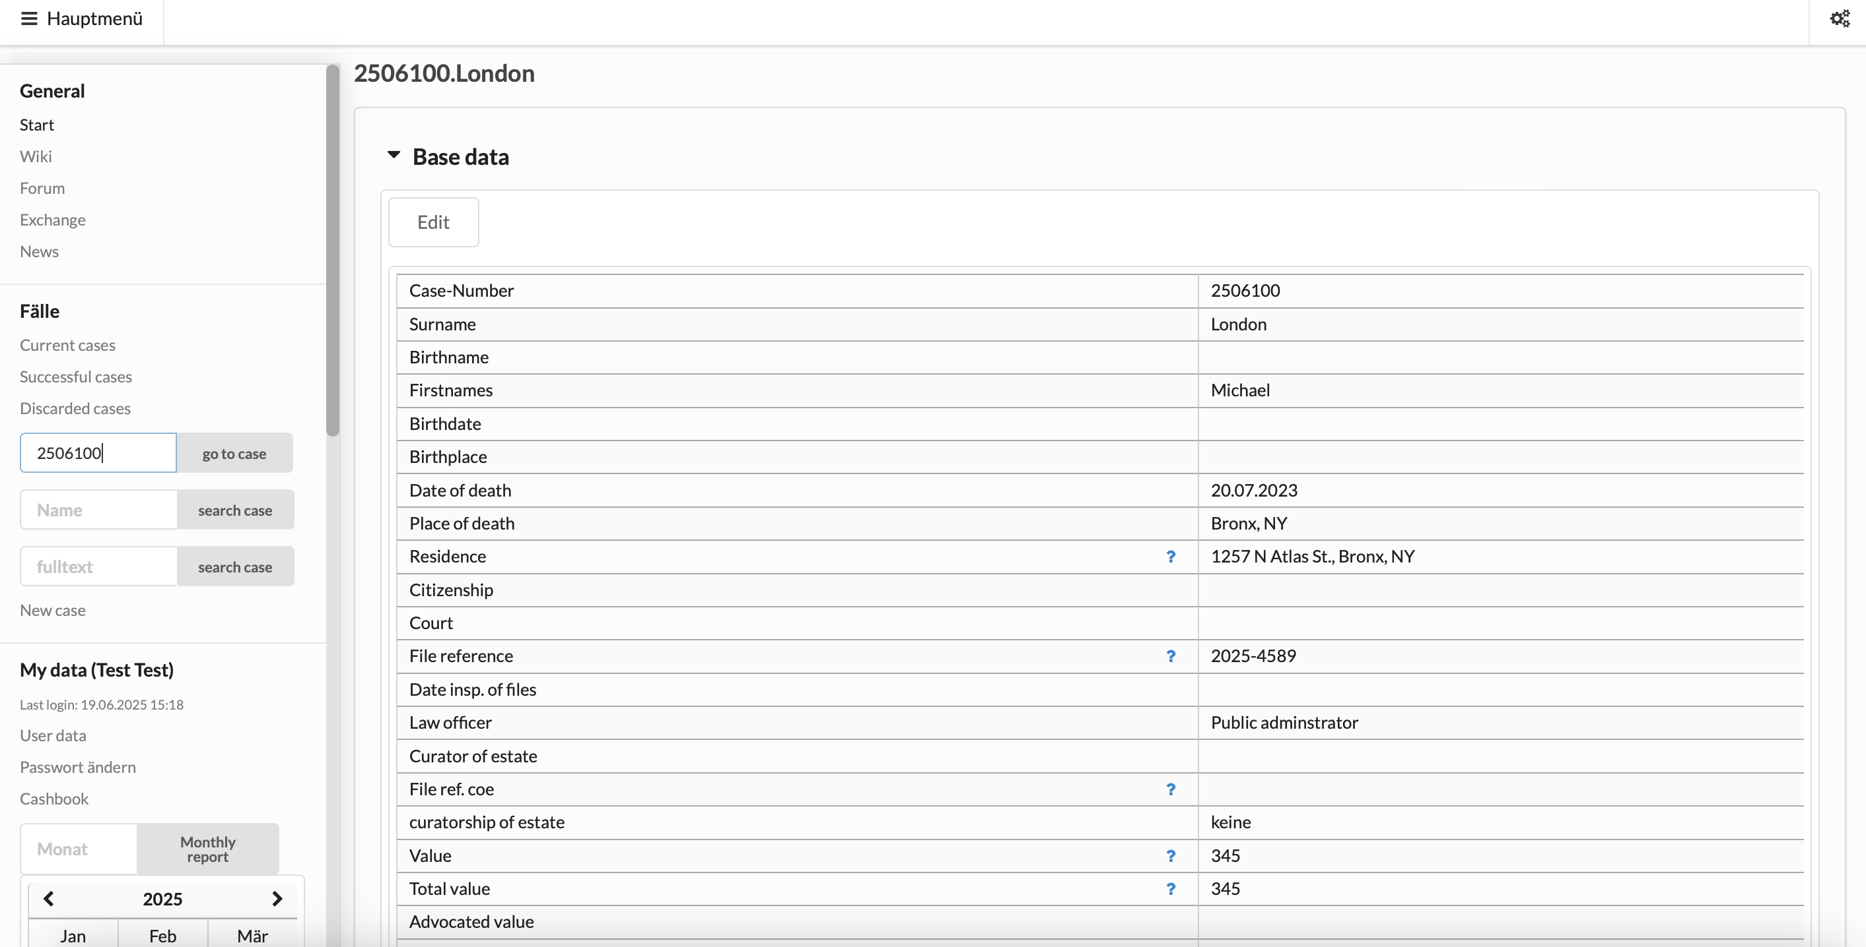
Go to case

Slide 3
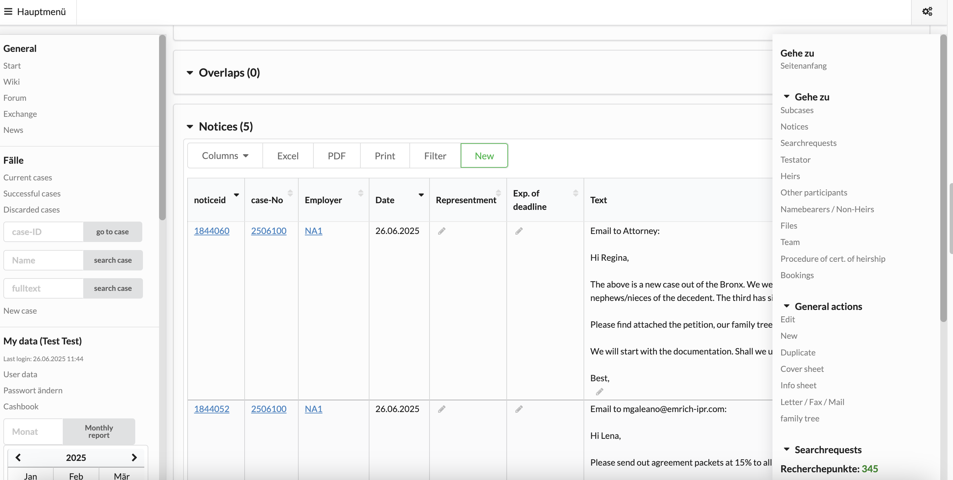
Open scroll-down
menu on the right
Go to Heirs

Slide 4
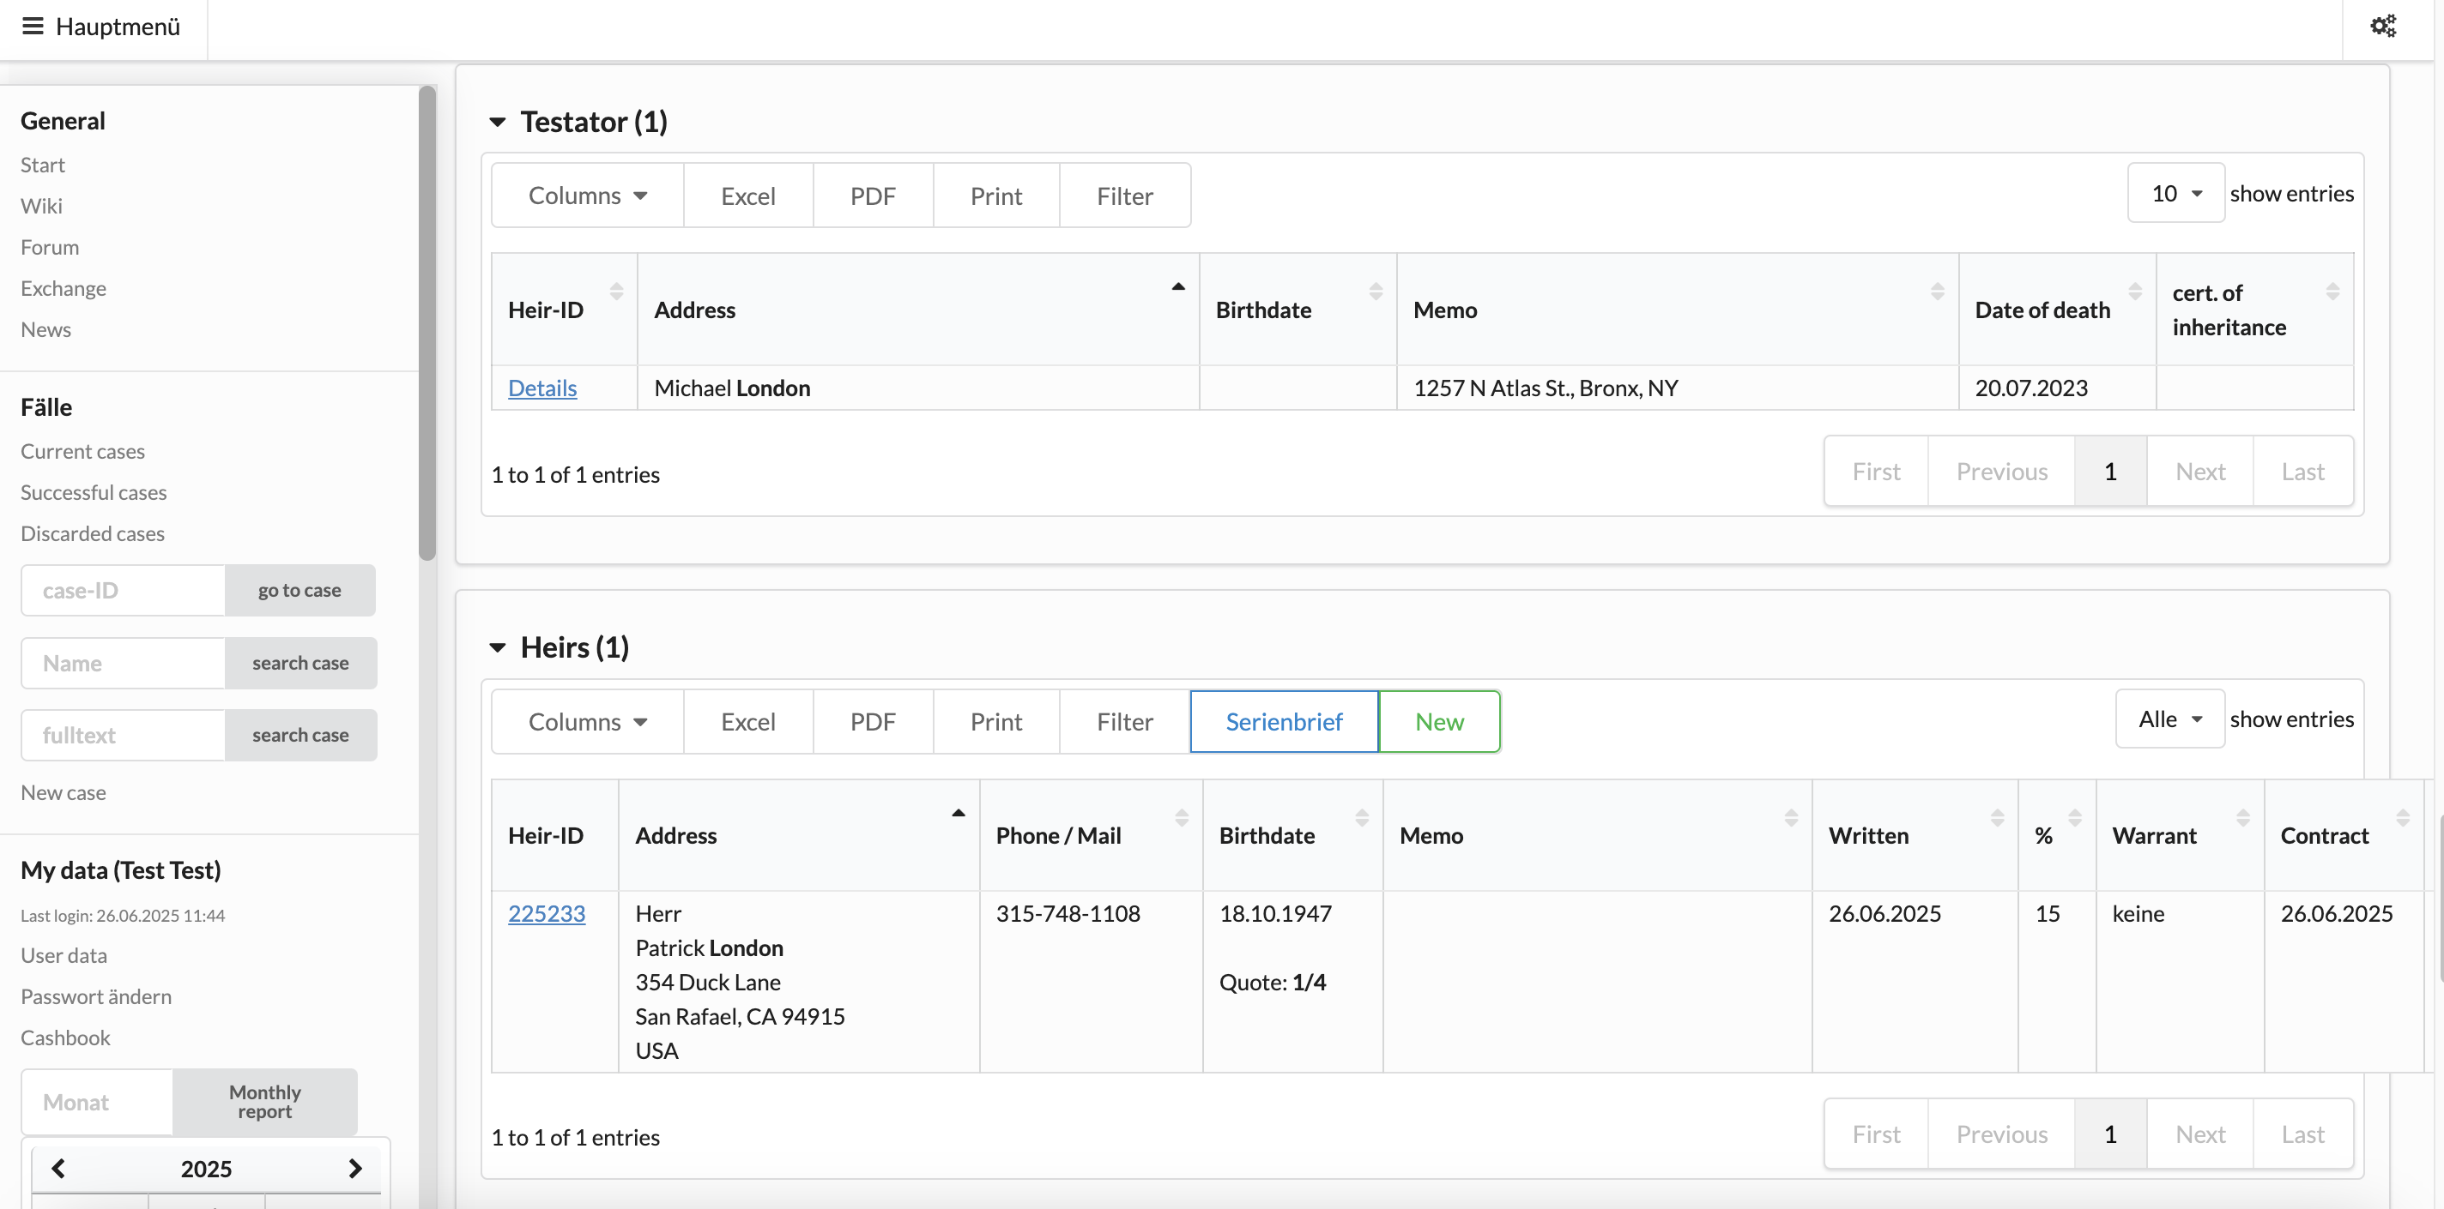
1. Add a new Heir
Click on „New“ to add a
new heir

Slide 5
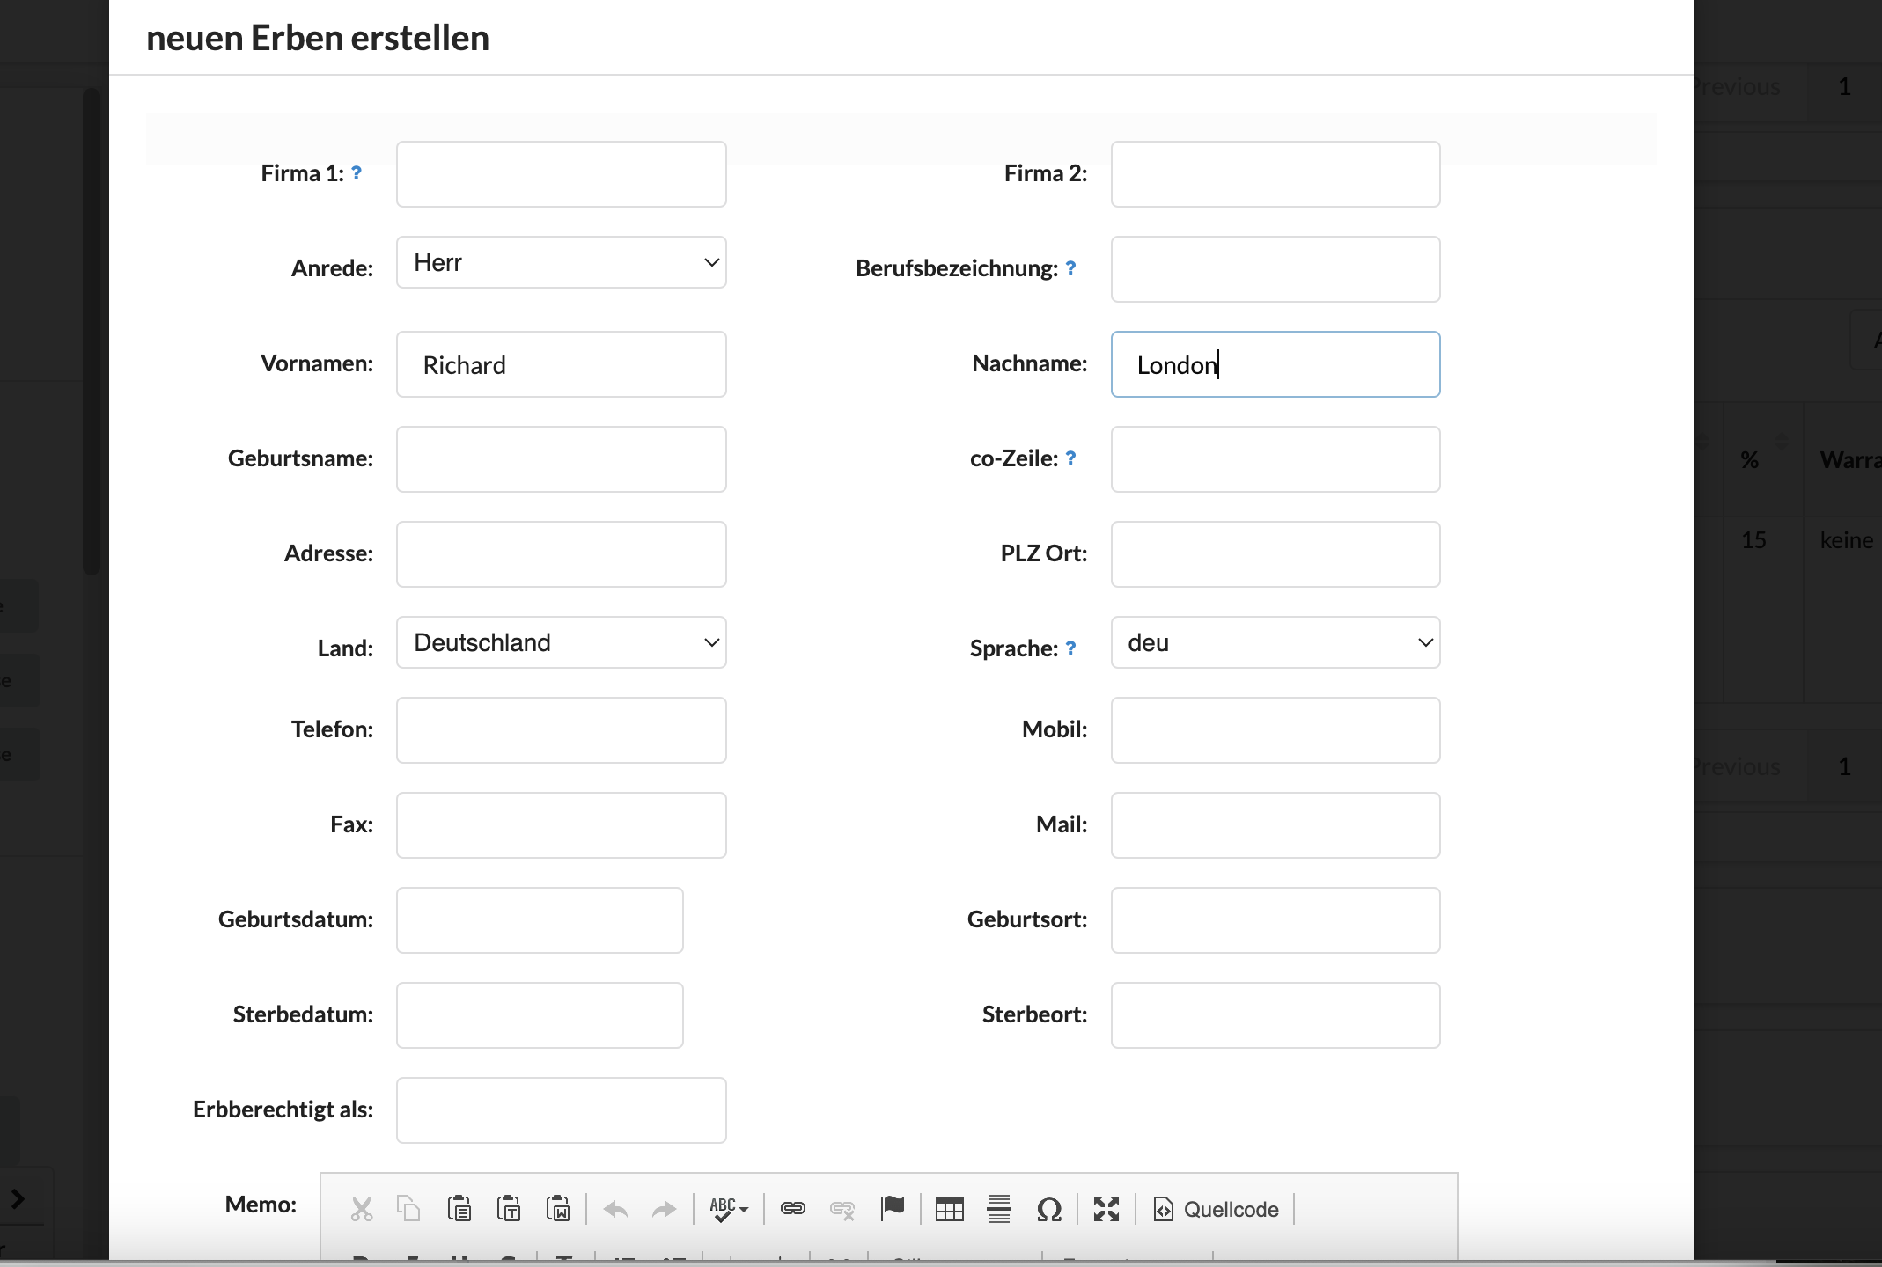
Fill in as much information as possible
N/A
N/A
Salutation: Mr. (Herr)
Mrs. (Frau)
N/A
Name(s)
Surname
Maiden name
Enter name if heir lives at
someone else‘s address
Address
Click to choose
country of
residence
City, State, Zip Code
Click to choose
language
Phone no
Cell phone no
E-Mail address
Birth date
Birth place
Death date
Death place
Relationship to decedent

Slide 6
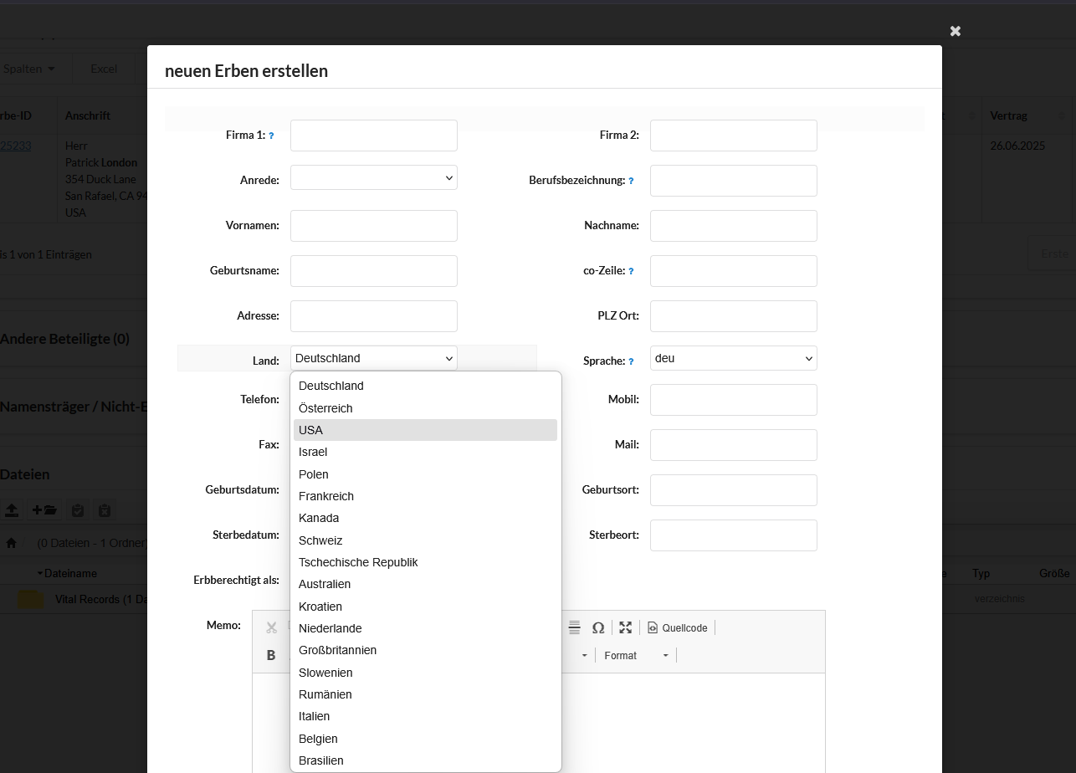
Choose country

Slide 7
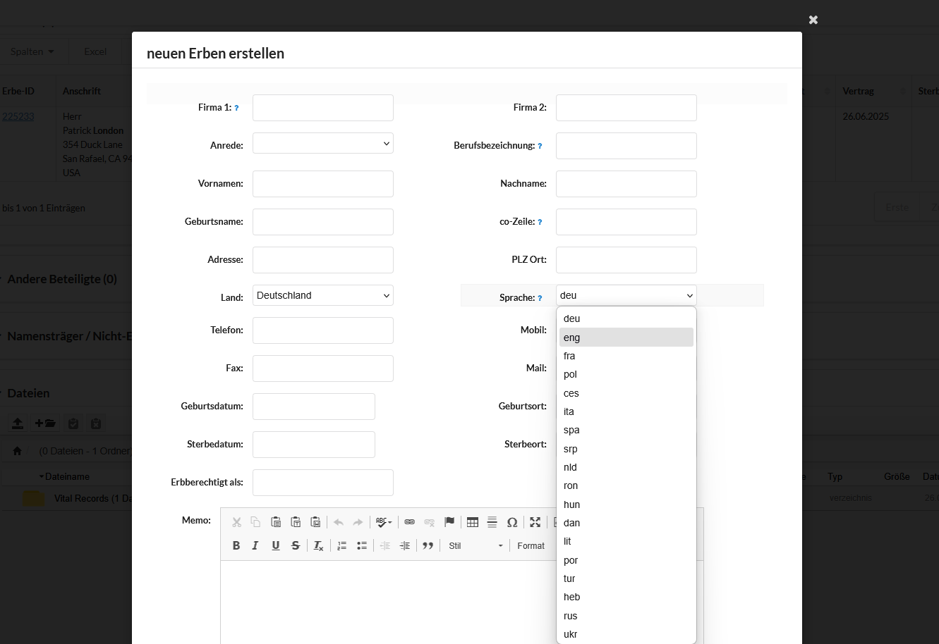
Choose language

Slide 8
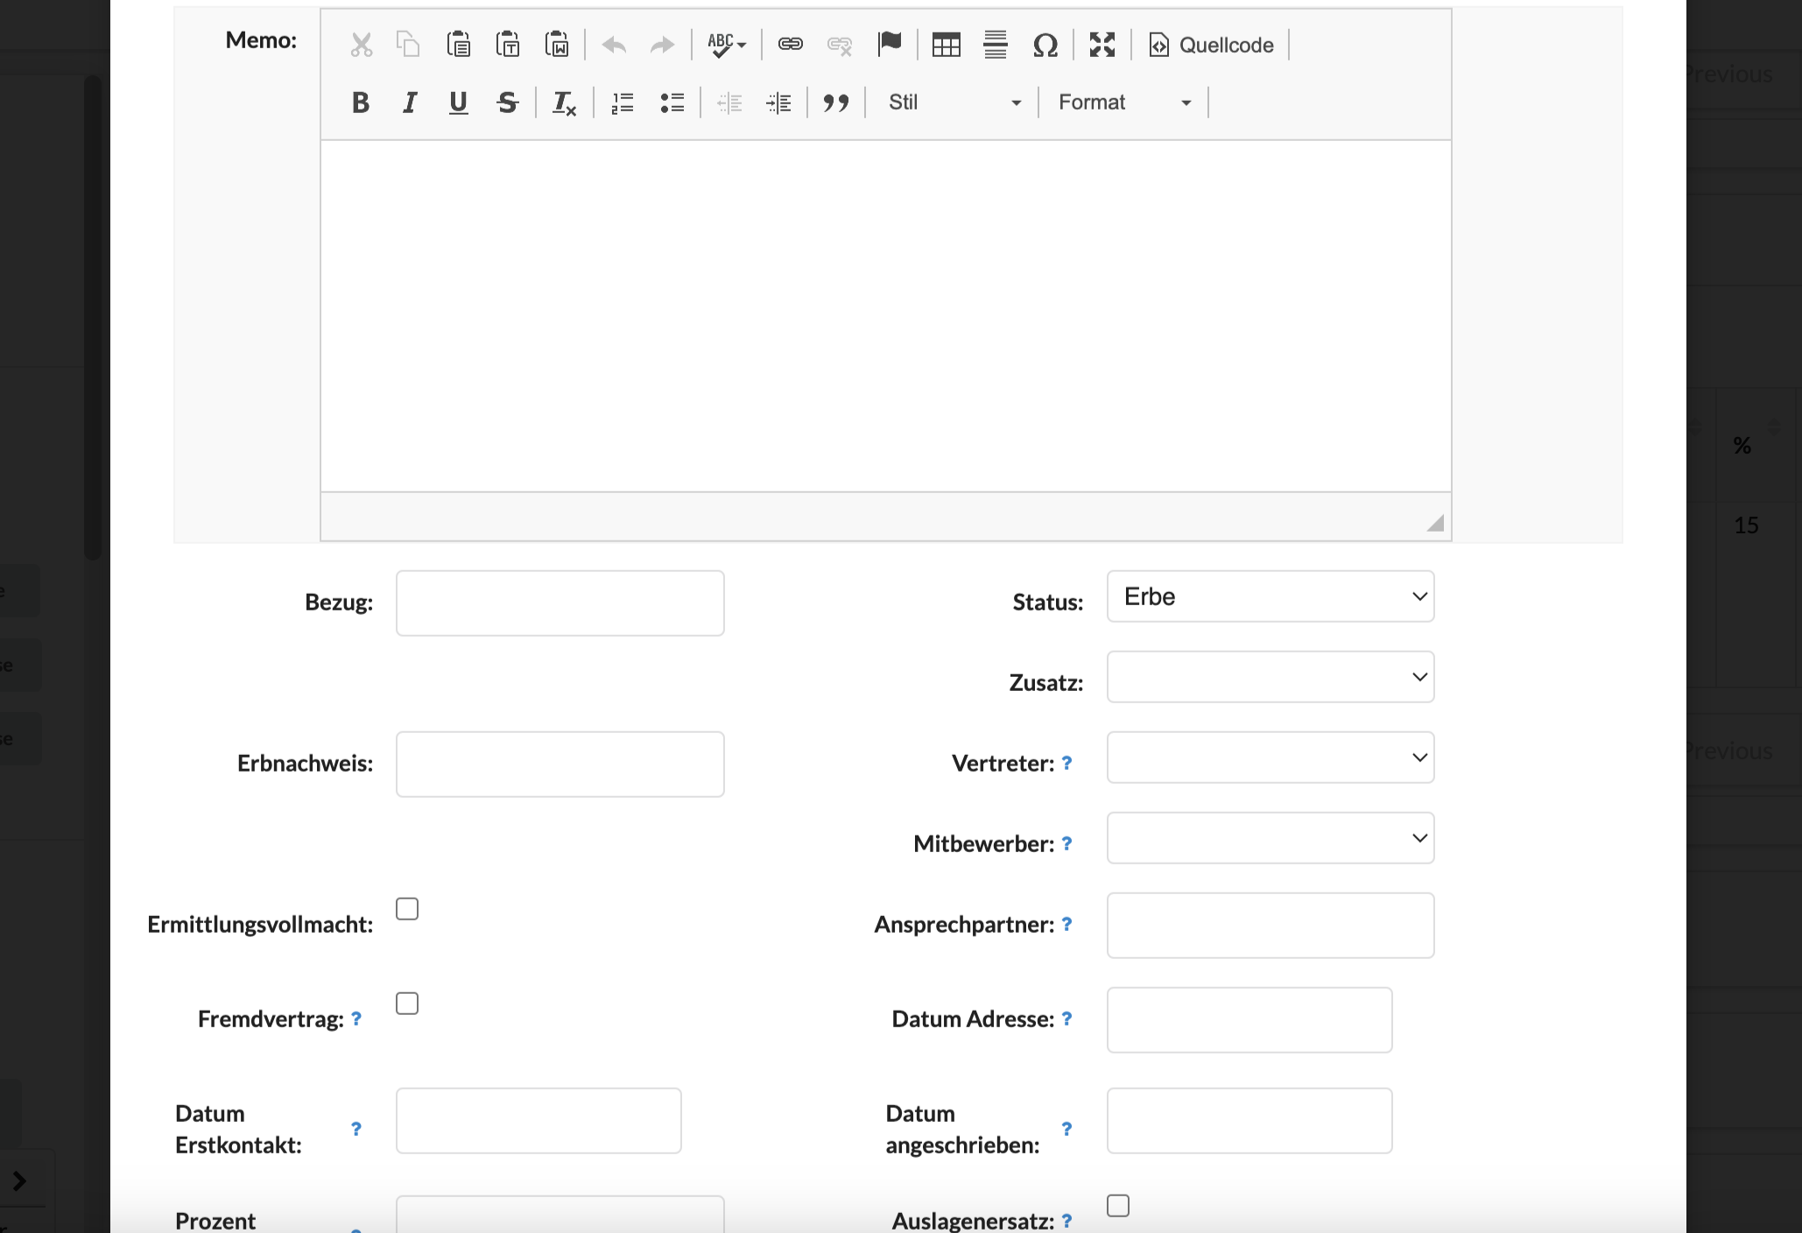
Use for alternative phone numbers, preferred form of contact,
Fedex returned, etc.
Click here to choose
which category person
belongs to (see slide 9)
N/A
Click here to choose (see slide 10)
If person post-deceased, enter
if there is a last will, trust, probate, etc.
Click here to choose (see slide 11)
N/A
N/A
Enter User-ID if contact person
other than yourself
N/A
N/A
Date of first contact
Date Agreement was sent
N/A

Slide 9
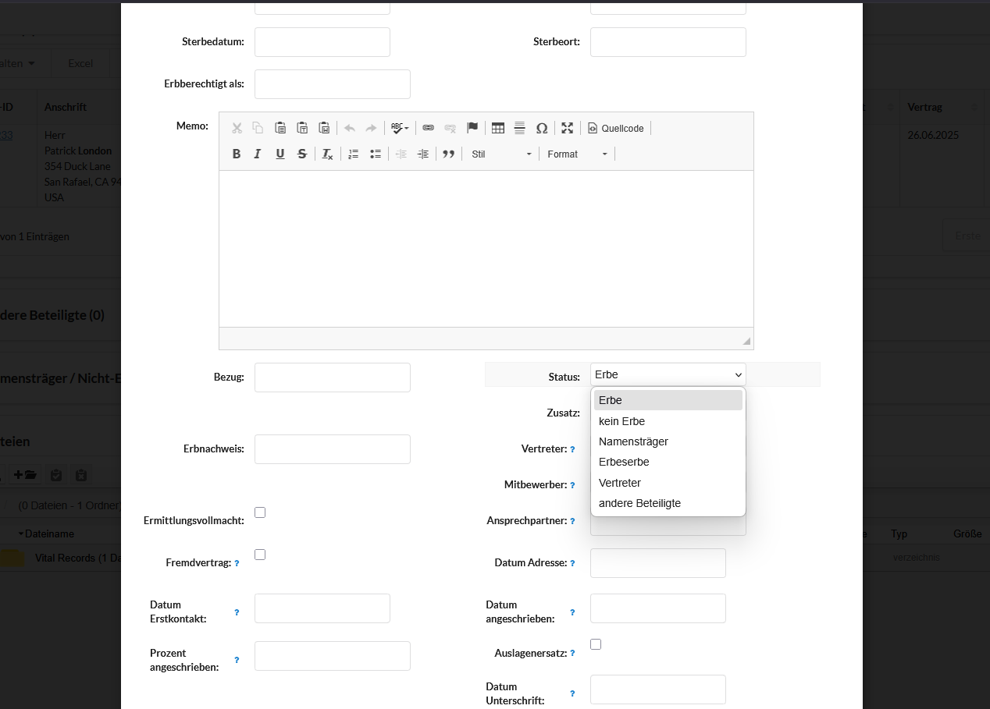
Heir
No heir
Namesake
Heir to the heir
Representative
Third party

Slide 10
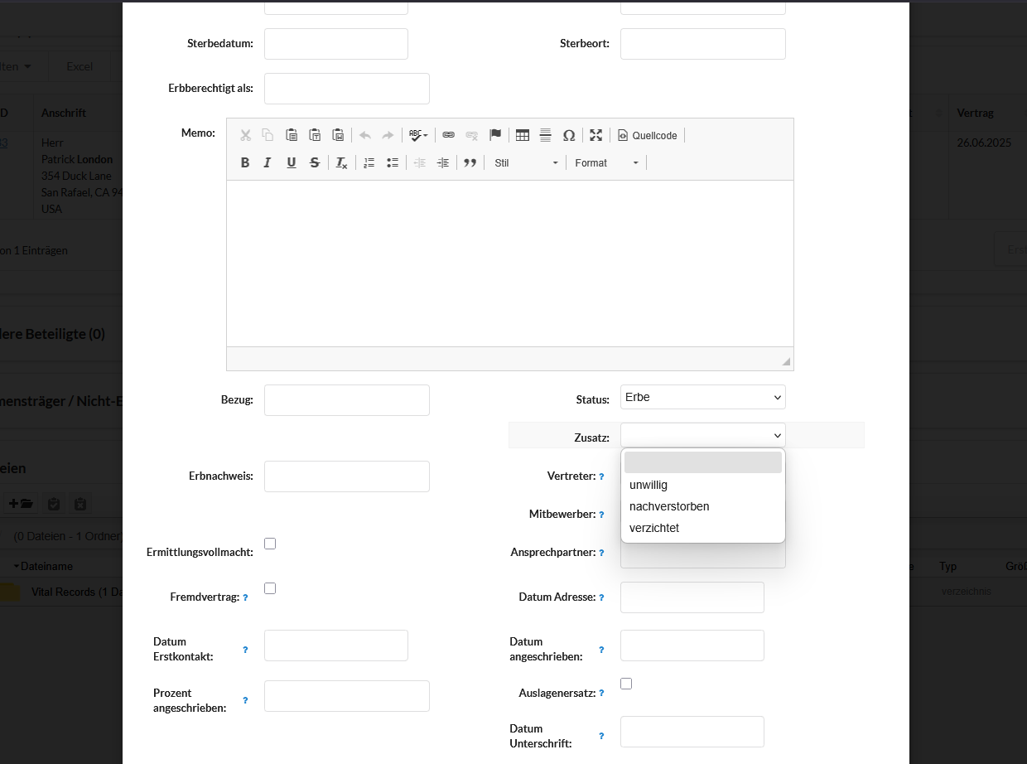
Additional information
Unwilling/signed
with competition
Post-deceased
Waiver

Slide 11
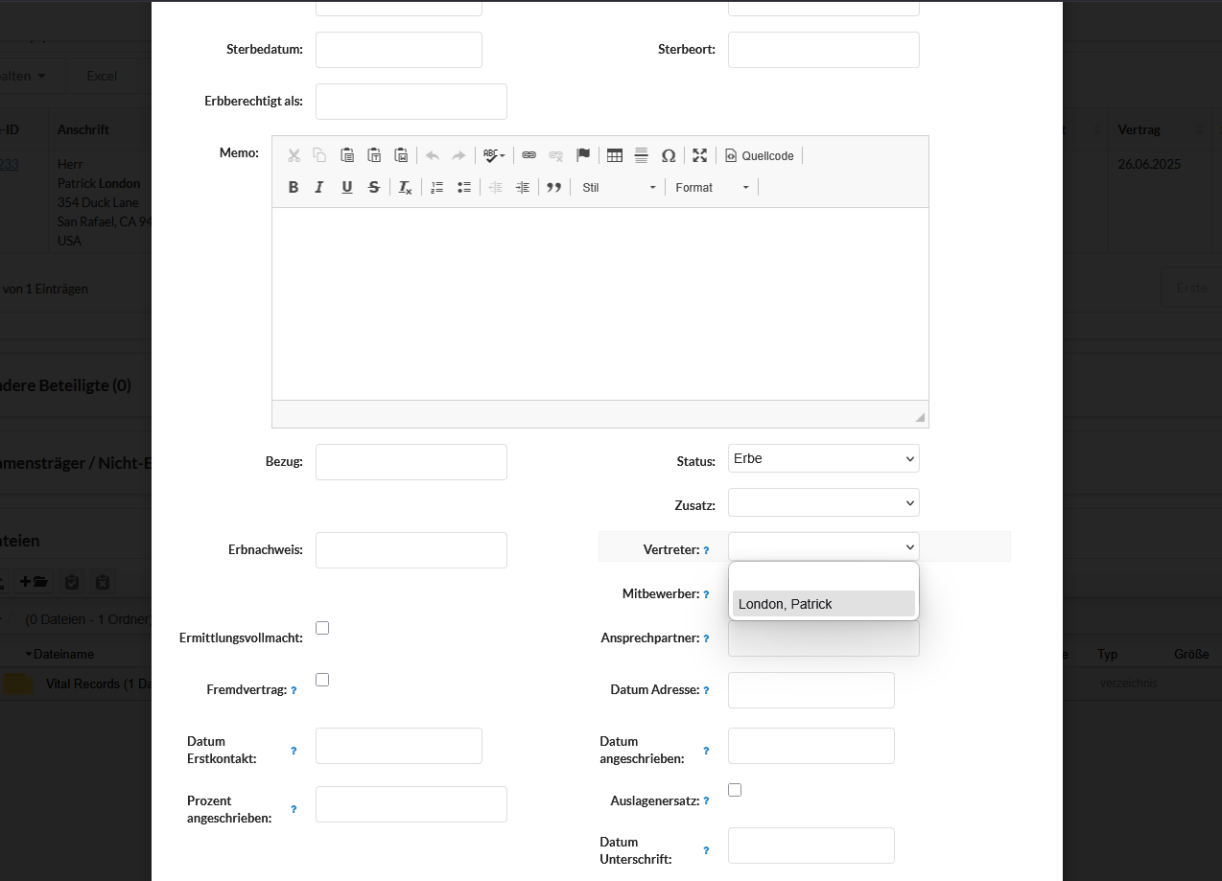
Representative
Choose from list
of all added
persons

Slide 12
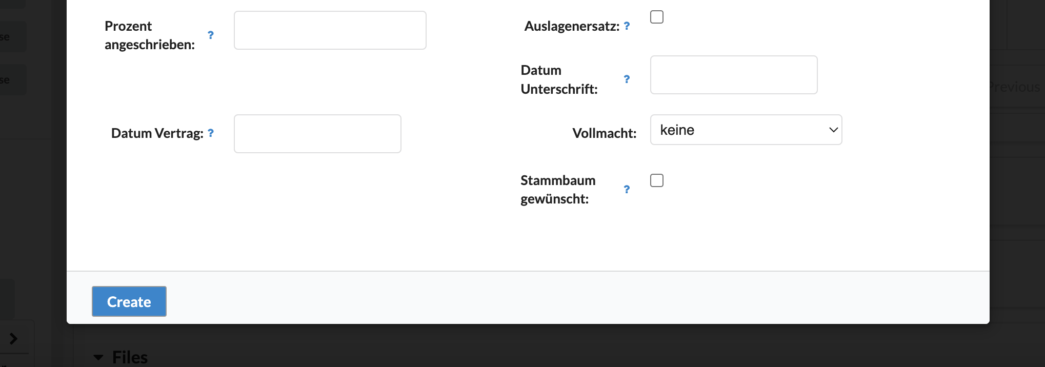
Enter fee percentage
N/A
Enter date of signature on Agreement
Enter date Agreement was received
N/A
N/A

Slide 13
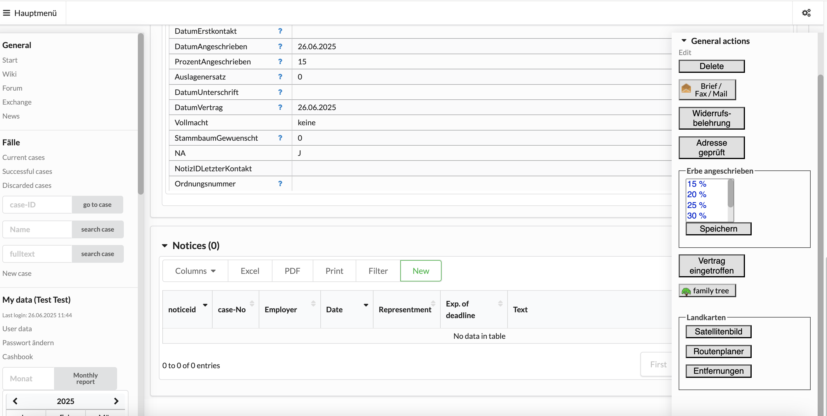
2. Send Solicitation Letter to Heir
Open menu
Make sure fee percentage is entered!
Click here to access
mail program

Slide 14
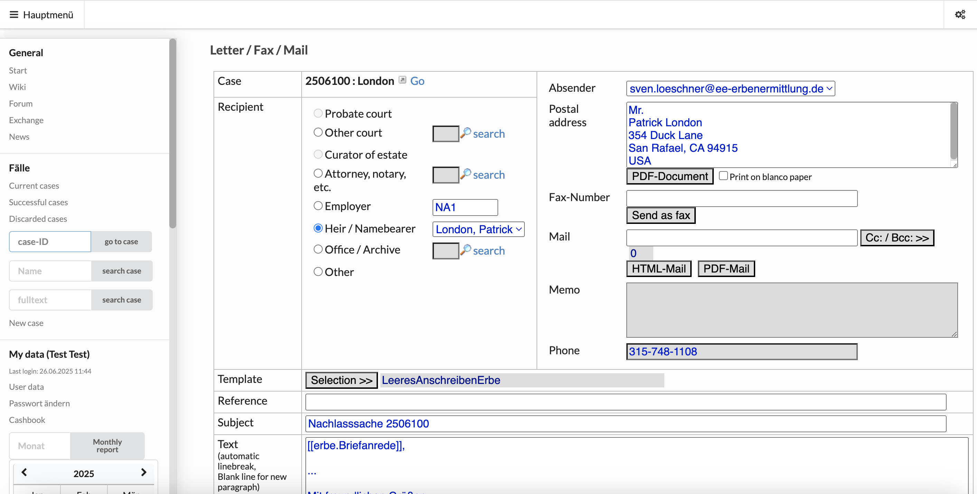
Choose your your email address if more than one account
Filled in automatically if you choose
heir or colleague
Click here to
choose from list
of colleagues to add
as CC or BCC
Send internal letter or email
Click here to create letter
Choose heir or third party
Add email address if not
prefilled
Click here to enter address
manually
Click here to create email
Click here to create email as
PDF attachment

Slide 15
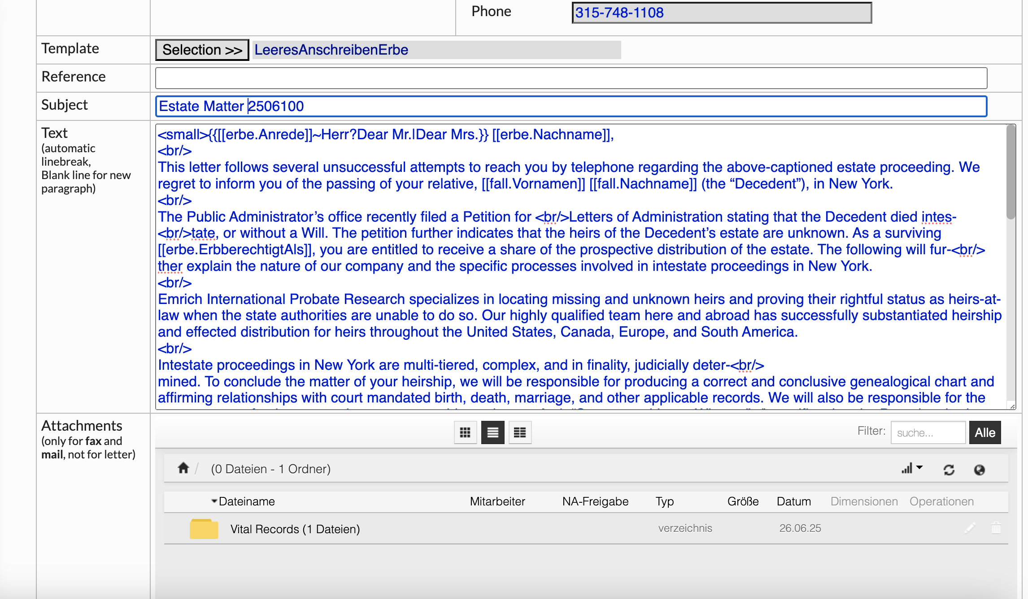
Enter subject line - subject line always switches back to German when you choose a new recipient!
Copy-paste letter drafts or write from scratch
Use HTML codes to format
FYI: If you uploaded a signature image to User Data,
it will show on document unless you delete the
HTML code
Attach files to emails

Slide 16
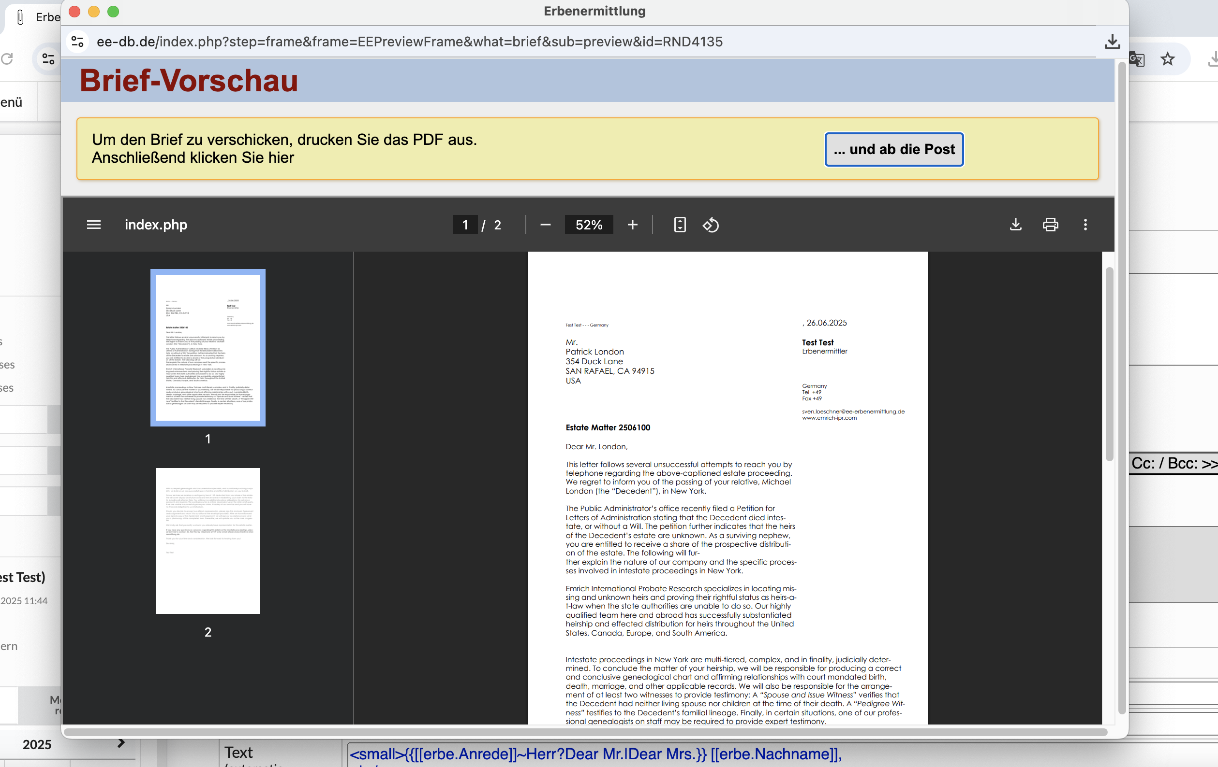
Preview of letter or email
Click here to send email or to signal
to DB that you sent letter
Follow these steps:
1. Download or Print if you
send a letter
2. Click on „… und ab
die Post“
3. Save the letter/email
in notes
download
print

Slide 17
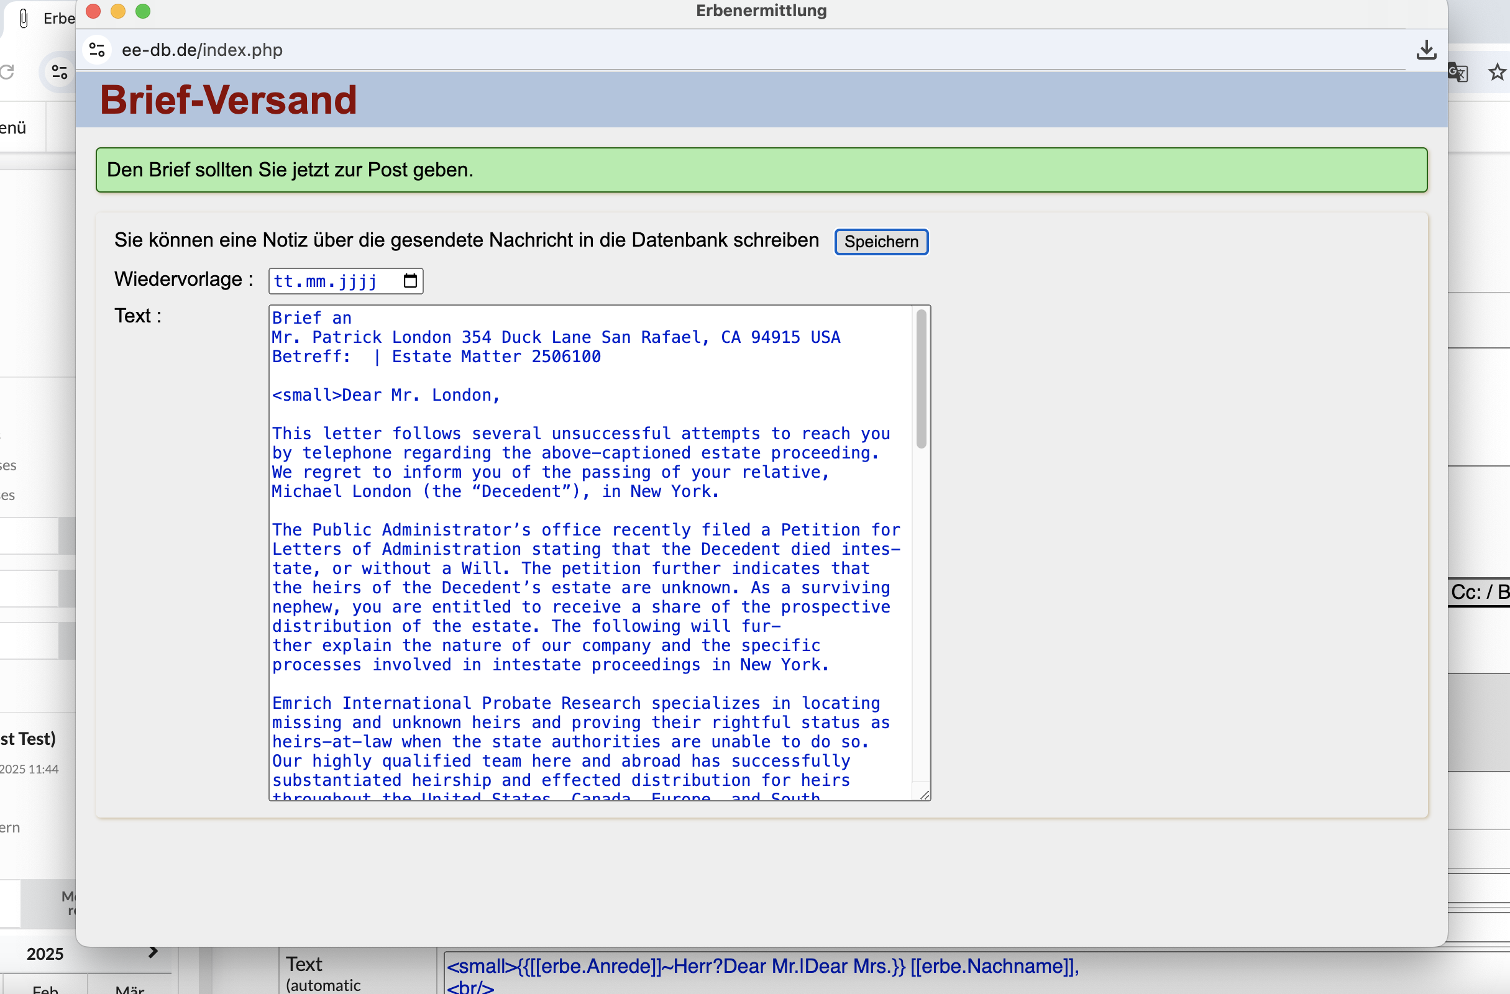
Letter or email sent
Click here to save note
Preview of email or letter to be saved in notes
-> letters or emails to heirs will be saved under respective heir
IMPORTANT:
The DB separates words automatically!
The word separations are often wrong. You need
to go over the text to correct the word
separations manually.

Slide 18
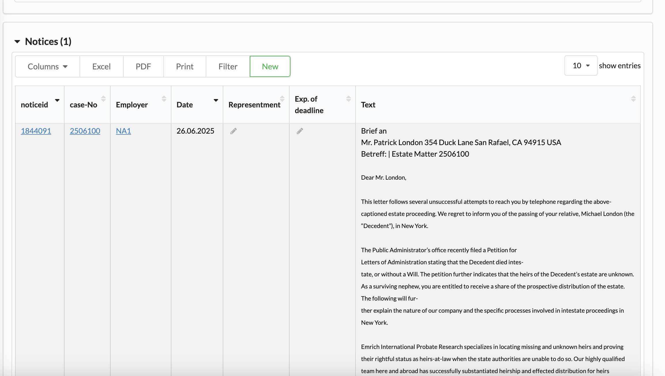
Create new note
Saved letter to heir

Slide 19
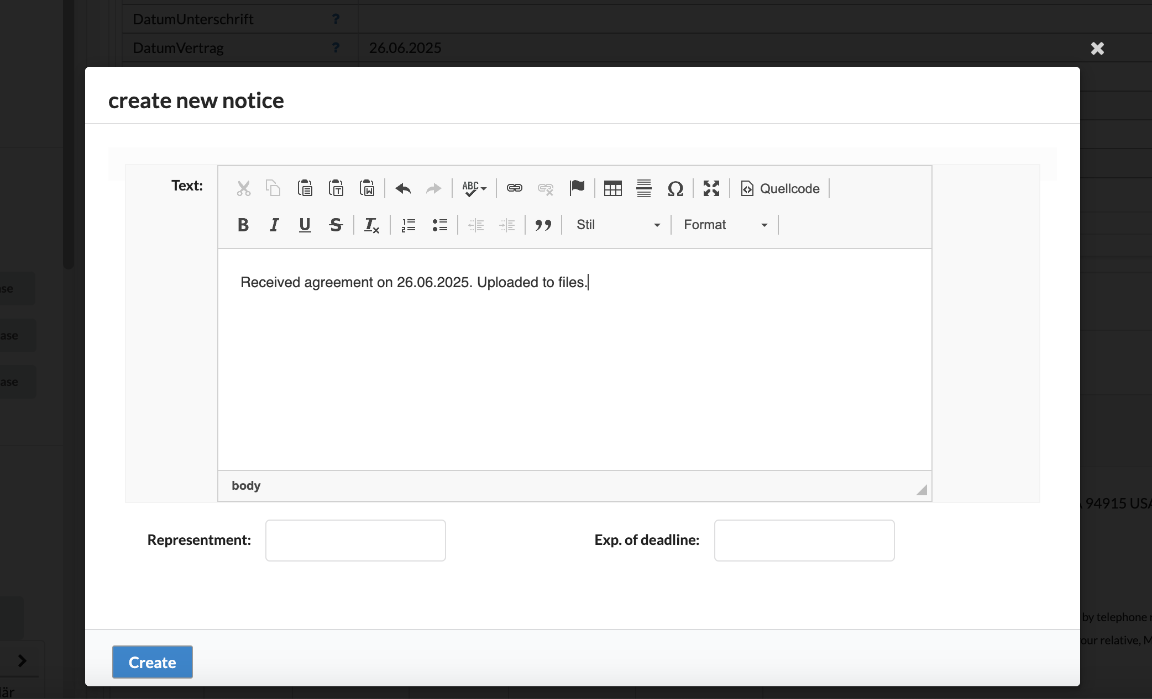
Enter text of new note
Enter every action in regard to or information
received from an heir: call log and summaries of
conversations, Questionnaire received,
emails and letters, documents received, etc.
Click here to save note

Slide 20
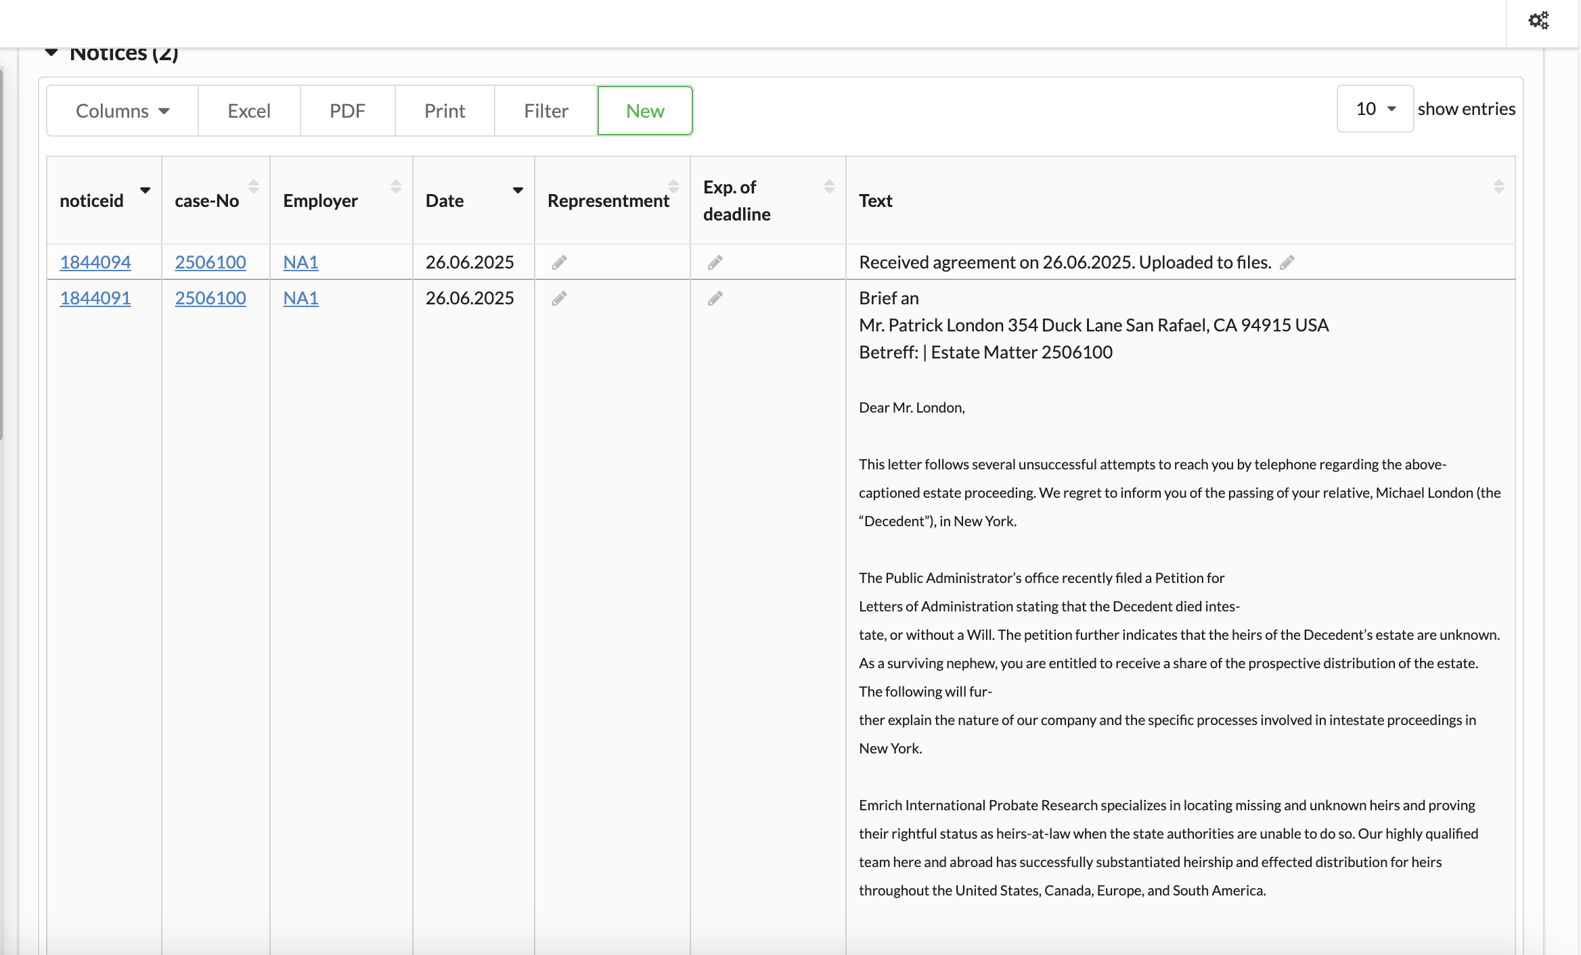
New note saved on DB

