Slide 1

Emrich Database
Creating a New Case

Slide 2
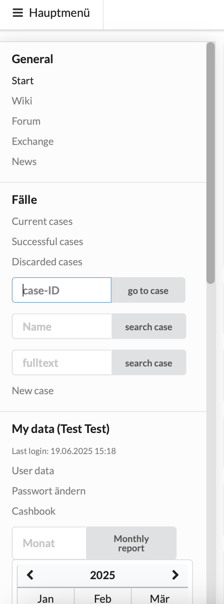
Main Menu
Click here to create a new case

Slide 3
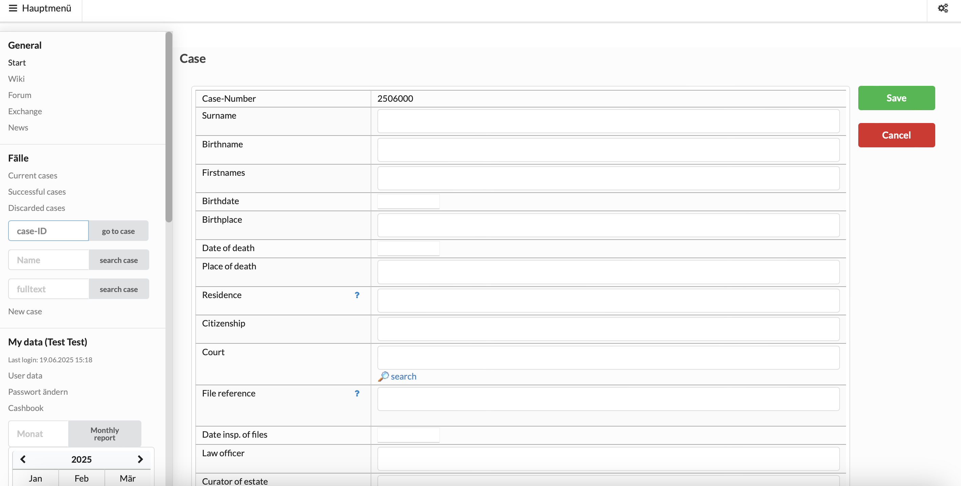
Enter as much information as can be gathered from the Petition and initial research!
Automatically awarded
Fill in
Fill in
Fill in
Fill in
Fill in
Fill in
Fill in
Fill in
Usually not important unless decedent does have other citizenship than US
Not applicable
Enter court file number
Not applicable
Enter information on the administrator (PA, friend, cousin, insurance, etc.)
Continued on next slide ->

Slide 4
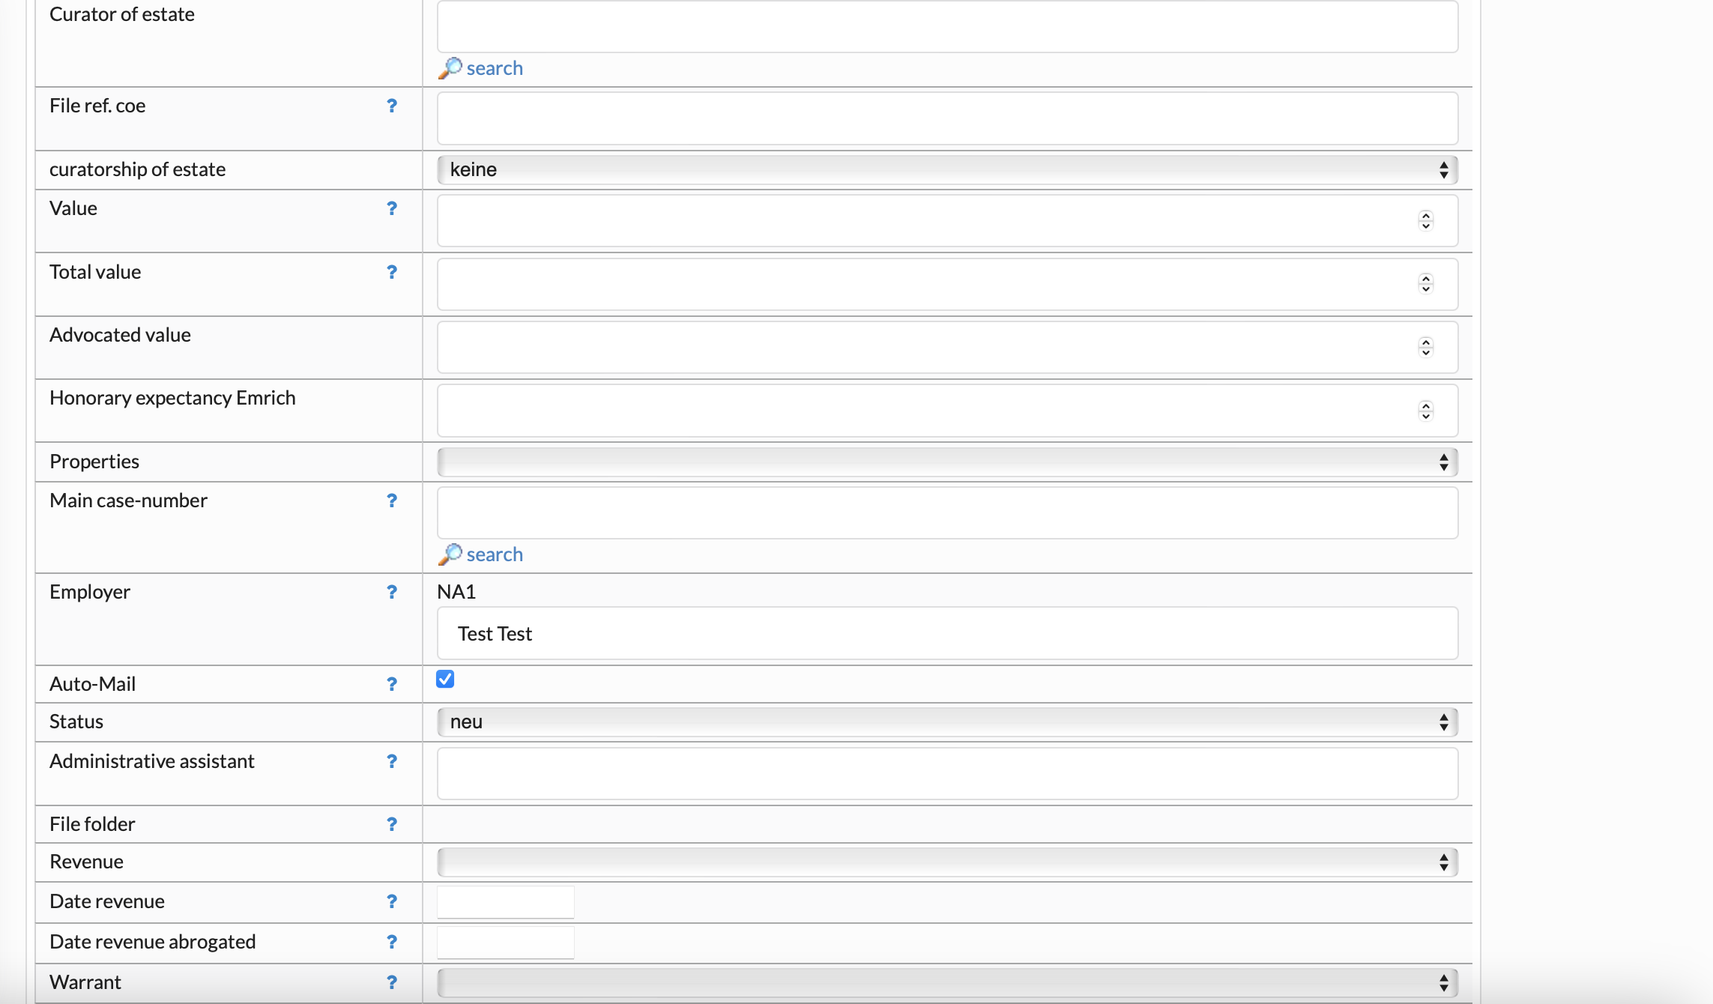
Not applicable
Not applicable
Not applicable
Enter if unclaimed value differs from total value (e.g. partner involved, one side already claiming)
Enter total value of case
When case switched to status Documentation: Enter value calculated on signed heirs
When case switched to status Documentation: Enter fee expectancy after deduction of attorney fees
Not applicable
Only applicable if this is a sub-case (e.g. succession of a post-deceased heir)
Your User-ID will be awarded automatically; you can change it to another colleague anytime
Case manager
Only the case manager can open the family tree for the first time!
Status „New“; should be changed to „Research (Recherche)“ when forseeable that case will be continued
Case worker allocated when case switched to Documentation
Not applicable
Not applicable
Not applicable
Not applicable
Not applicable
Continued on next slide ->

Slide 5
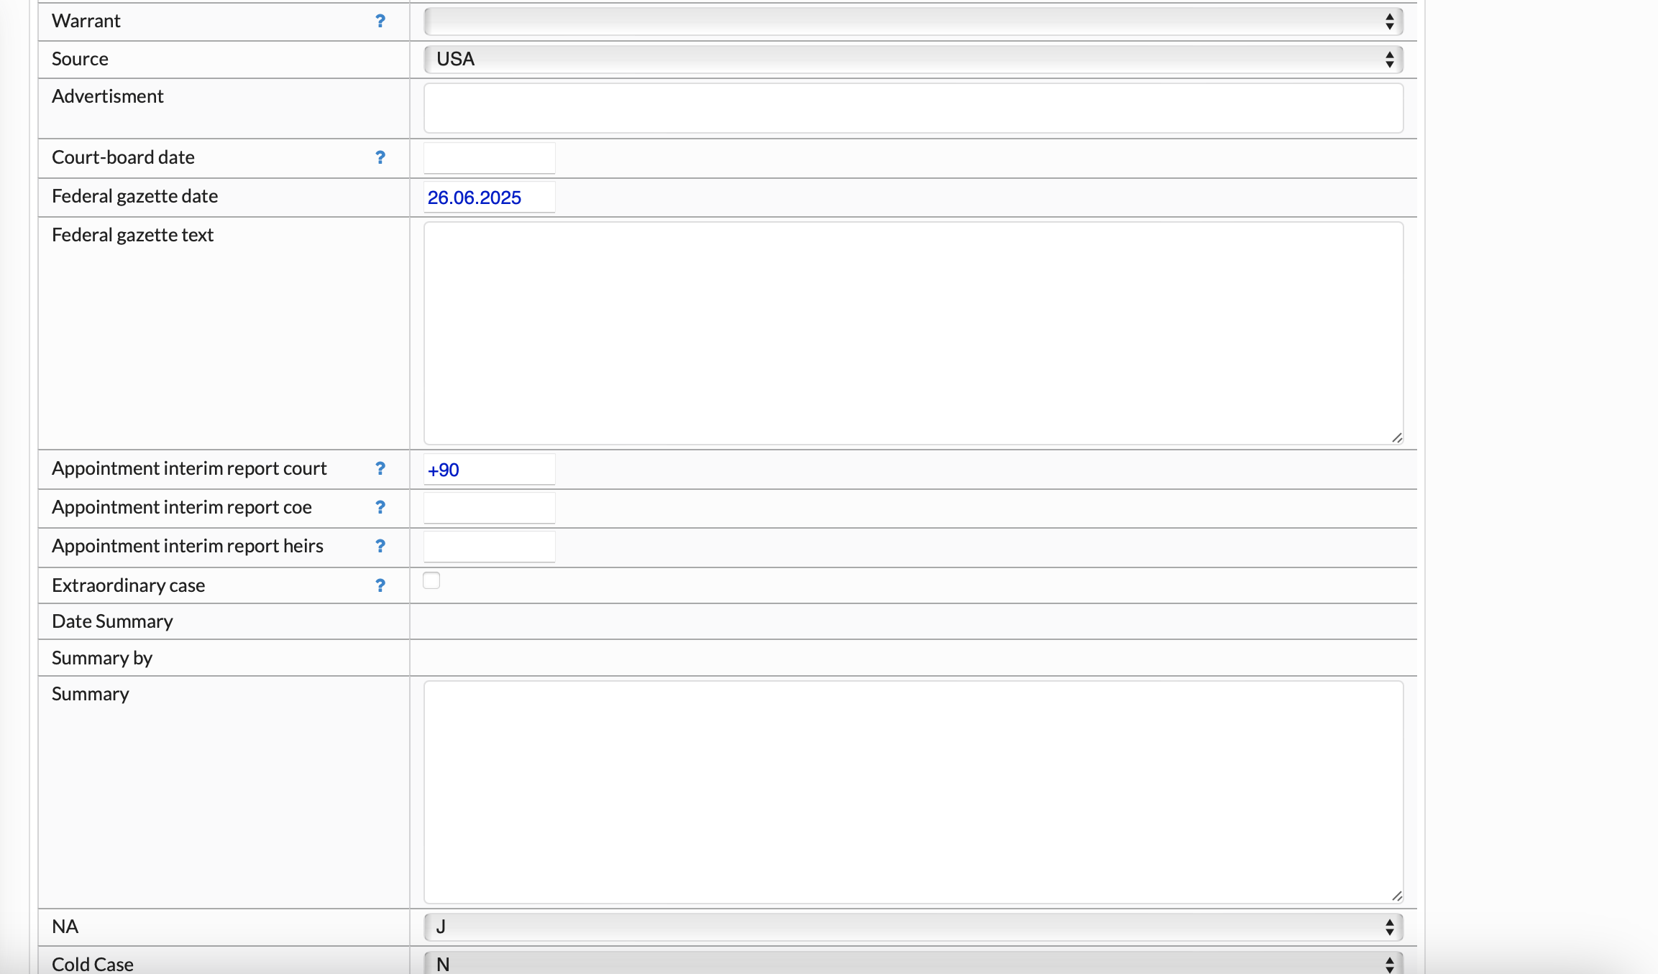
Not applicable
Not applicable
Not applicable
Enter date when case was filed
Short summary of case specifics (e.g. how many heirs are already claiming,
community property, decedent lived in care home, etc.)
Not applicable
Not applicable
Not applicable
Not applicable
Filled in automatically
Filled in automatically
Important case updates filled in as case progresses
Always enter your User-ID and date when you post an update!
Continued on next slide ->

Slide 6
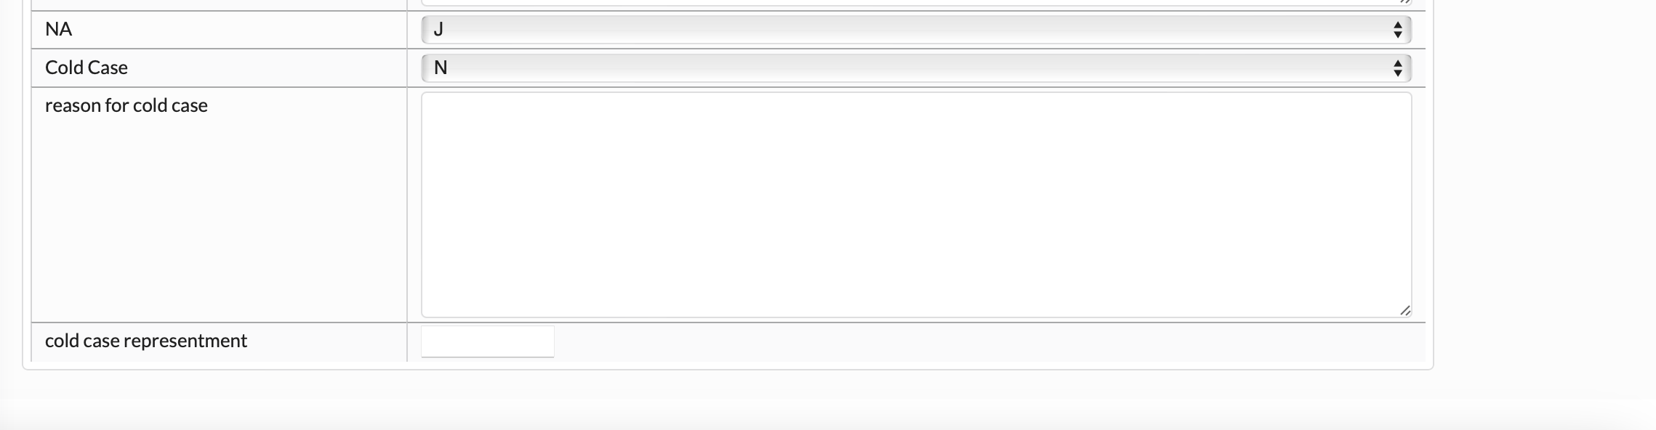
Needs to be switched to „J“ for „Yes“, so that case is visible on US-Database
Not applicable
Not applicable
Not applicable

Slide 7
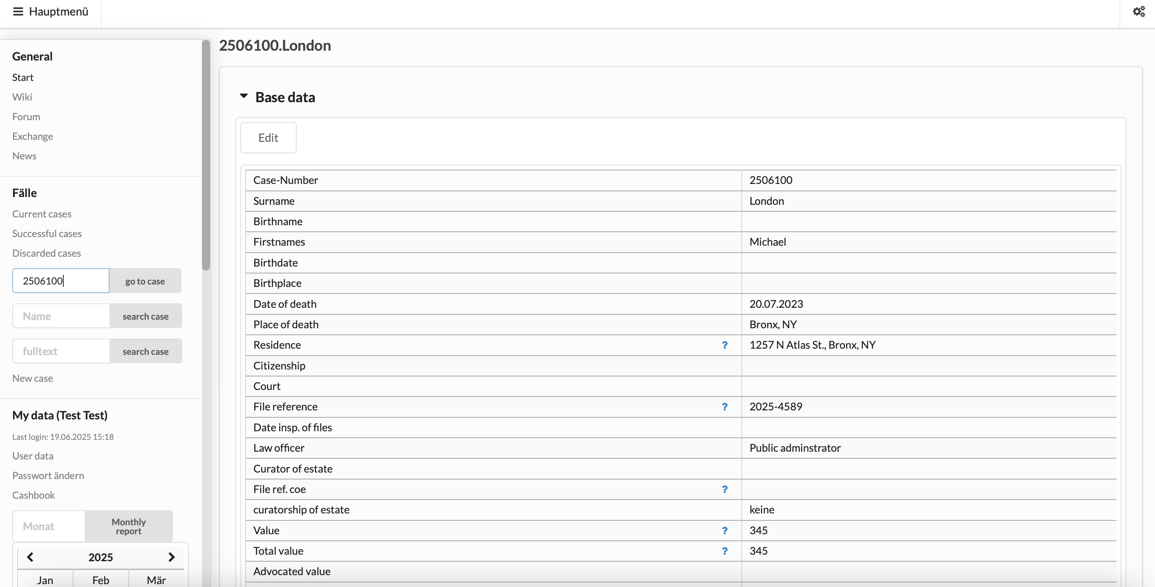
Example

Slide 8
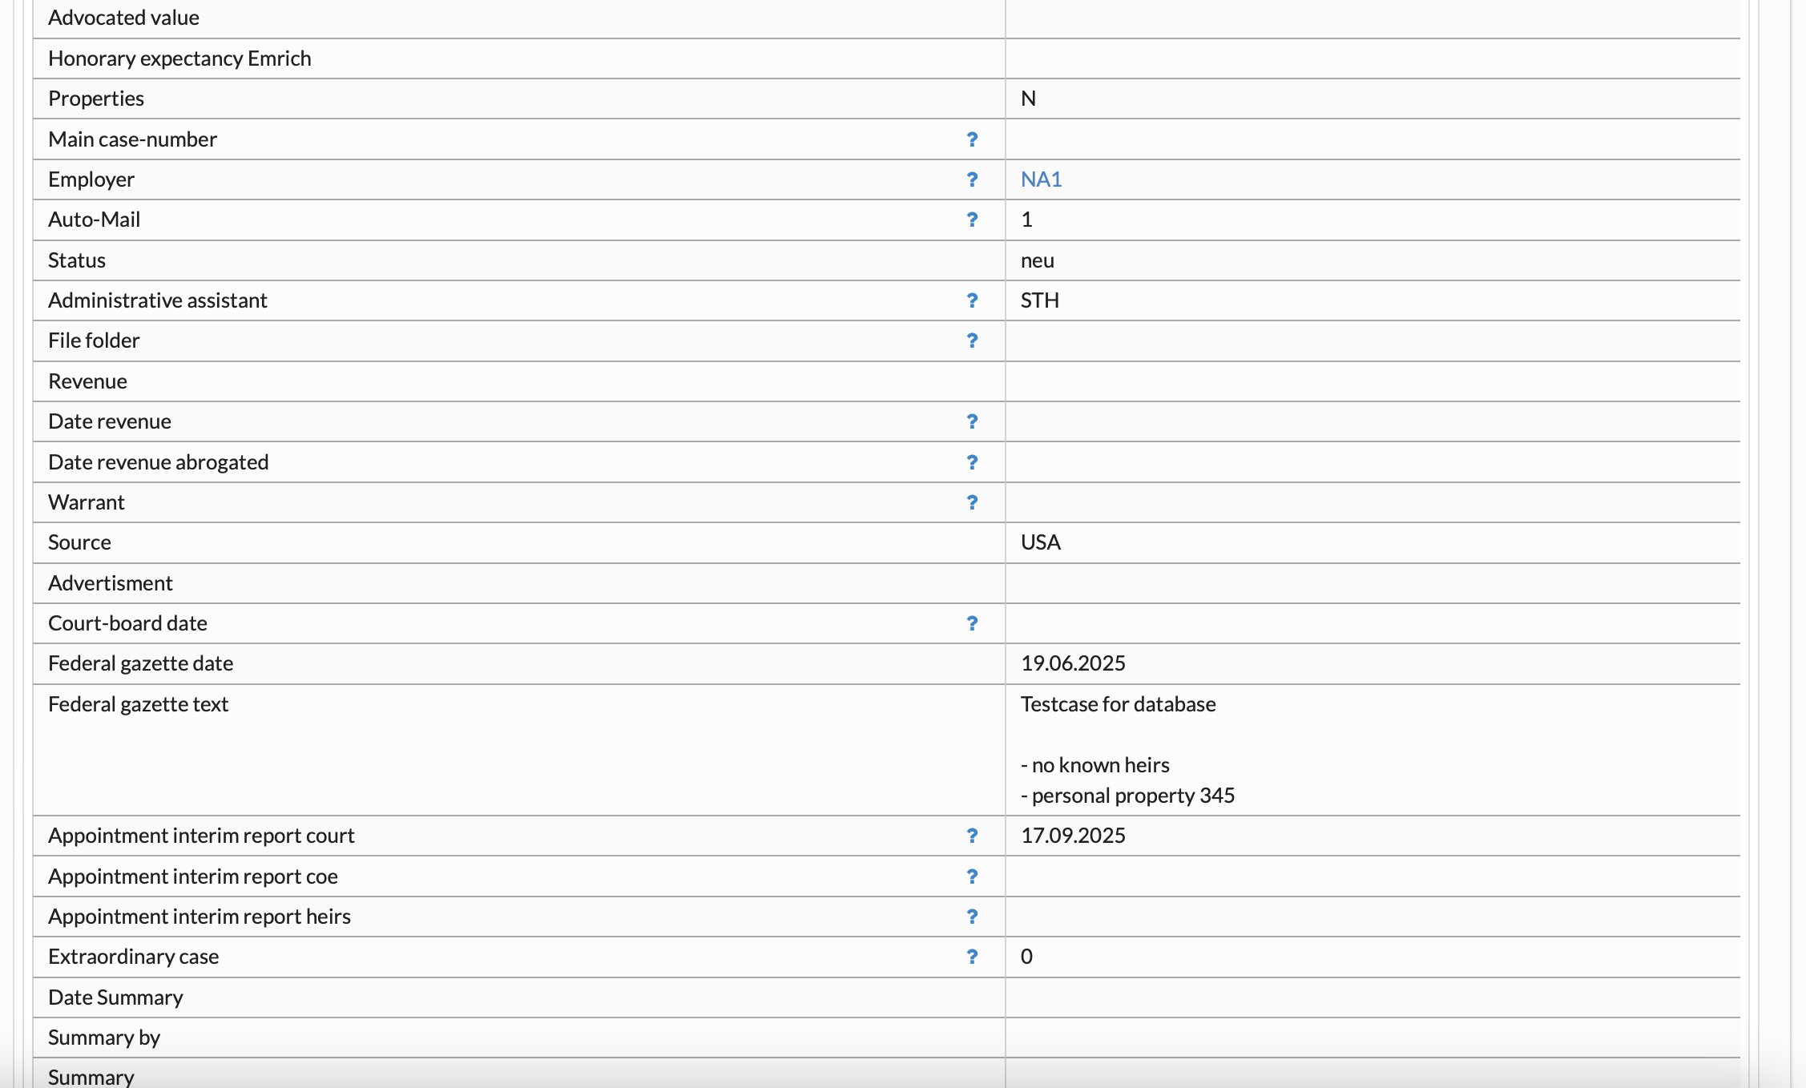

Slide 9
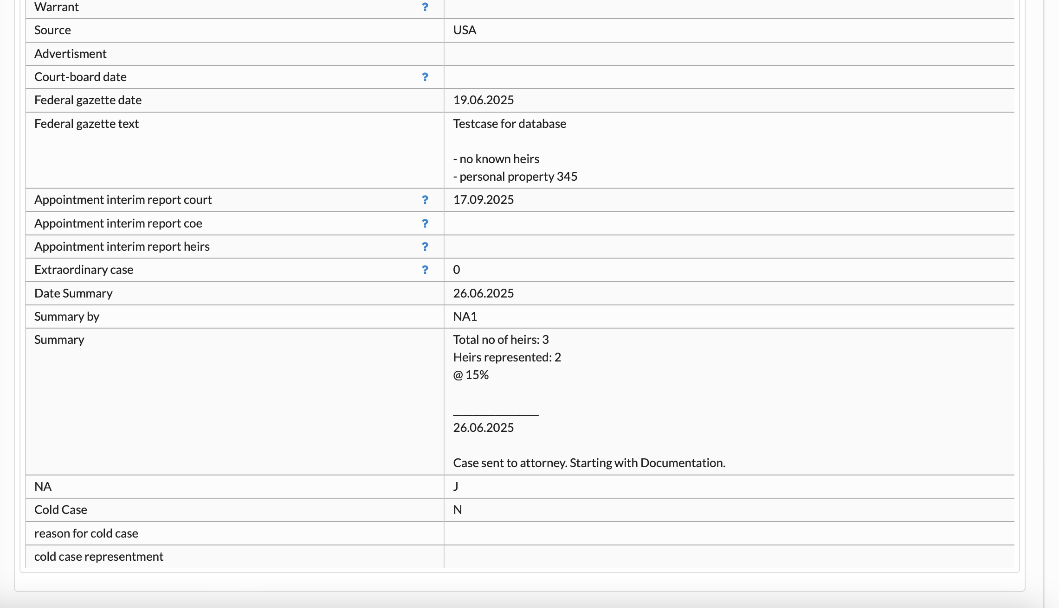

Slide 10
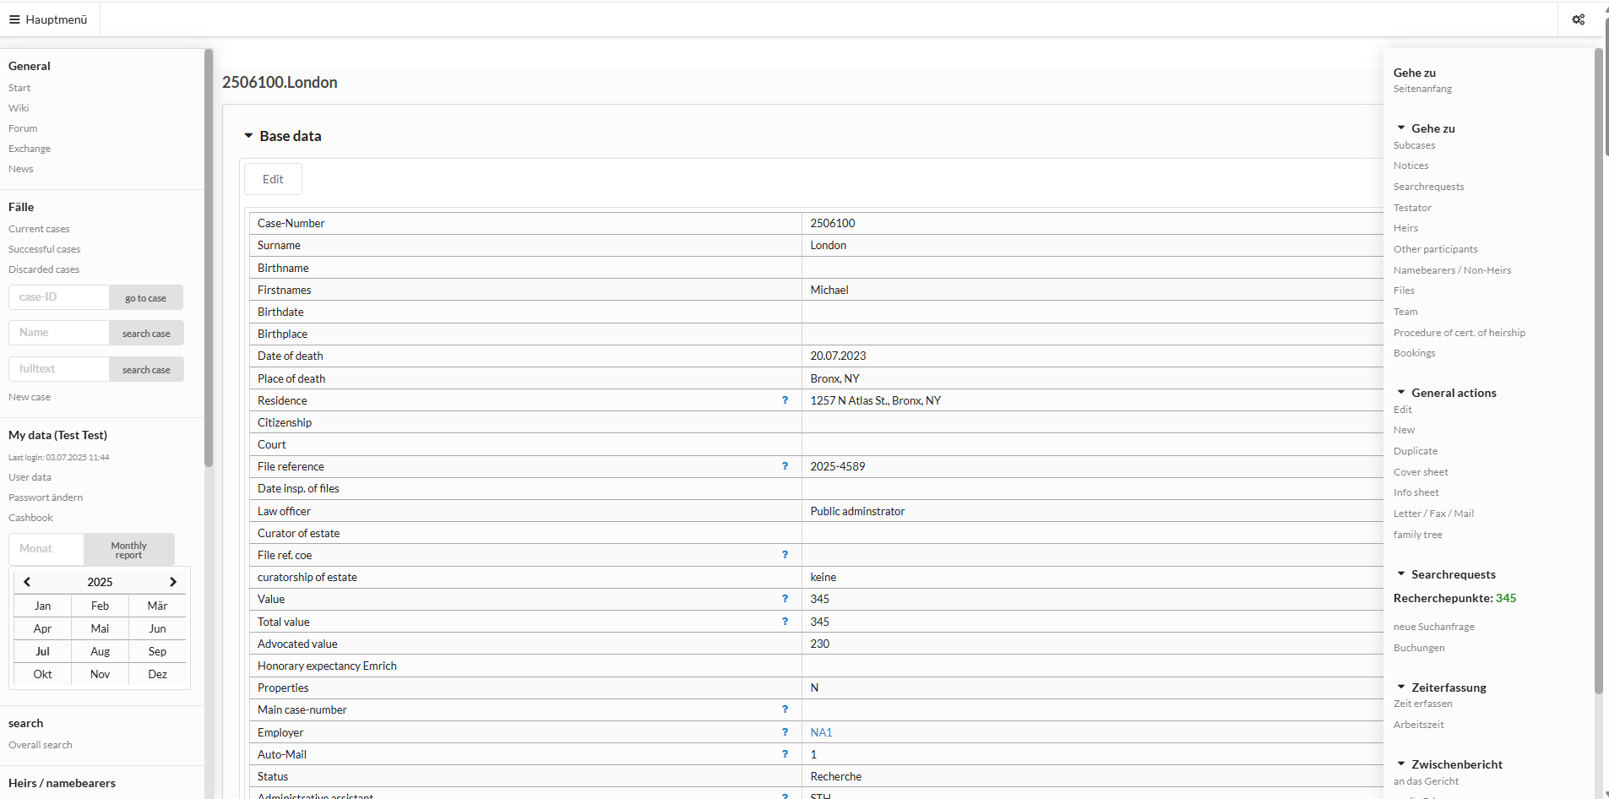
Next Steps
Upload Petition for Probate and additional
court filings to files!
-> see PPP on „Navigating a Case“
Add your team members to the case!
-> see PPP on „Navigating a Case“
Click here to initiate
the family tree

