Slide 1

Emrich Database
General Introduction

Slide 2
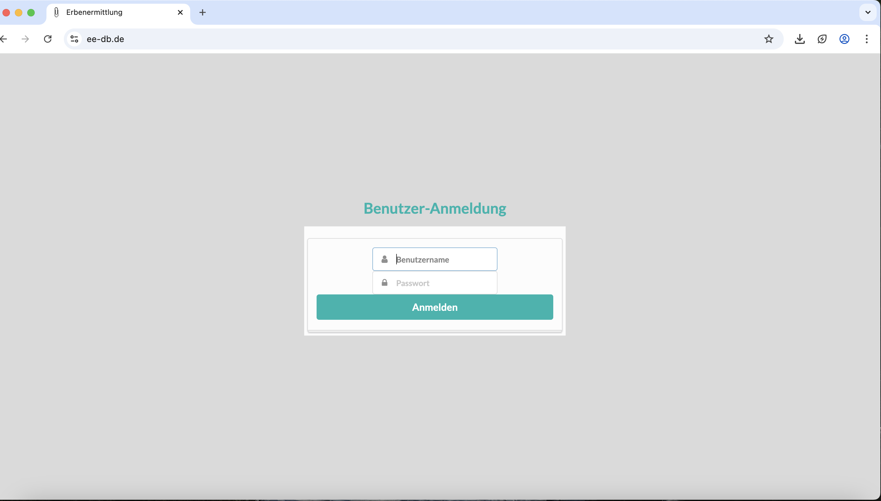
Enter User-ID
Enter Password

Slide 3
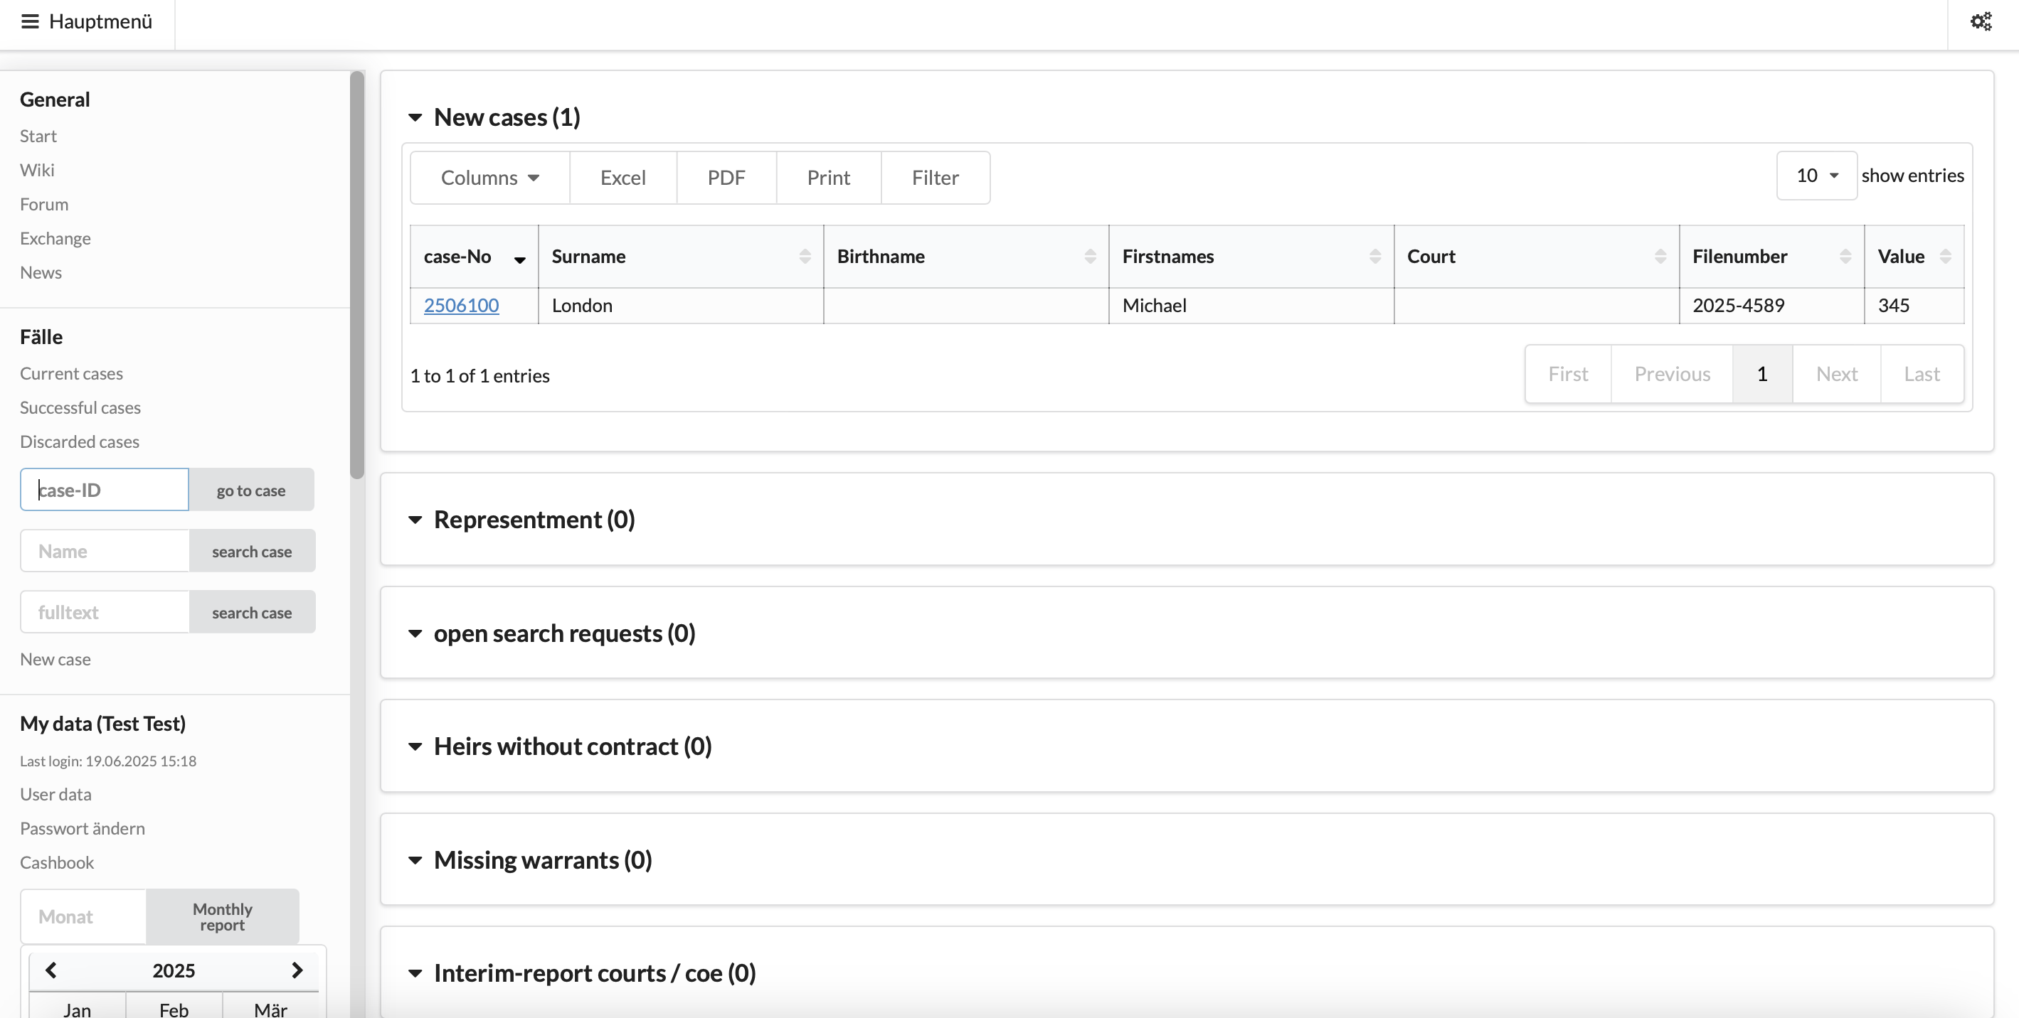
Main Menu
1. Home Page

Slide 4
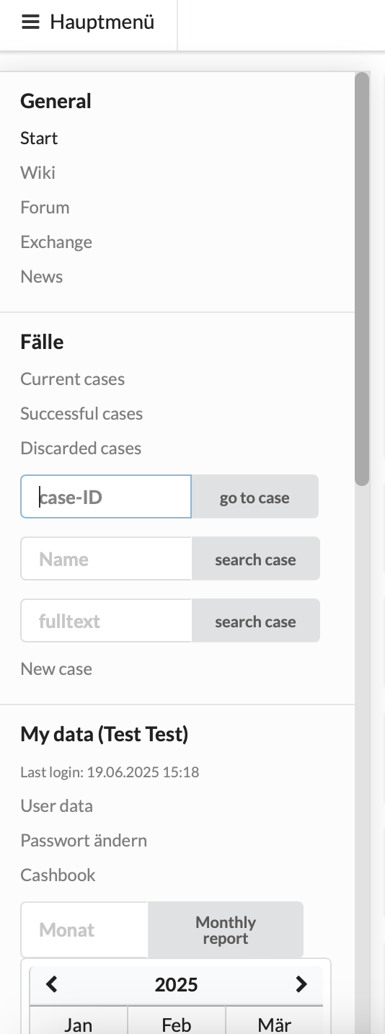
1.1. Main Menu
Go to Home Page
Access internal information hub
Access internal message board
Access your own cases and your co-cases
Search for case by case number
Search for case by case name
Search for keyword, such as heir‘s name, to find case
Create a new case
Access your user data to make changes, upload
signature, photo, etc.

Slide 5
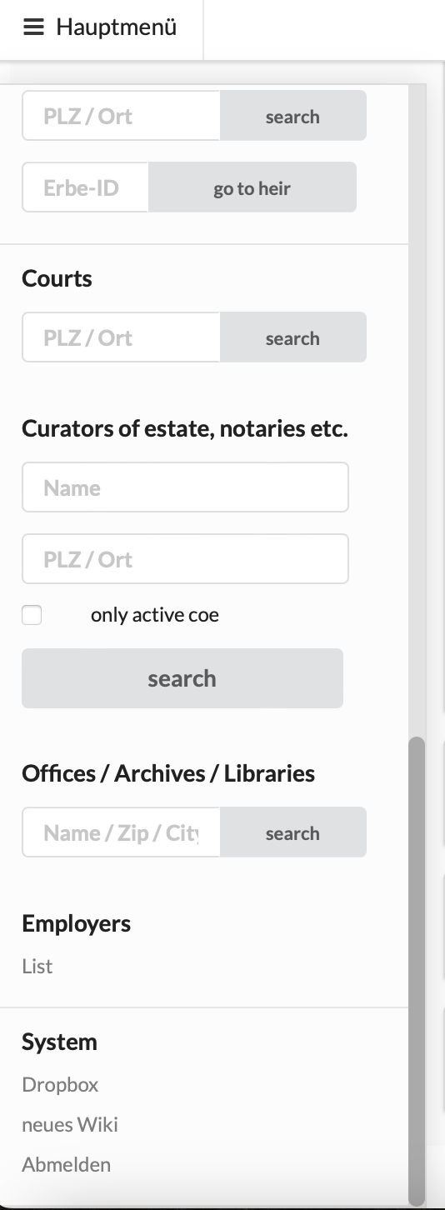
Access list of your US colleagues
Access your personal drop box
Logout

Slide 6
2. User Data
Prefilled with your name and User-ID (initials)
Fill in company address, your work phone number and function
Fill in any personal data you feel comfortable with sharing (e.g. birth date,
cell phone number, Skype/Teams name) (optional) -> will not appear on
any outgoing correspondence
Upload photo (optional)
Upload signature (optional) -> can be used for outgoing
correspondence

Slide 7
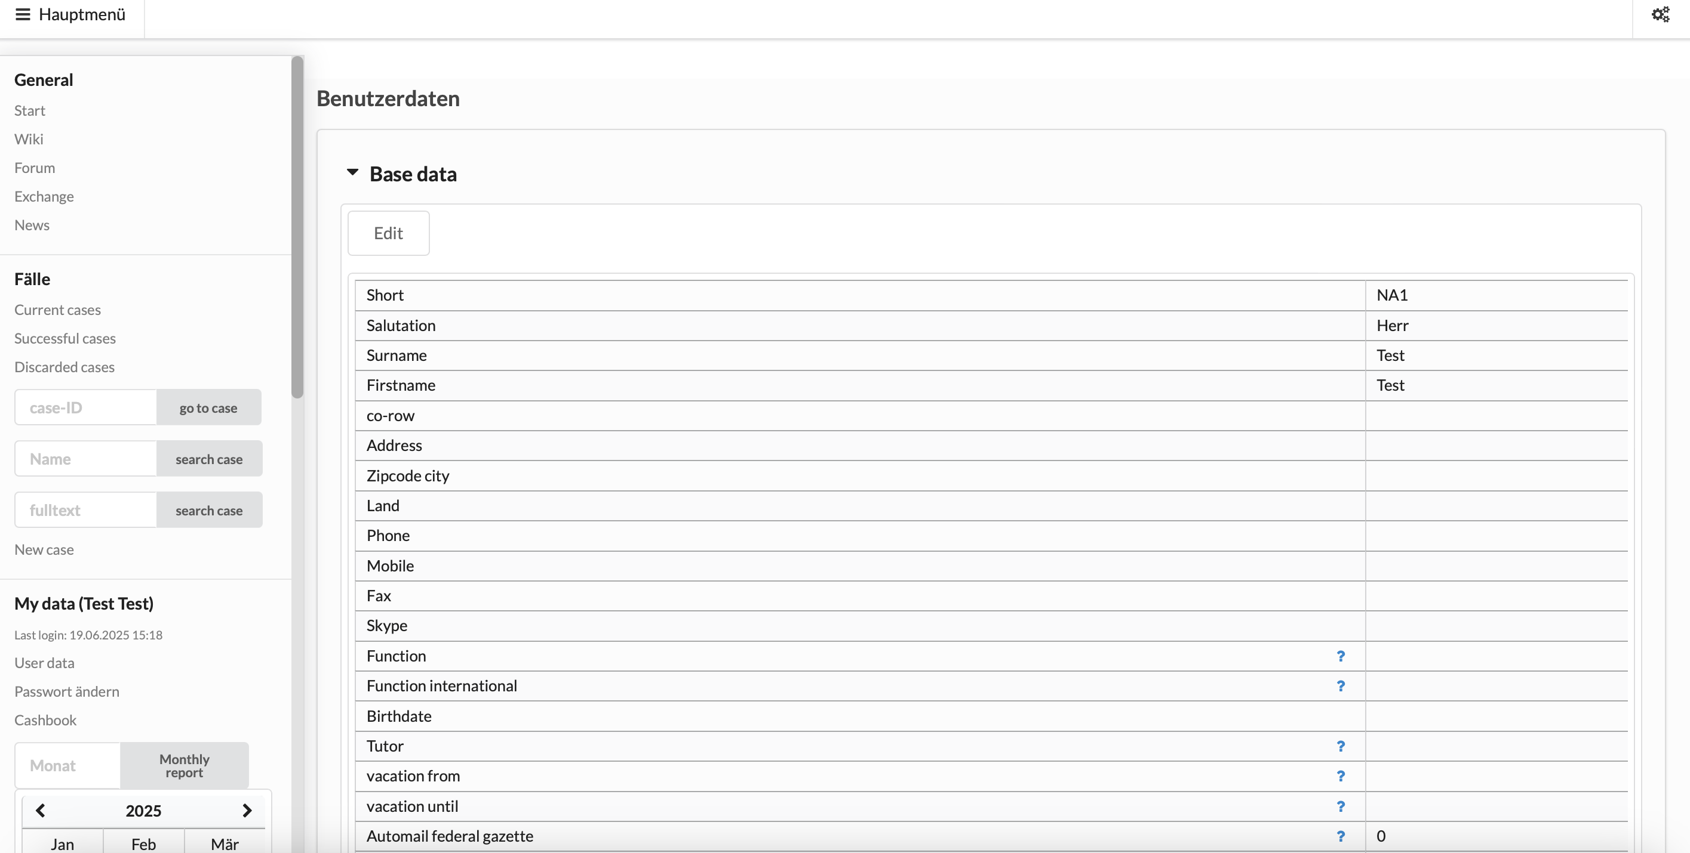

Slide 8
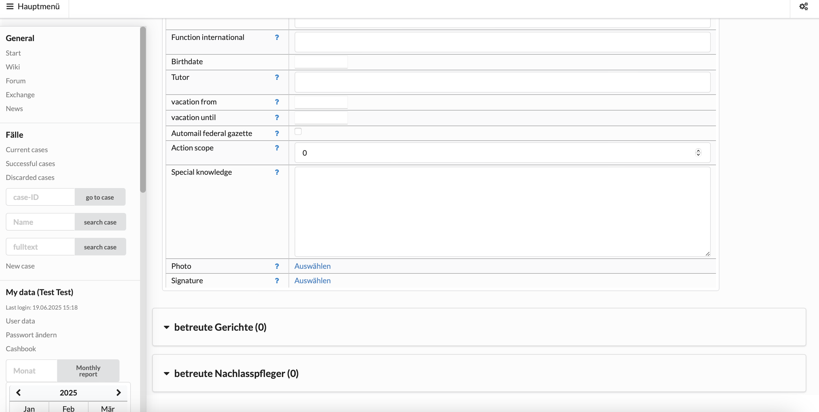
Click here to select and upload

Slide 9
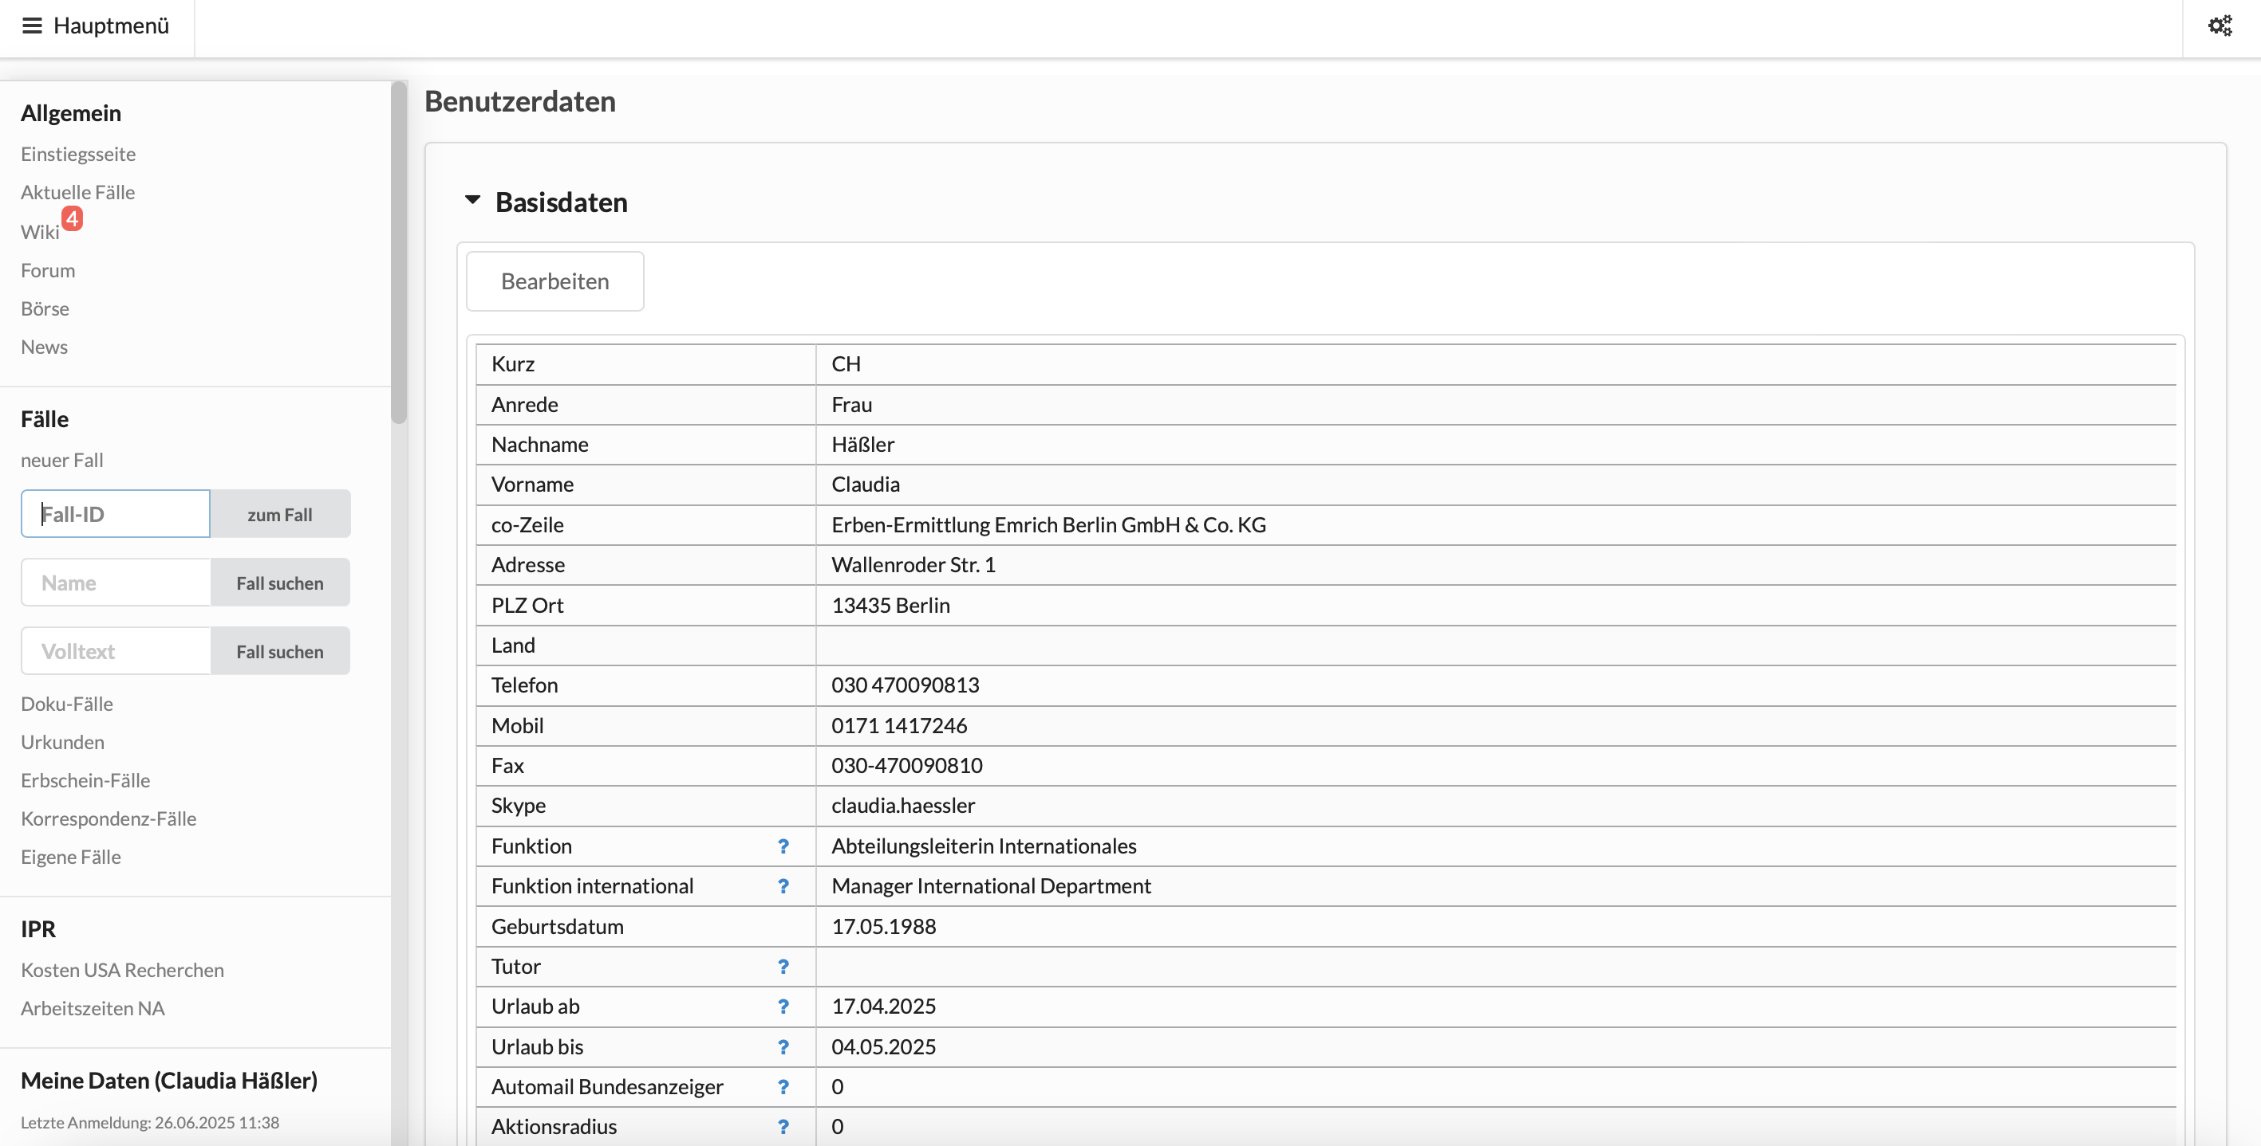
Example

Slide 10
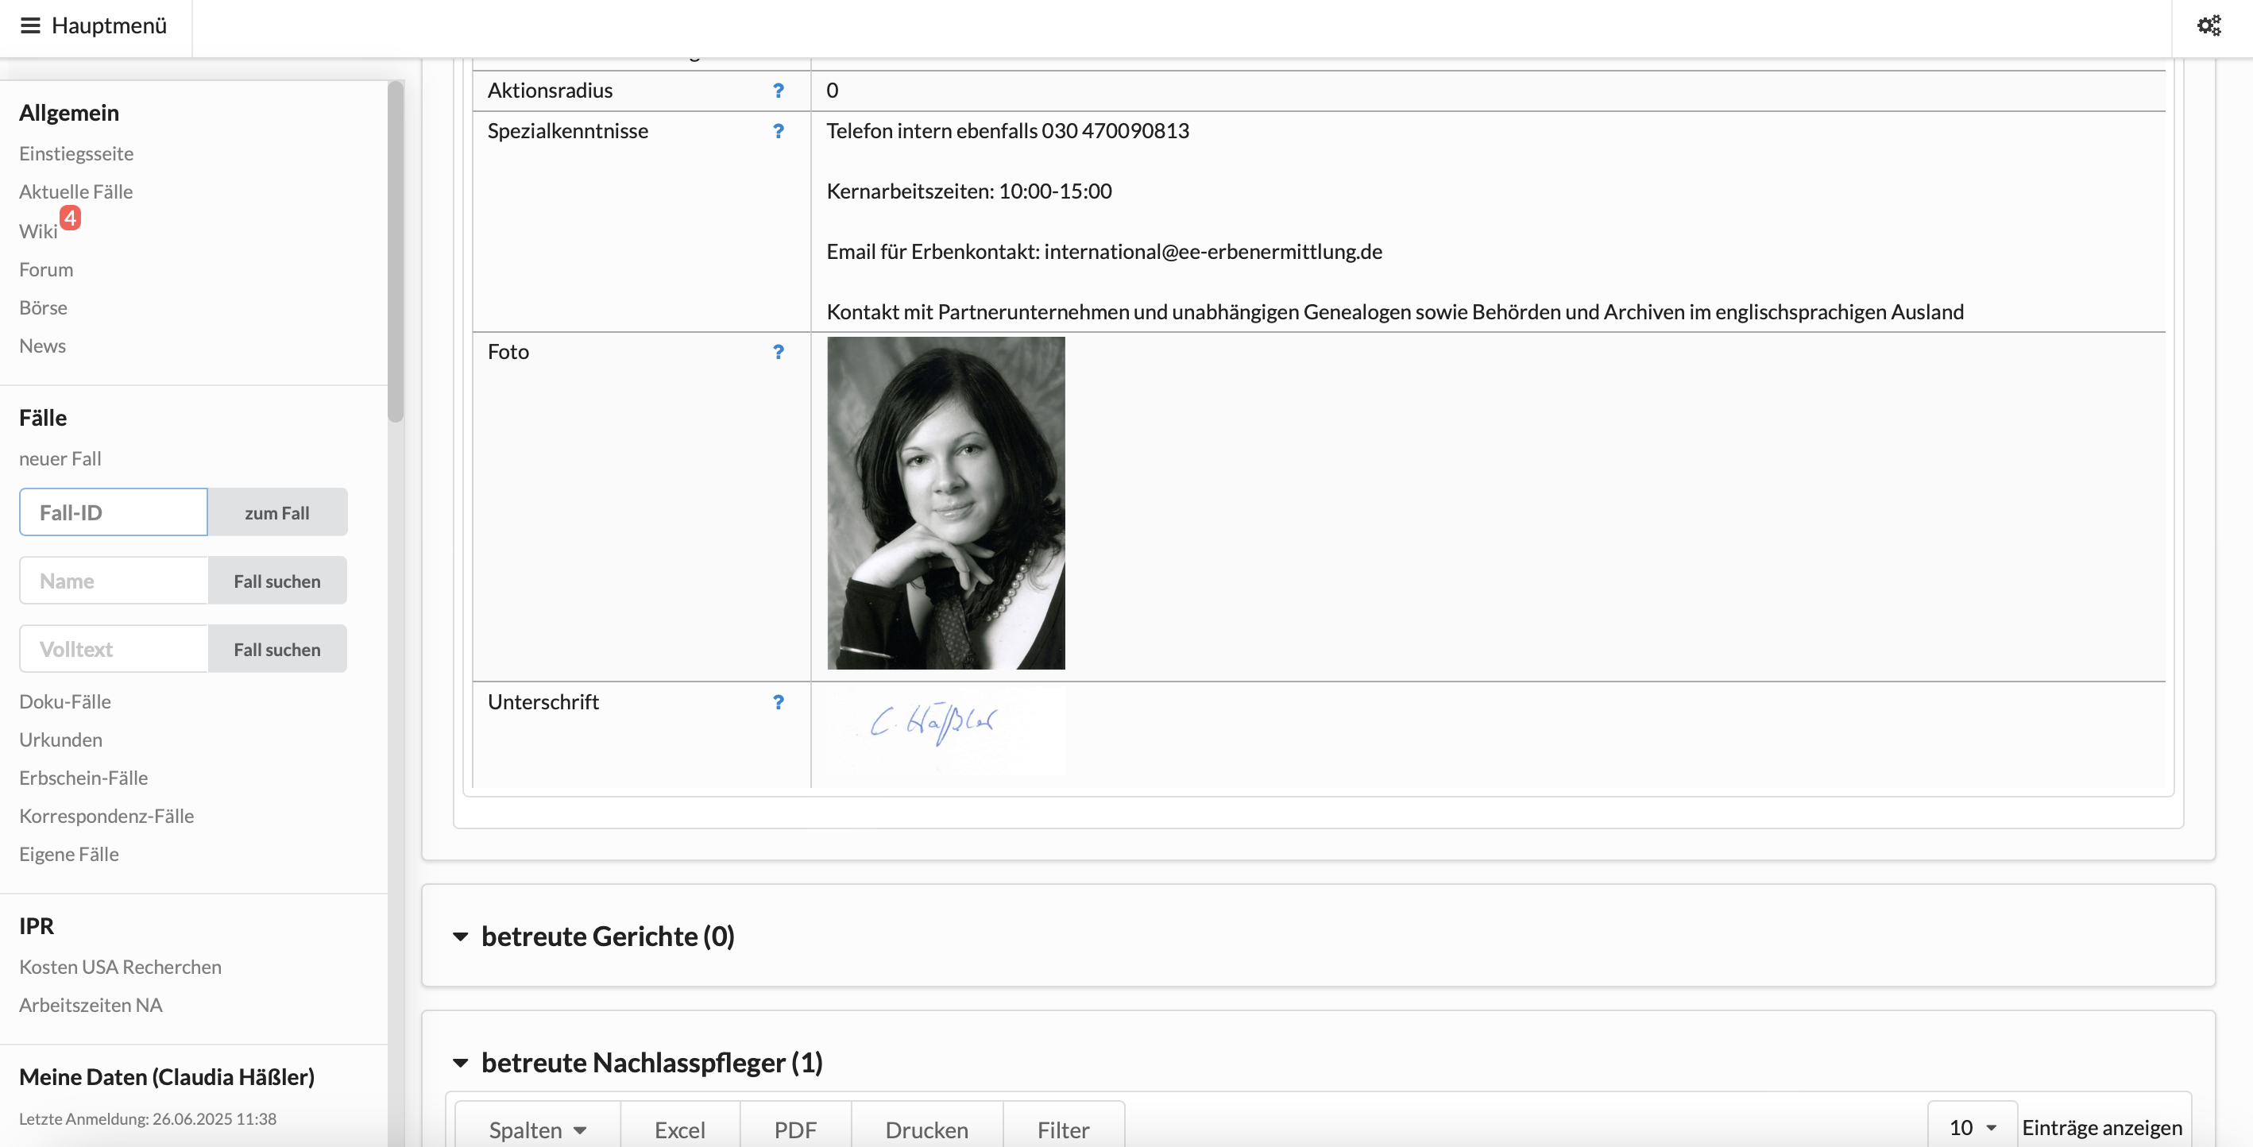

Slide 11
3. List of Employees
Access User Data of your US colleagues
Access individual case lists of your US colleagues
Search for colleagues via name or User-ID

Slide 12
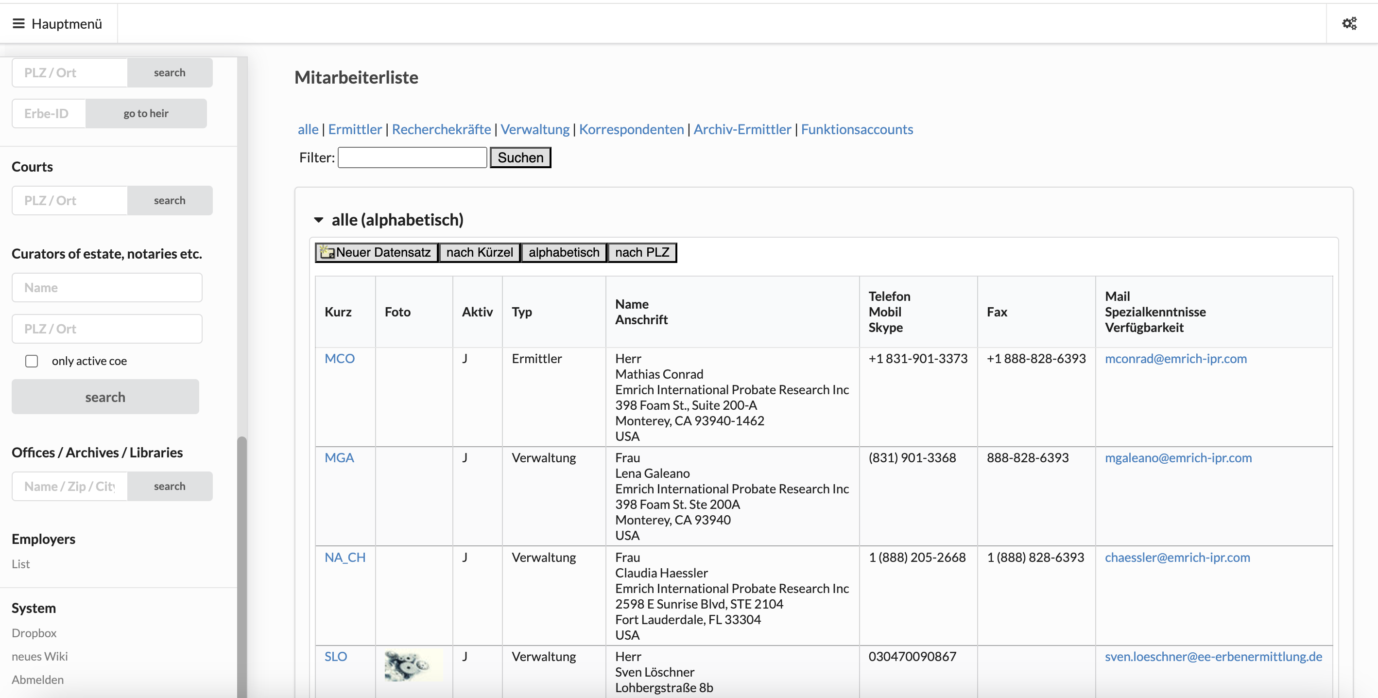
Search for name or User-ID
Click here to access
case list

Slide 13
4. Drop Box
Save all important files – can be accessed from anywhere
Share files with colleagues or third parties
Download files that are shared with you
Save all receipts from purchases with Company Card and share folder
with CH and MGE for accounting purposes

Slide 14
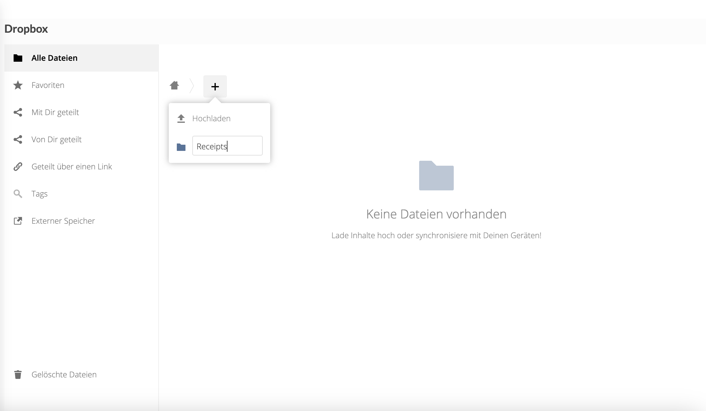
4.1. Create Folders
Create new folder
Enter new folder name

Slide 15
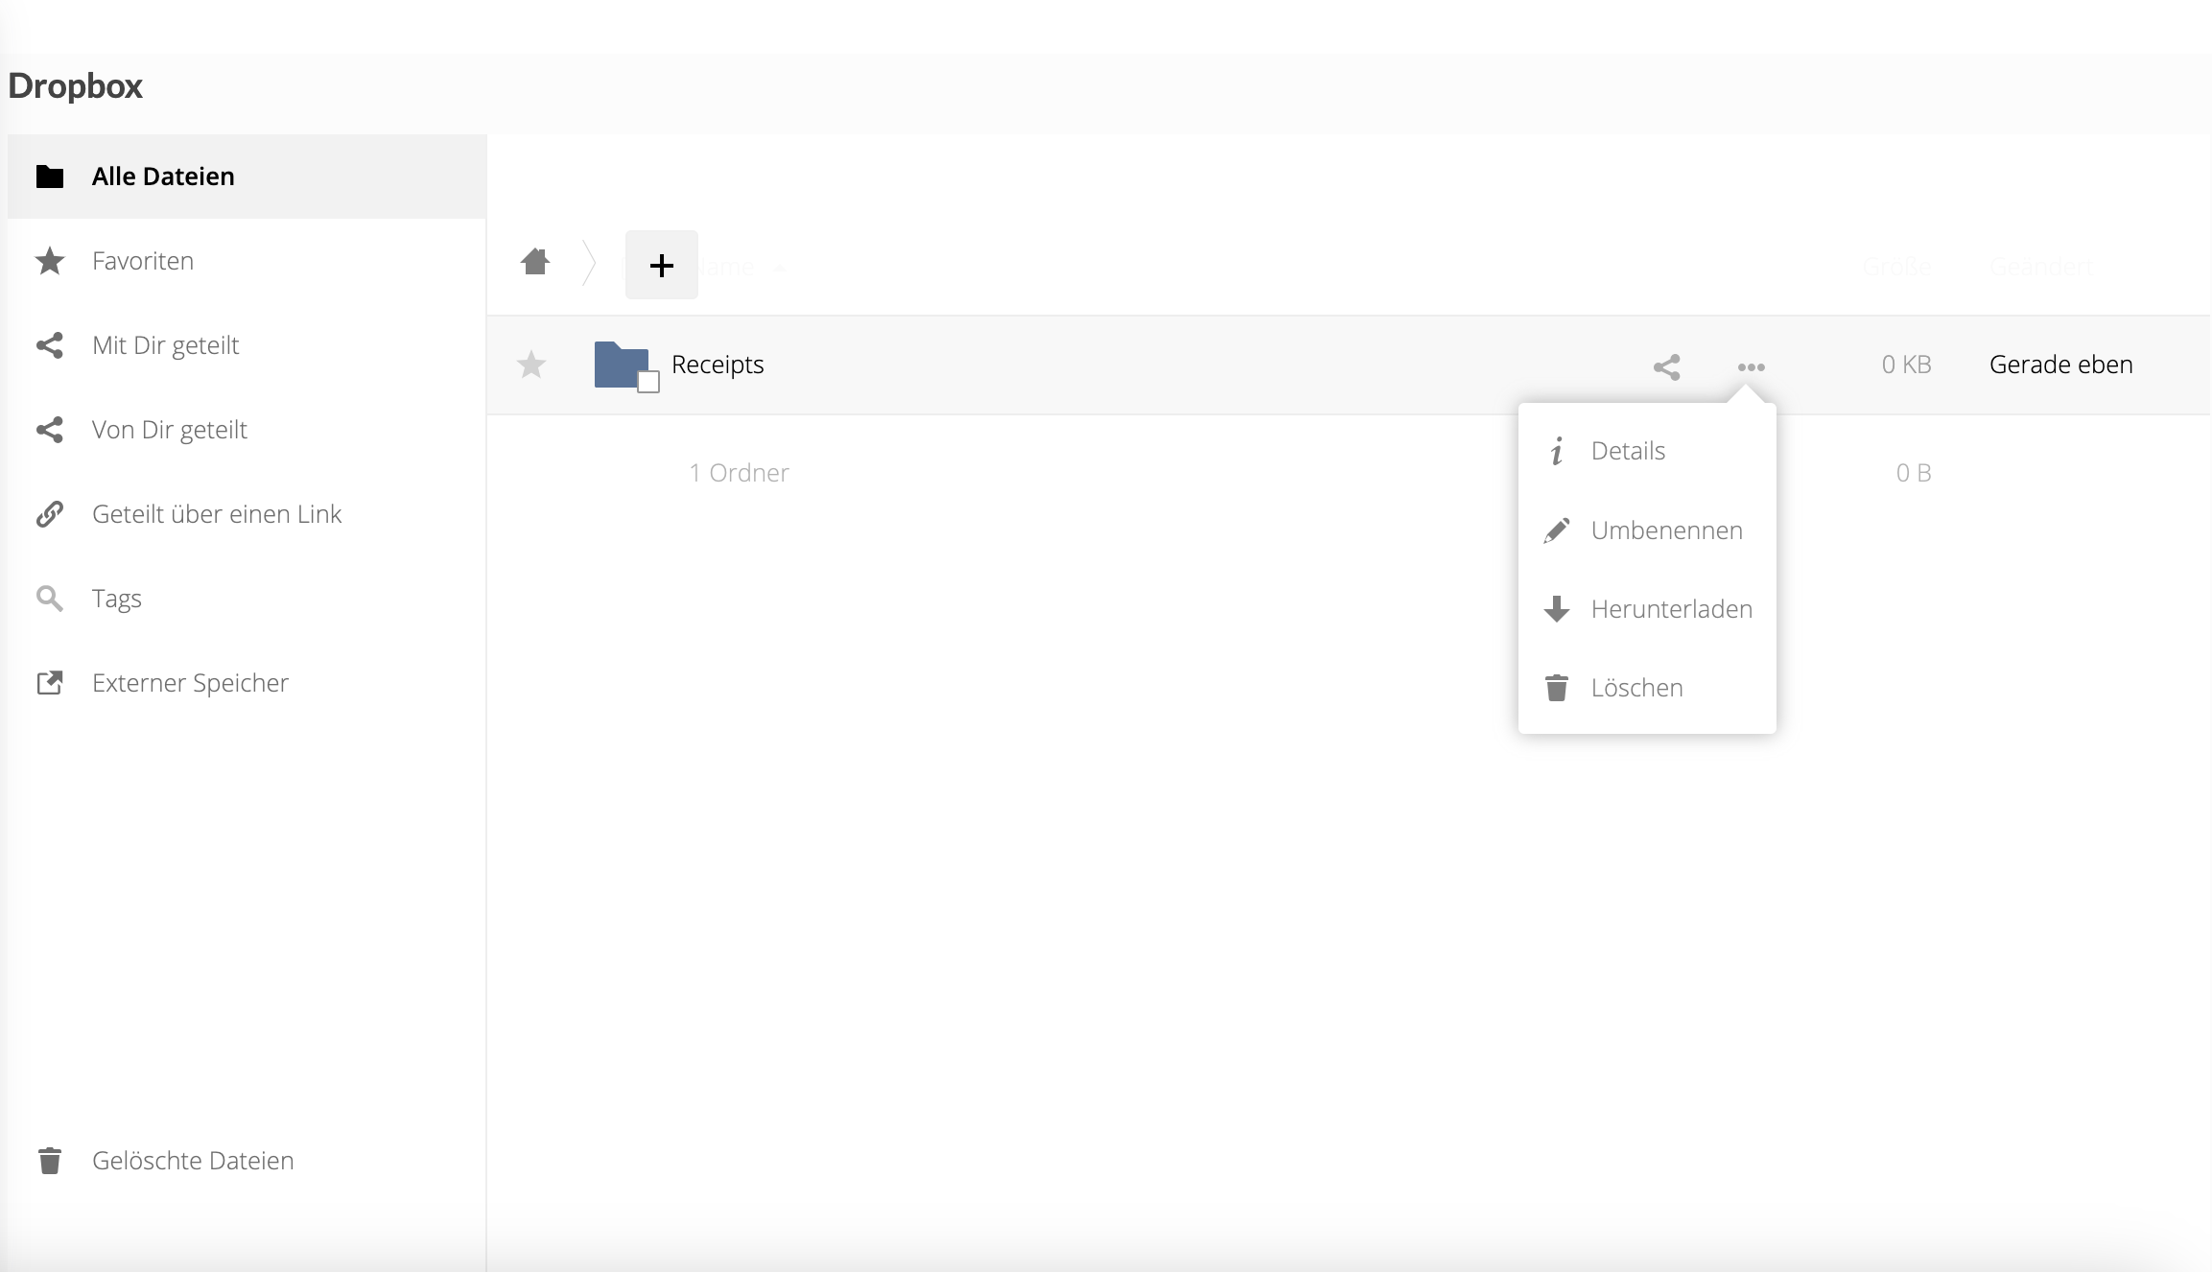
Re-name
Download
Drag and drop files into drop box
Click on files you want to download
Drag files into various folders and sub-folders
Upload and download entire folders
Delete

Slide 16
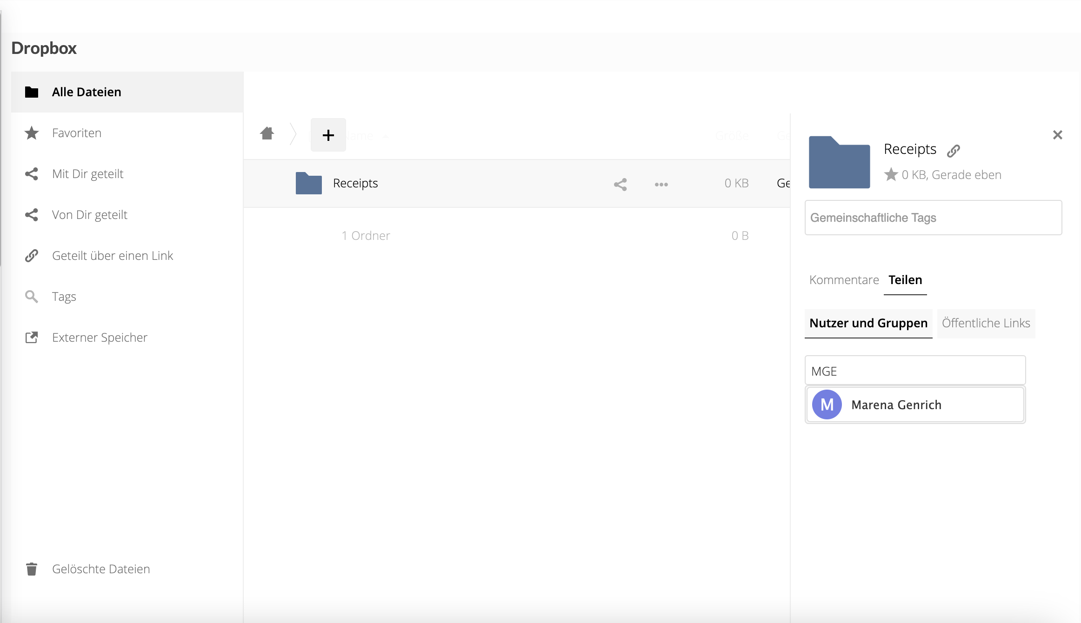
4.2. Share Folders/Files with Internal Users
Share folder or file
Share with internal users
Enter User-ID
Select from choices

Slide 17
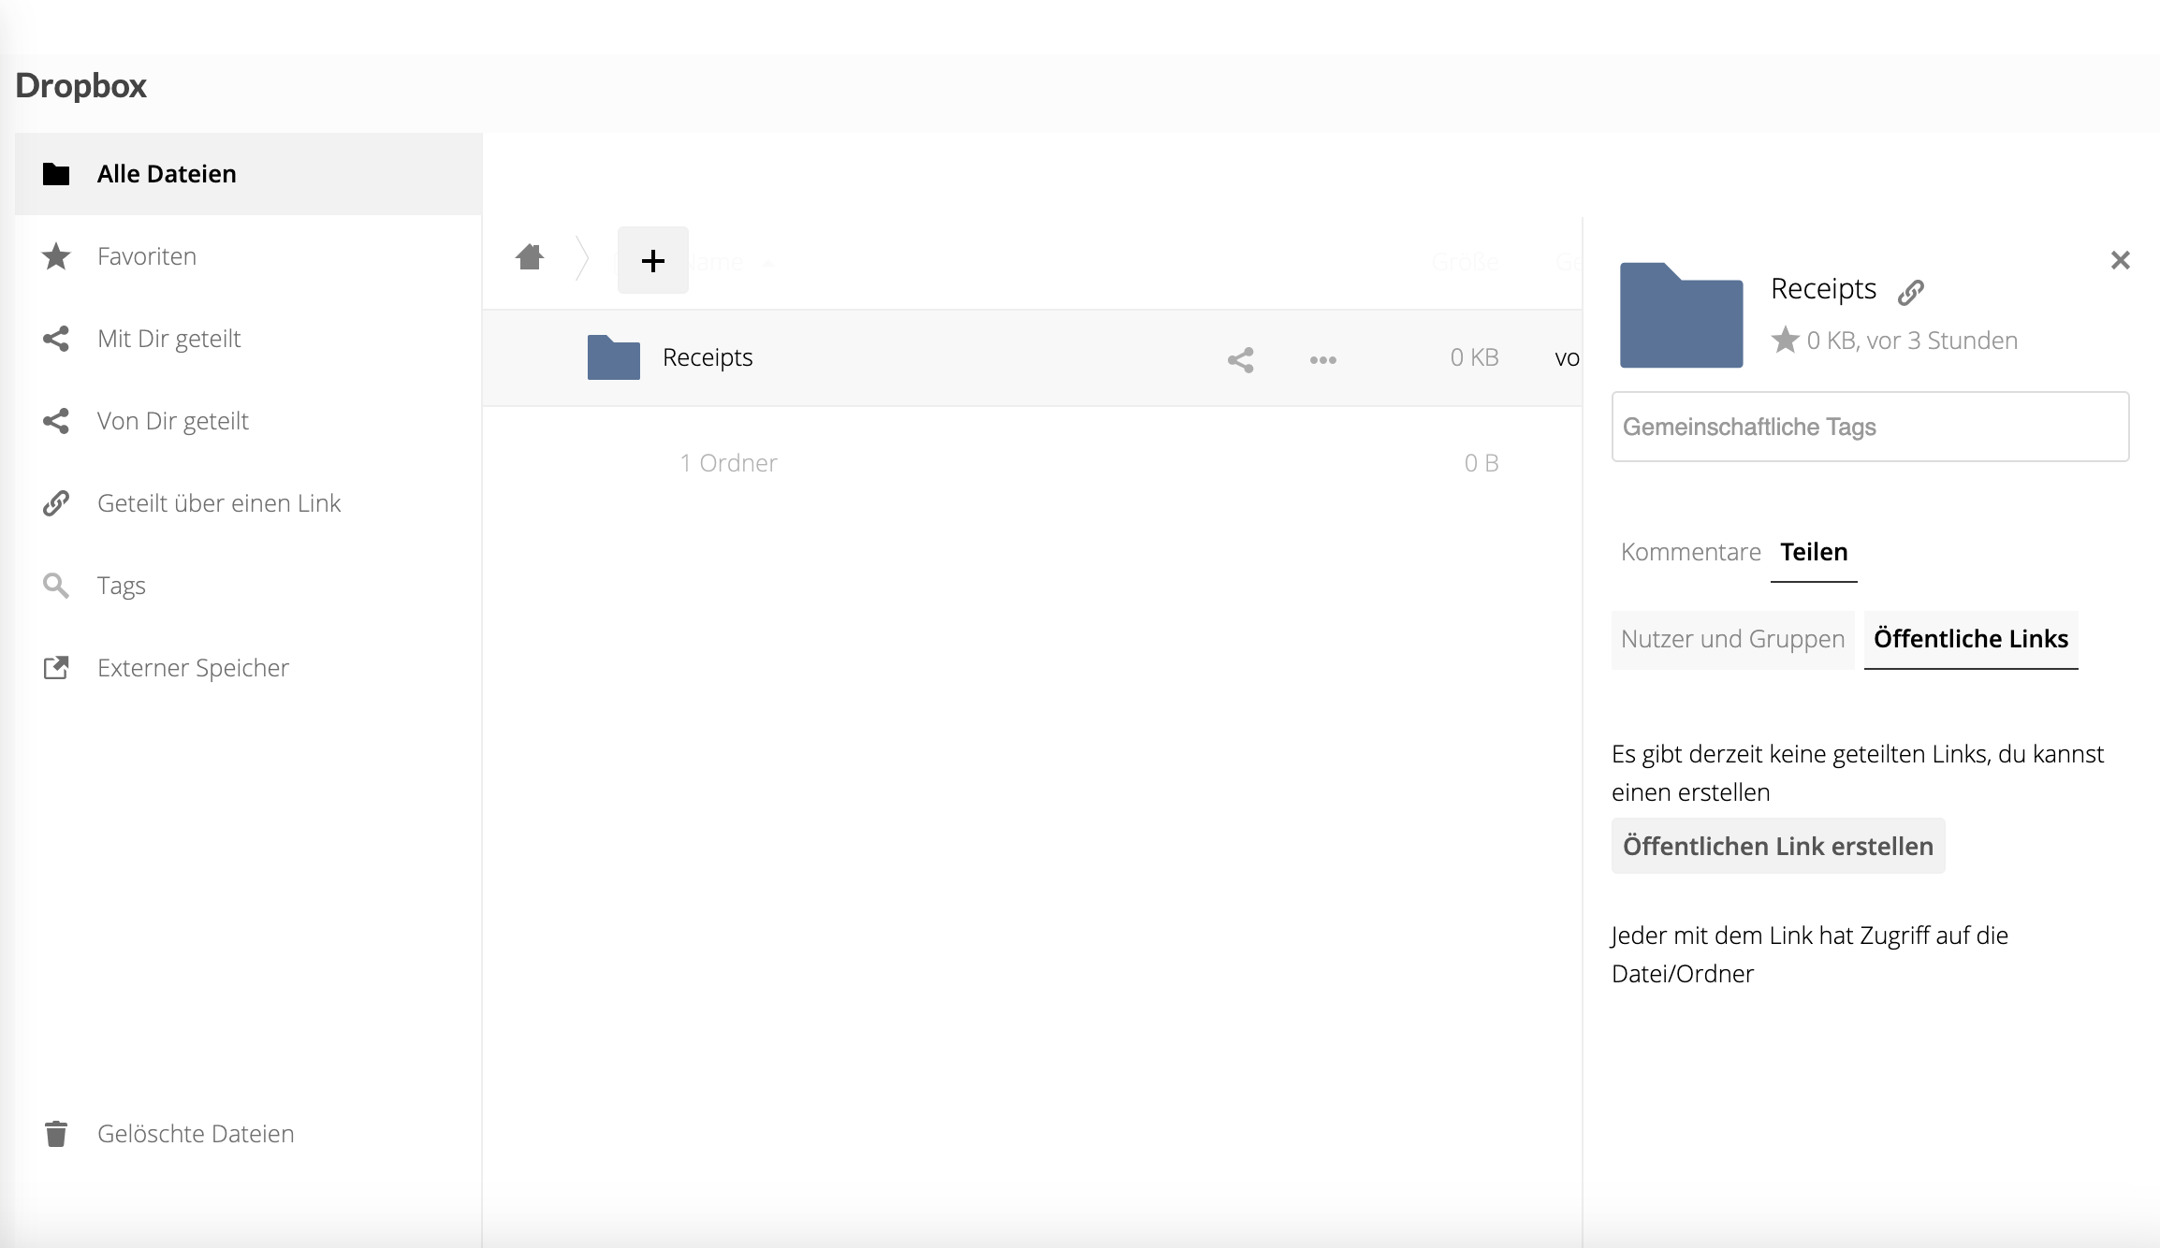
4.3. Share Folders/Files with External Users
Share with external users
Click here to create a link for external users

Slide 18
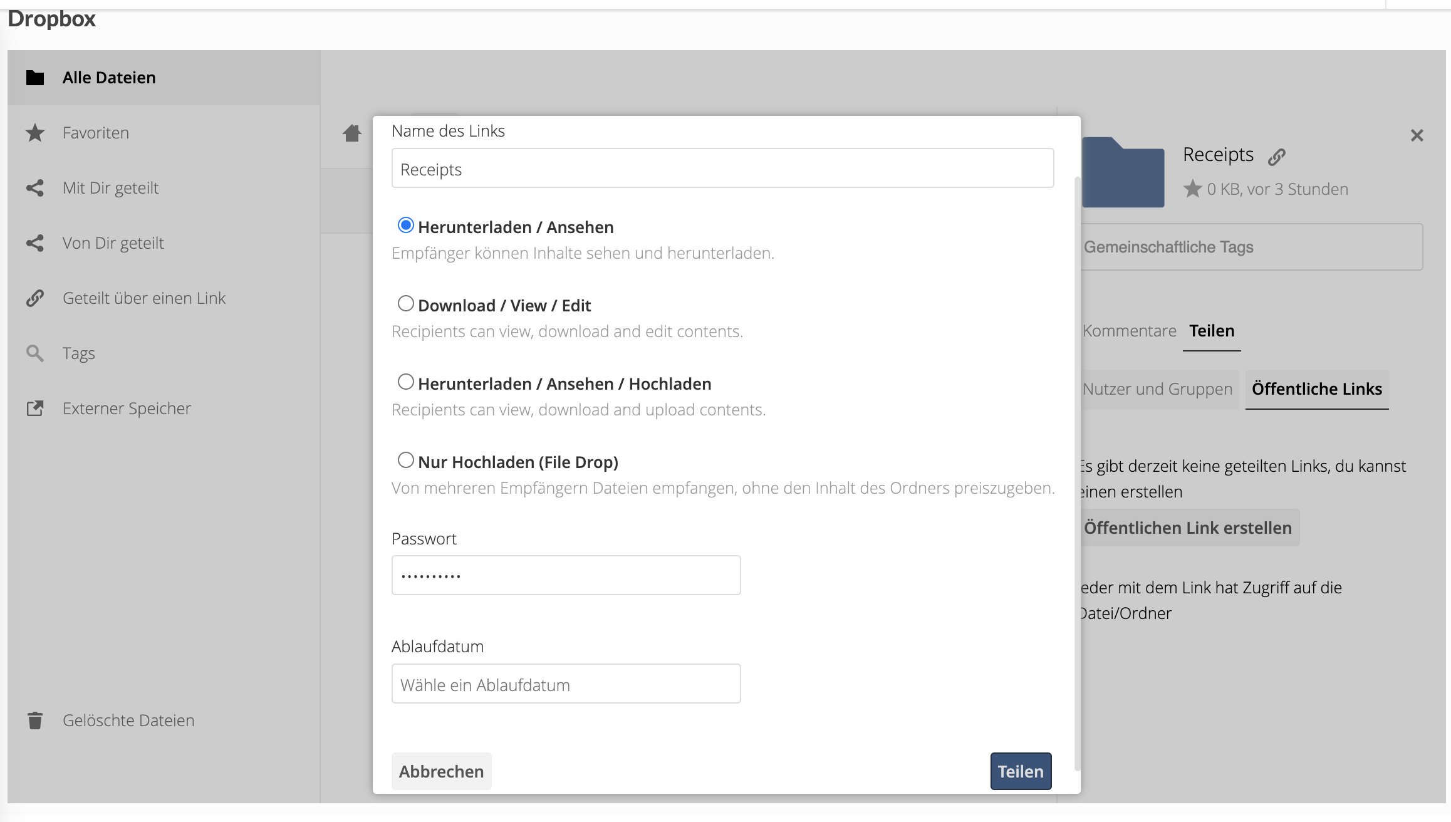
Create link name
Download/view
Choose from:
Download, view,
upload
Upload only
Create password
Click to choose
expiration date

Slide 19
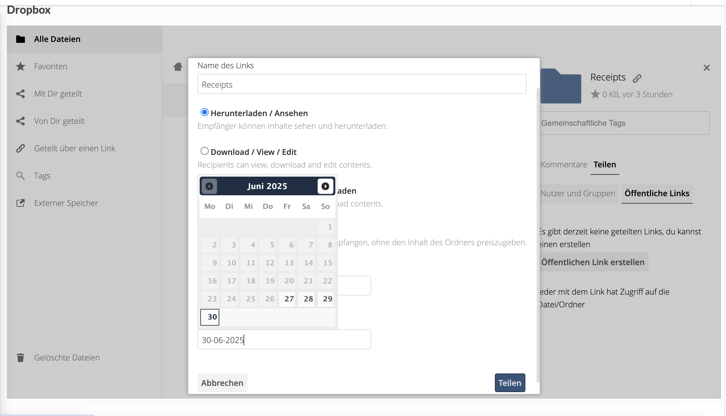
Choose date when link
will expire
cancel
Create and share link

Slide 20
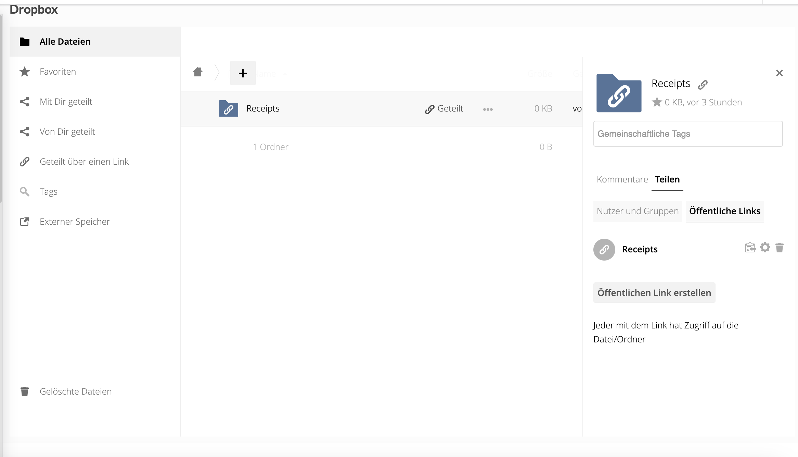
External link
Click here to copy link to send to external users
-> Make sure you send password as well

