Slide 1

Emrich Database
Family Tree

Slide 2
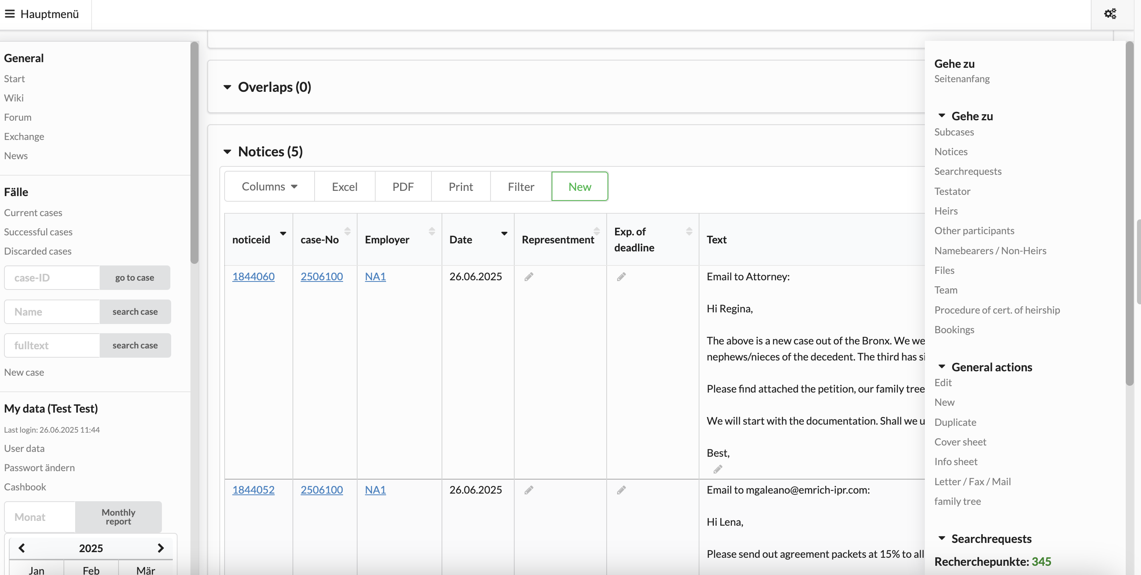
Open scroll-down
menu on the right

Slide 3
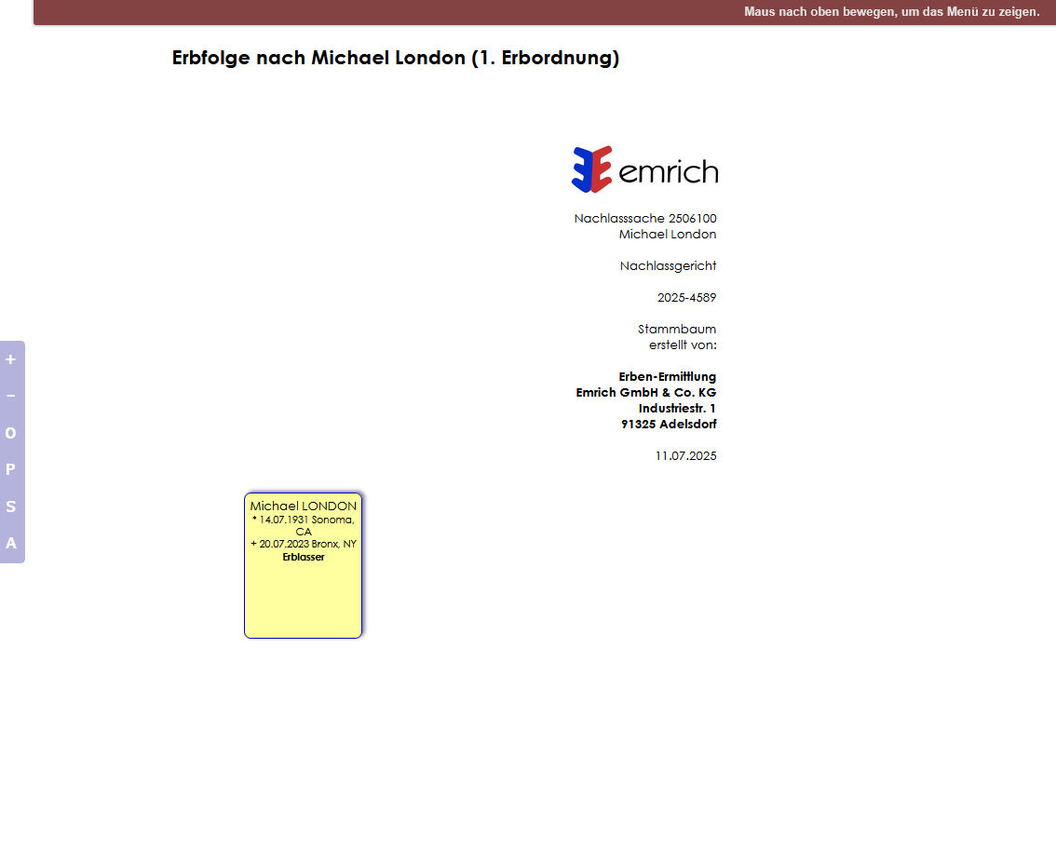
Start page when family tree is first initiated
Information on birth and death of decedent
is copied automatically from the case page
Add information, if necessary
Always start by adding a mother and father
(if you do not know their names yet, fill in NN
as place holder)
Add spouse, if applicable

Slide 4
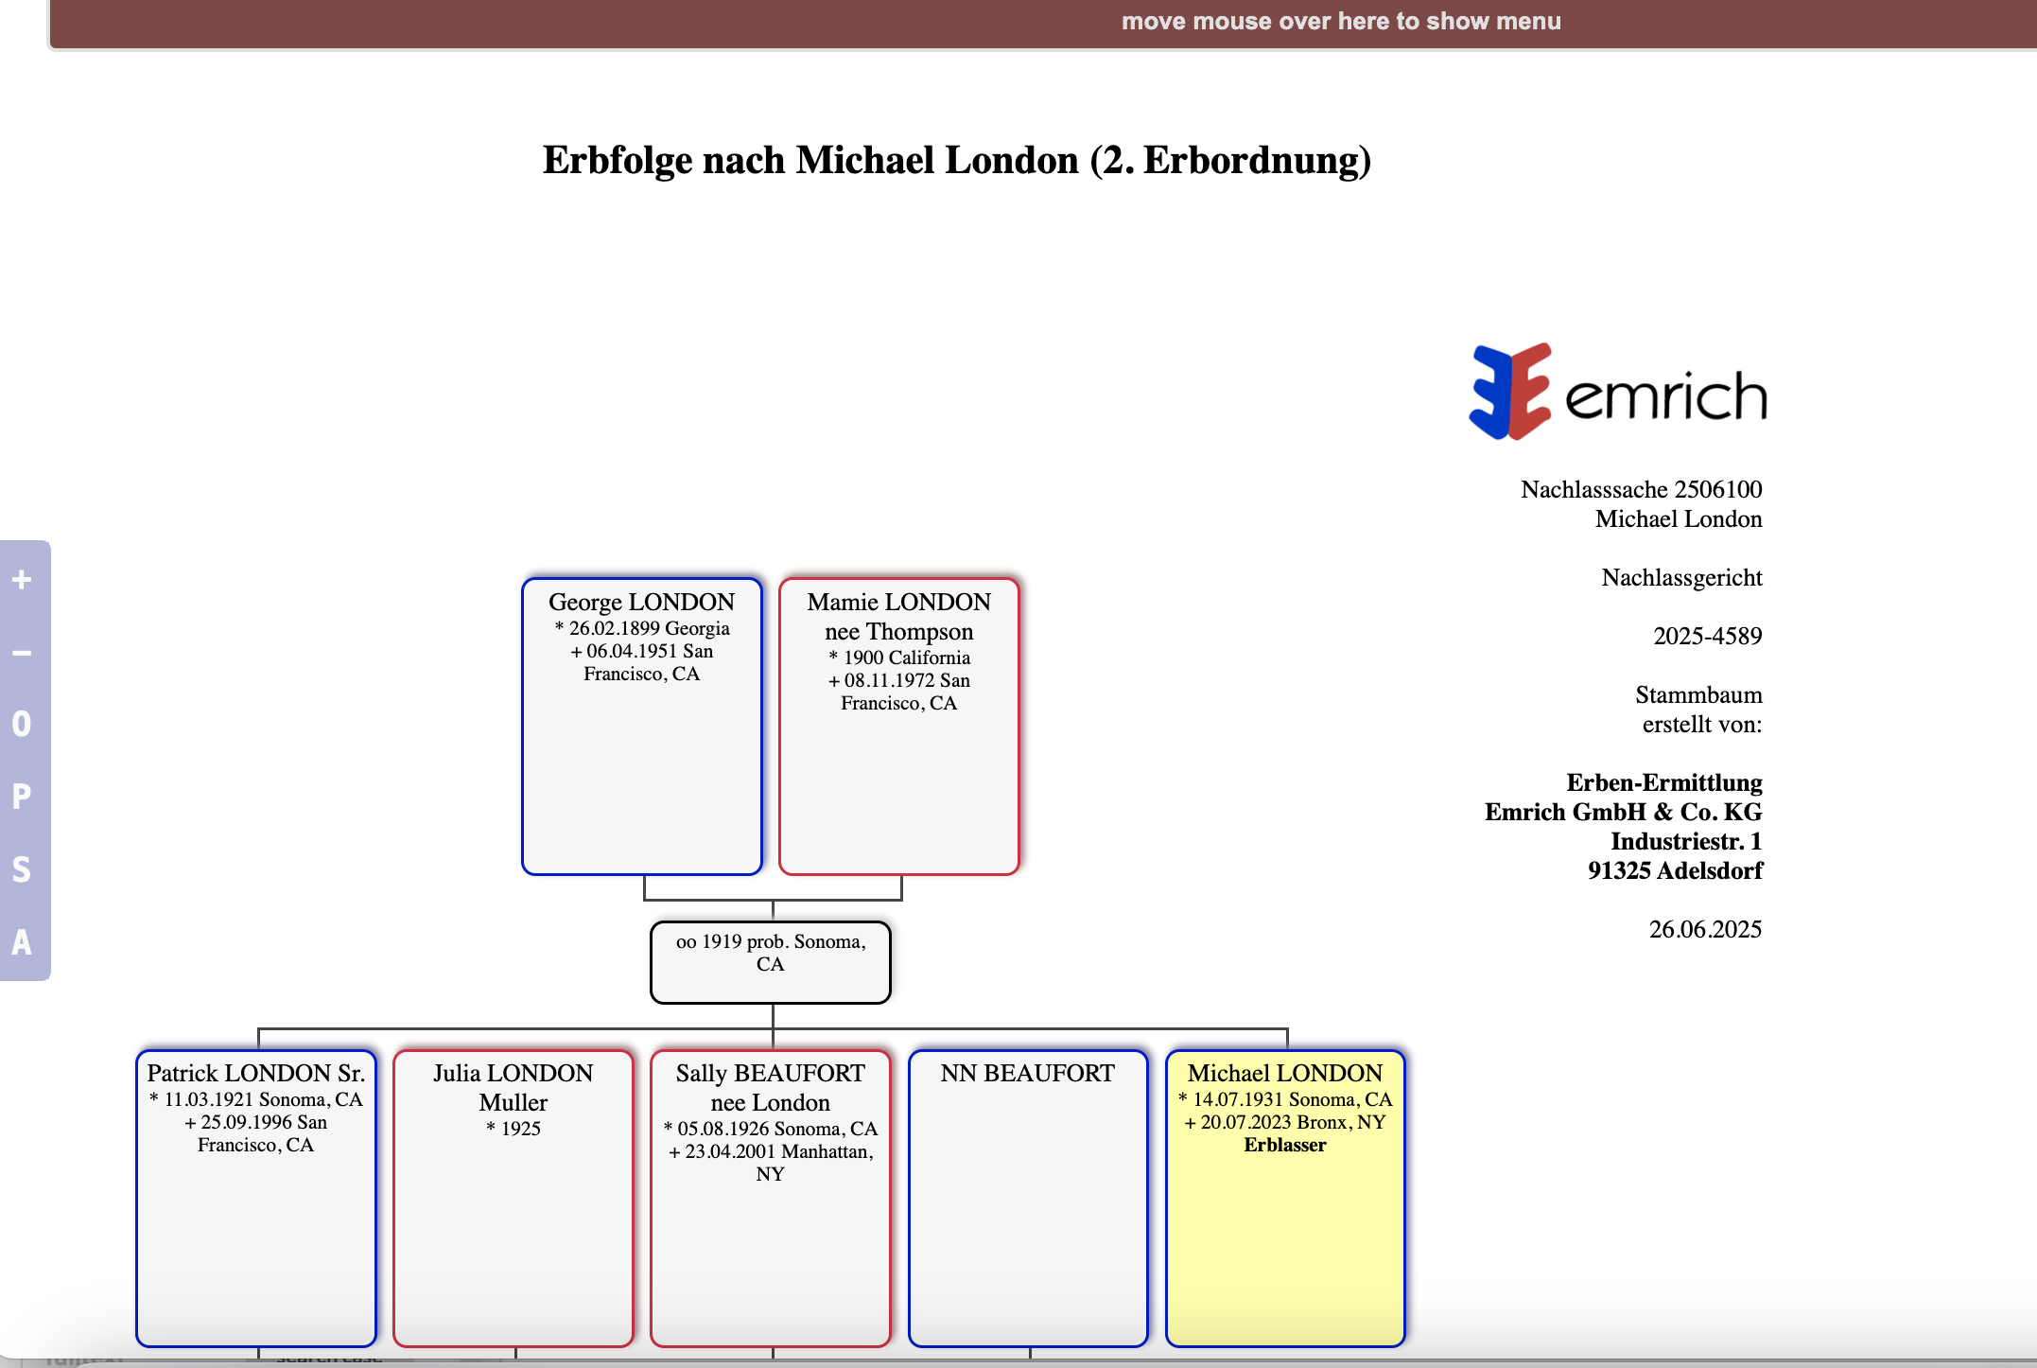
1. General Information
Succession of
Second tier of succession, i.e. siblings and issue of siblings
Father and paternal side always on the left
Mother and maternal side always on the right
Make boxes bigger
Make boxes smaller
Settings
Create PDF
Search for person on FT
Anonymize persons on FT
Marriage field
Decedent always shows yellow

Slide 5
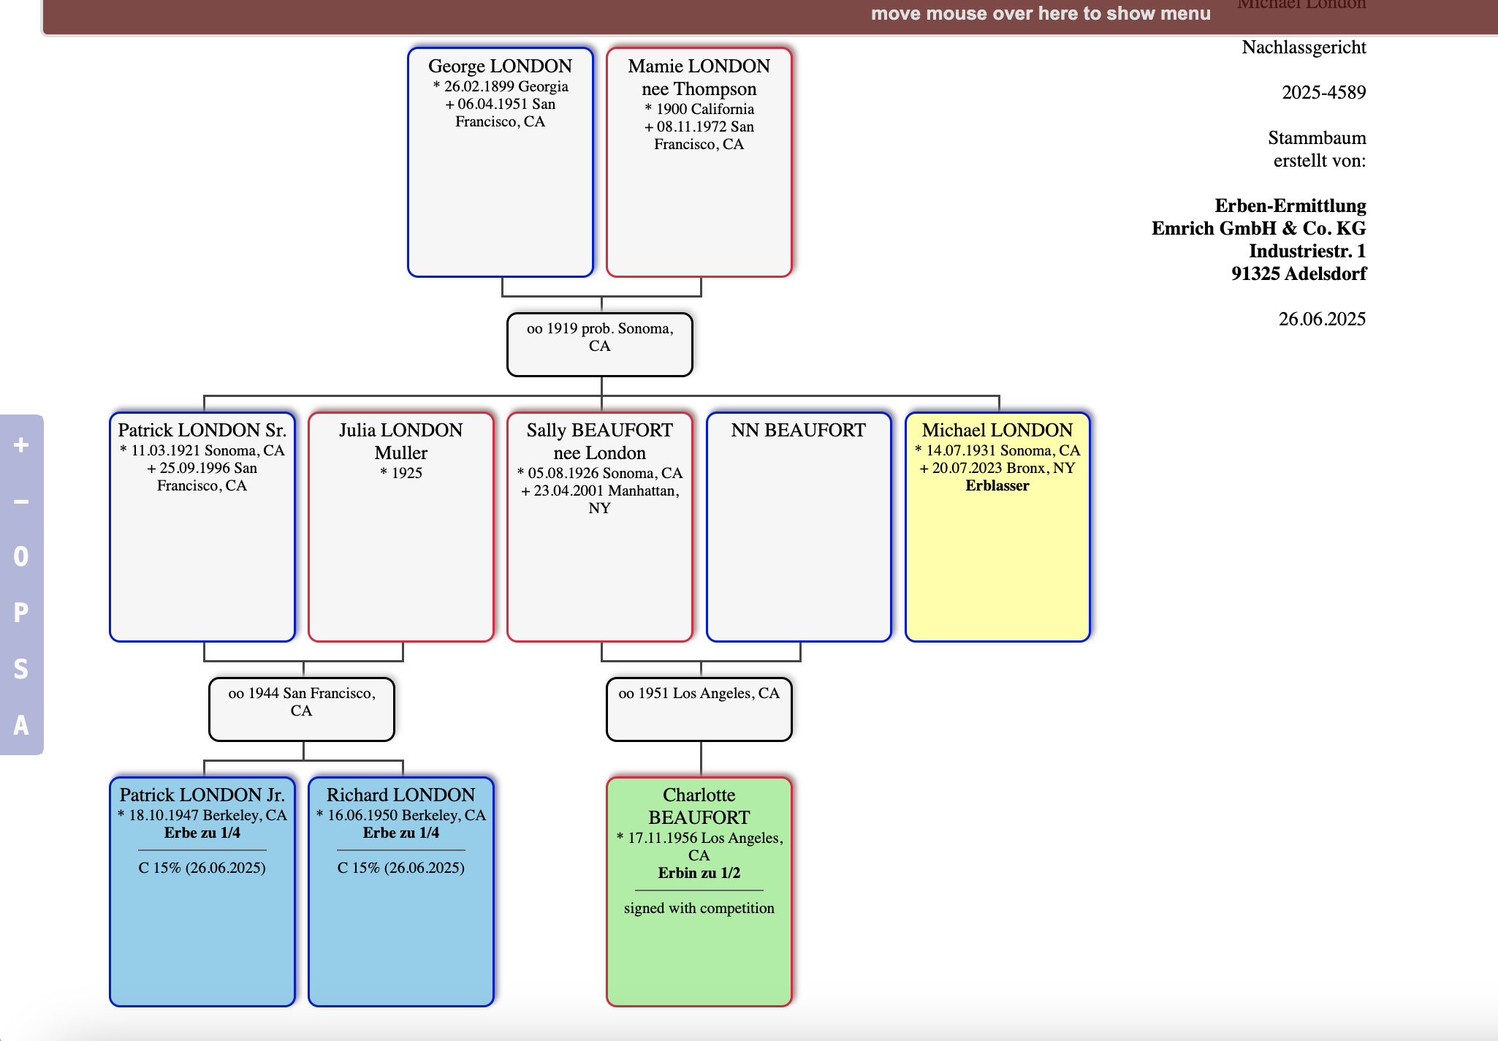
Heirs always show green unless color
switched manually
Nephews/nieces
of the decedent

Slide 6
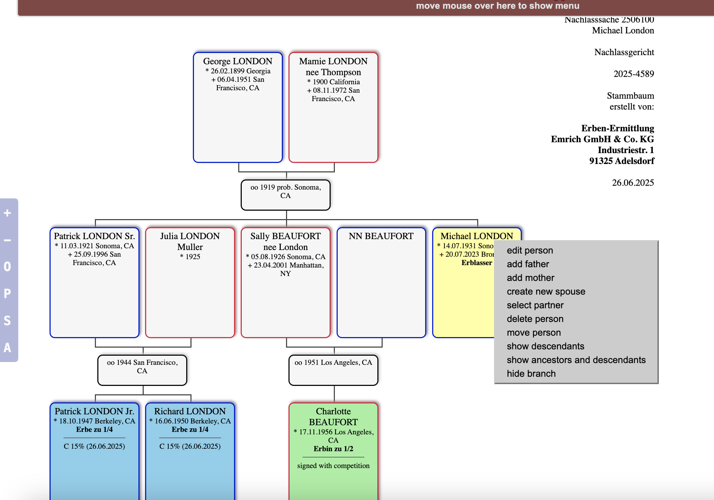
2. Adding and editing persons to the Family Tree
Click on right mouse button
to show menu
FYI: To edit a person, you can also
double click on that person

Slide 7
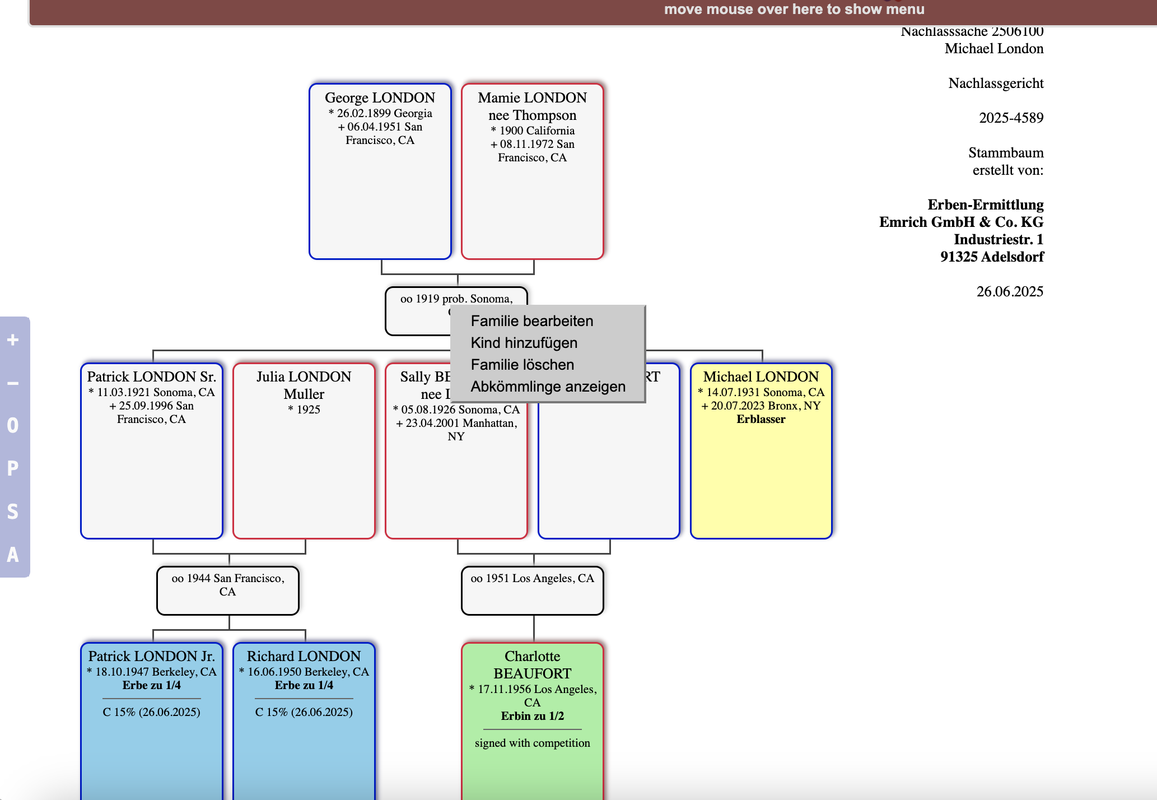
Click on right mouse button
to show menu
Edit family
Add child
Delete family
Show descendants
FYI: If you delete a family,
the spouse and children will
„hang in air“ and can still be found
under Person Search

Slide 8
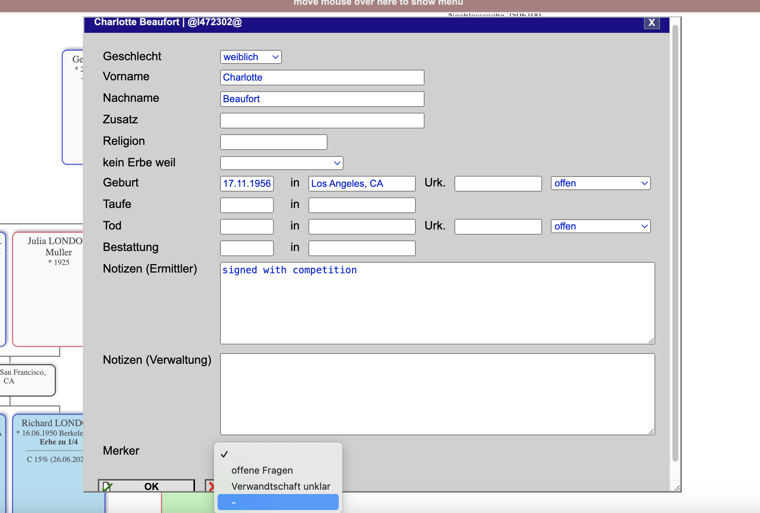
Click to choose
between männlich (male)
and weiblich (female)
Edit or add new person on the FT
Fill in all relevant information as research
progresses
Sex
Name(s)
Surname
Addition (e.g. Jr, Sr)
Birth date and place
Death date and place
Notes
Enter important information pertaining to Agreement
status
Enter research results with links to research databases
Click to choose
Color code
Open questions
Relationship unclear
Blue color for our clients

Slide 9
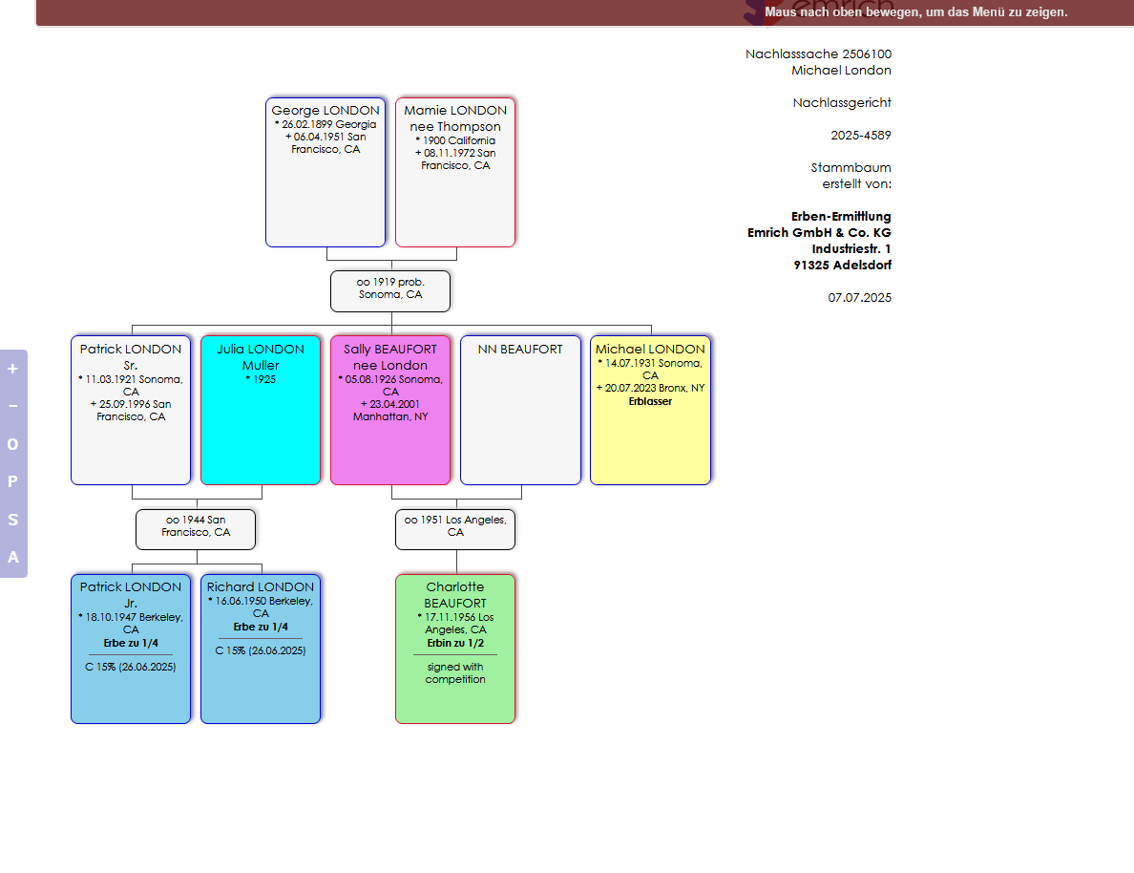
FYI: Color Coding
Yellow: Decedent
Green: Heir
Blue: Signed heir
Turquoise: Open questions
Pink: Relationship unclear

Slide 10
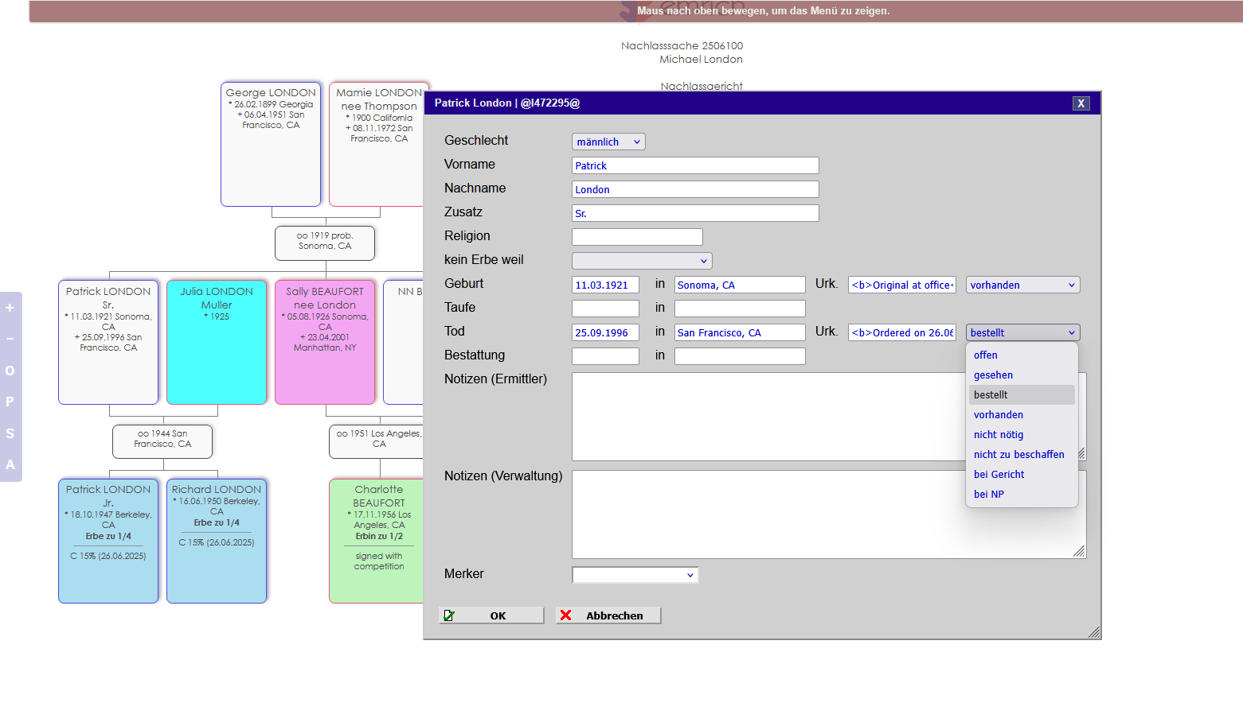
3. Documenting a Case
Edit the relevant person
Enter when vital record was ordered
After receipt, enter where original is kept
Use HTML codes <b> and </b>, so that text appears
in bold letters on the certificate list
Click to choose
status of vital record
Open
Viewed
Ordered
On file
Not necessary
Cannot be obtained
With court
With administrator
FYI: Vital Record Status will show
on Certificate List

Slide 11
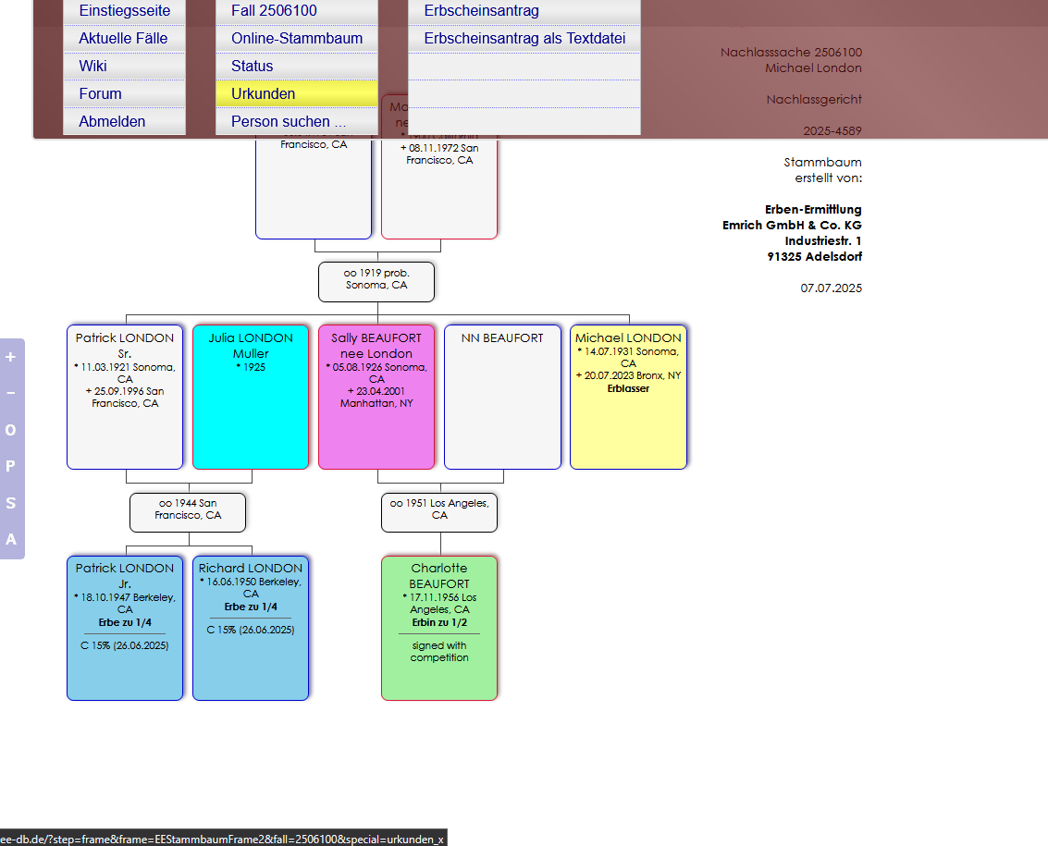
Go back to case page
Go back to Family Tree
Certificate List
Search person on the FT
Move cursor to top to
drop down menu

Slide 12
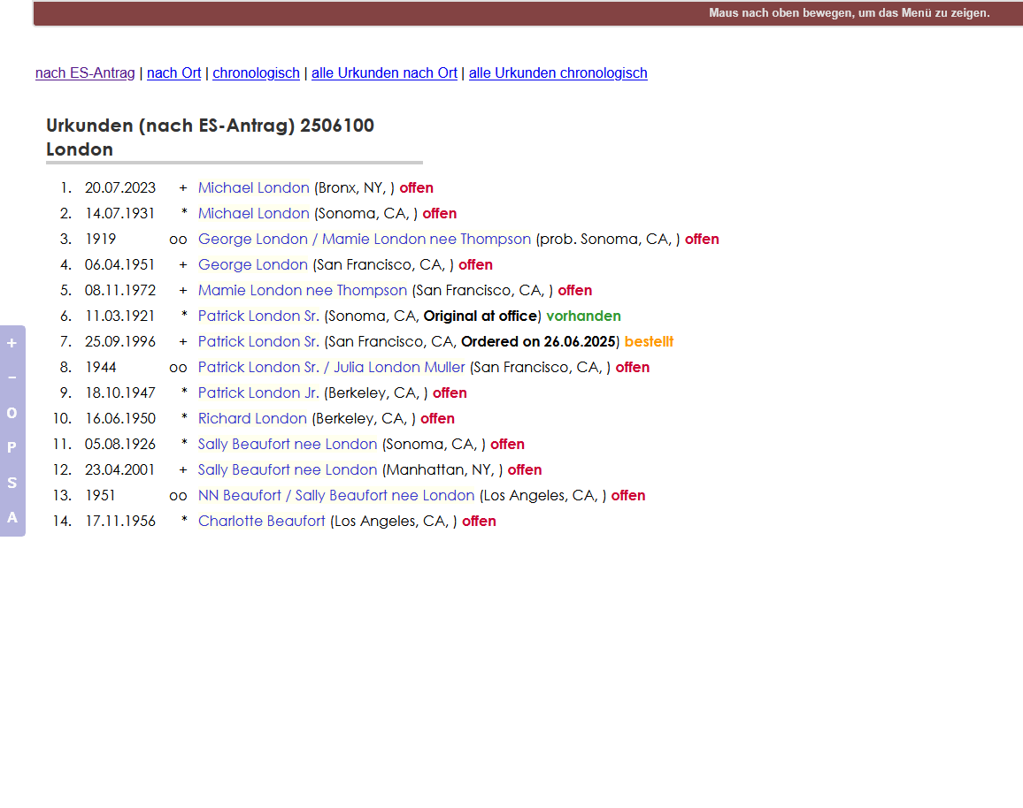
Sort by place
Sort by date
All VRs sorted by place
All VRs sorted by date
Certificate list sorted by German porbate proceedings standards
Does not show all possible vital records!
Legend:
* Birth Certificate (BC)
+ Death Certificate (DC)
oo Marriage Certificate (MC)
o/o Divorce

Slide 13
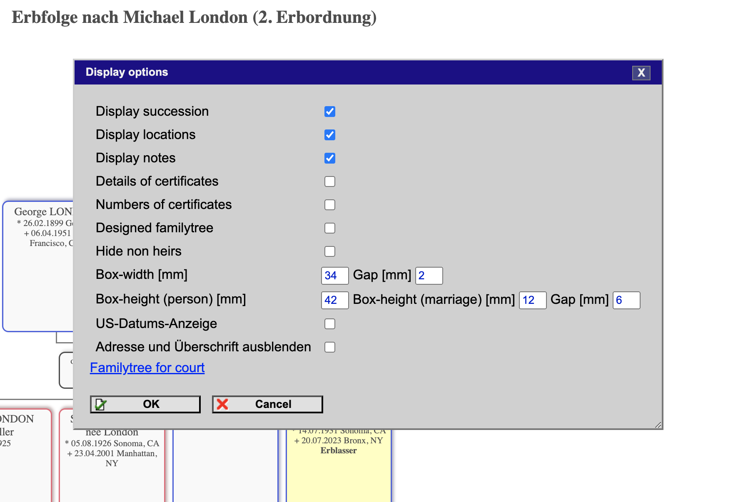
4. Settings
Click here to show US format of dates (does not work on
marriages; need to be changed manually)
Click here to hide title of FT and information on the right
Displays succession, certificate numbers and hides non-heirs

Slide 14
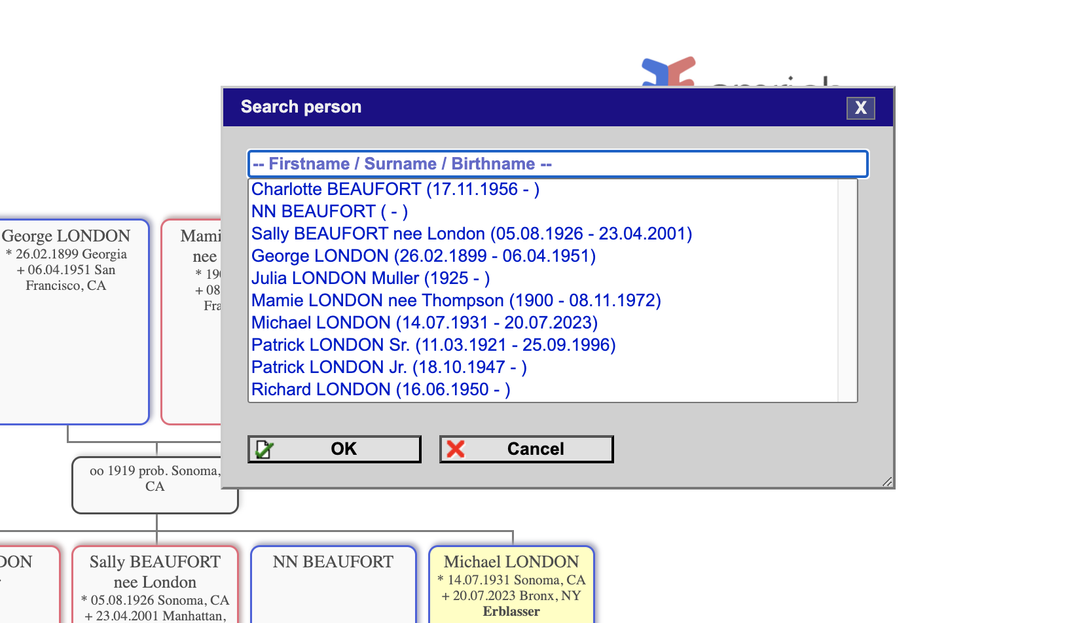
5. Search Persons on the Family Tree
Fill in name and choose from list
When you select a
person, it will direct
you to their location
on the family tree

