Slide 1

Emrich Database
Navigating a Case

Slide 2
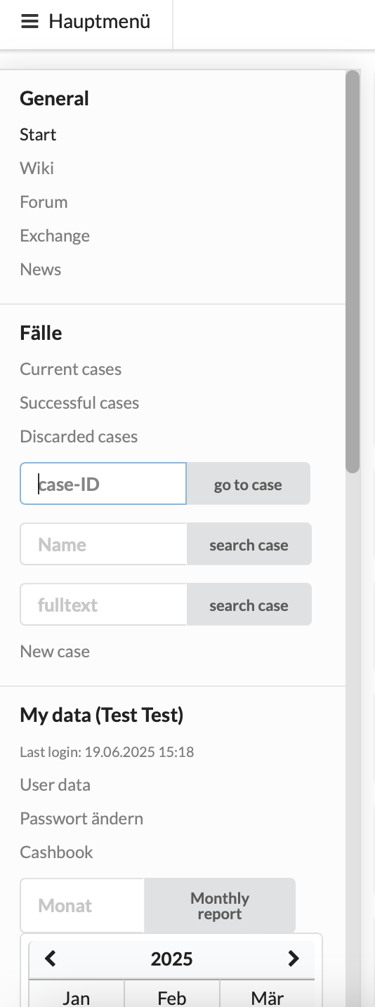
1. Accessing a Case
Click here to access your case list
Access case via case number
Access case via case name
Search for case via keyword (for example: heirs often do not
remember the case name or have the case number at hand
when they call. You can try to find the right case by searching
the heir‘s name.)

Slide 3
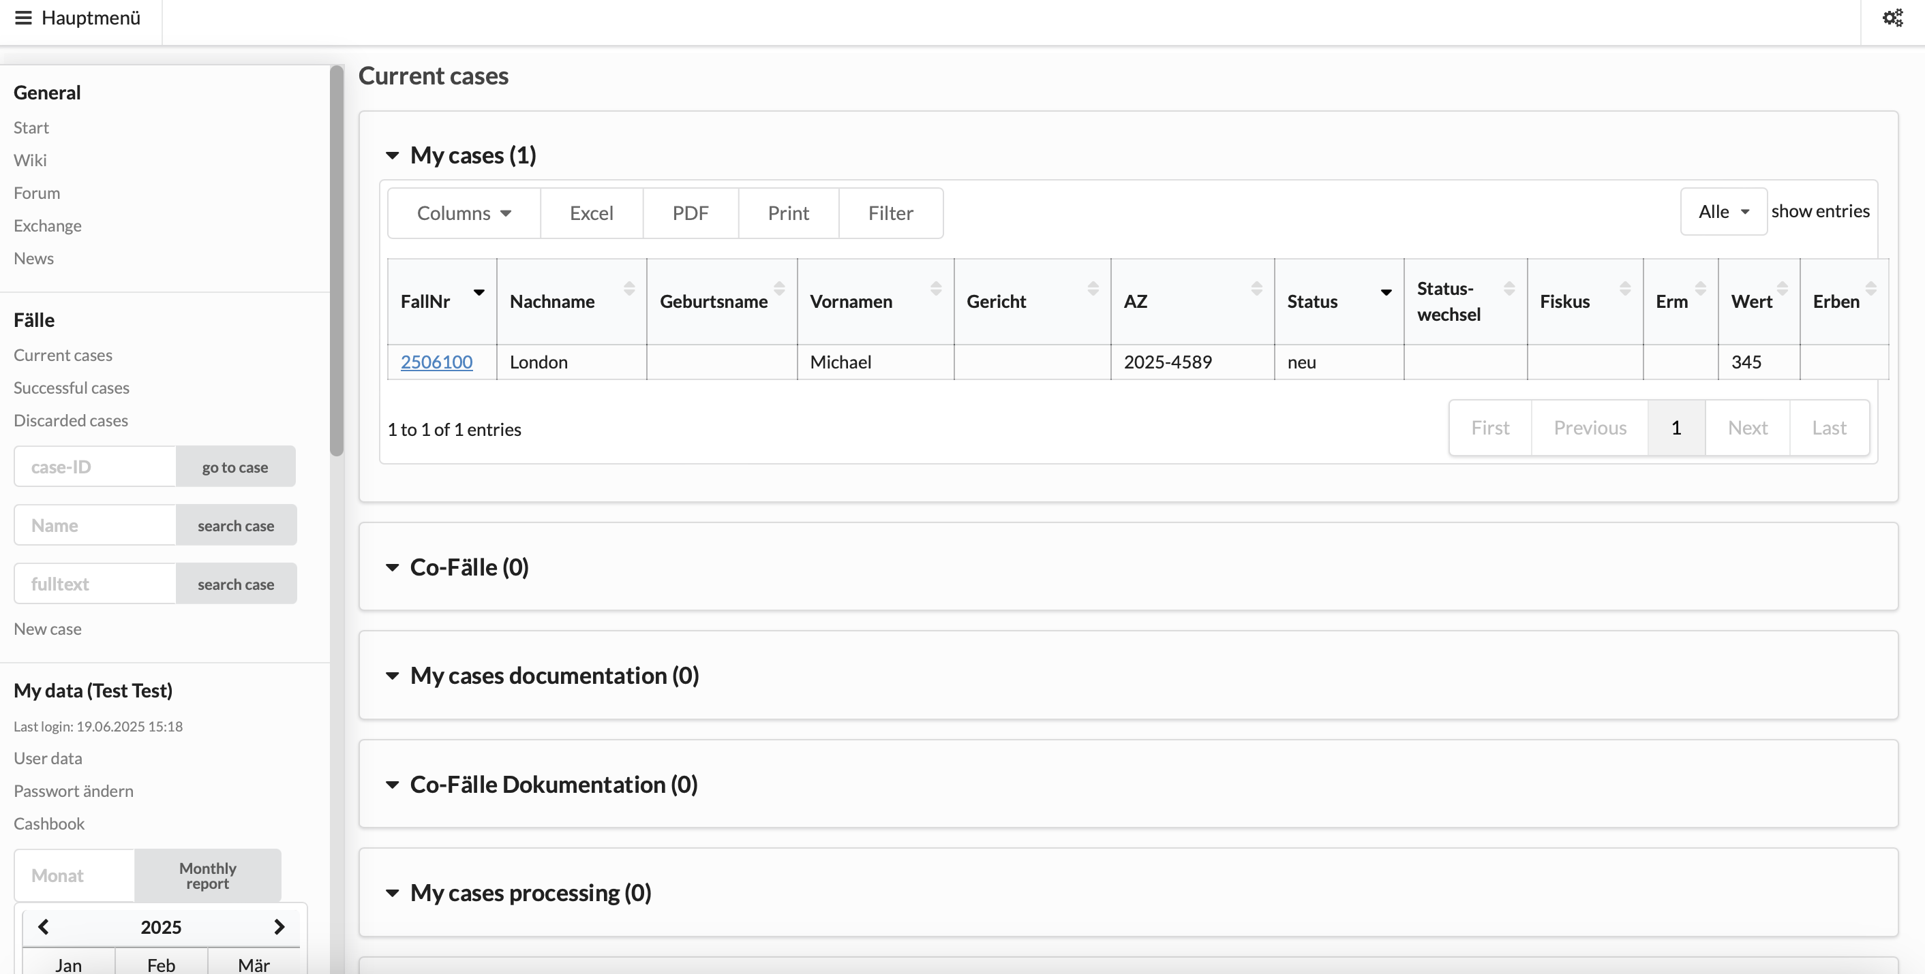
Cases where you are a team member but not the case manager
Continued on next slide ->

Slide 4
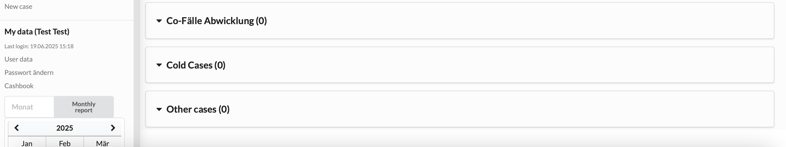
Discontinued cases

Slide 5
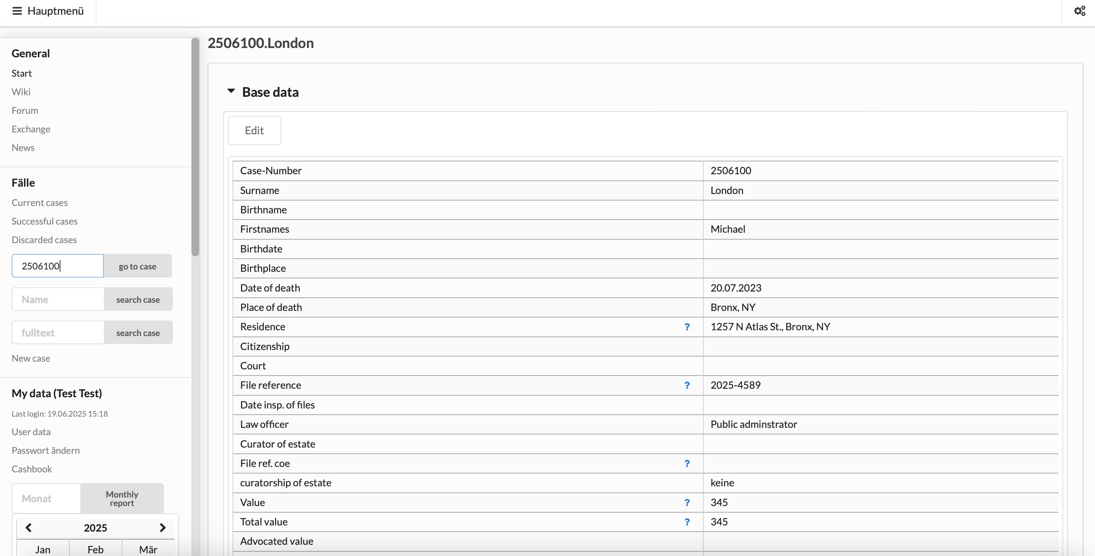

Slide 6
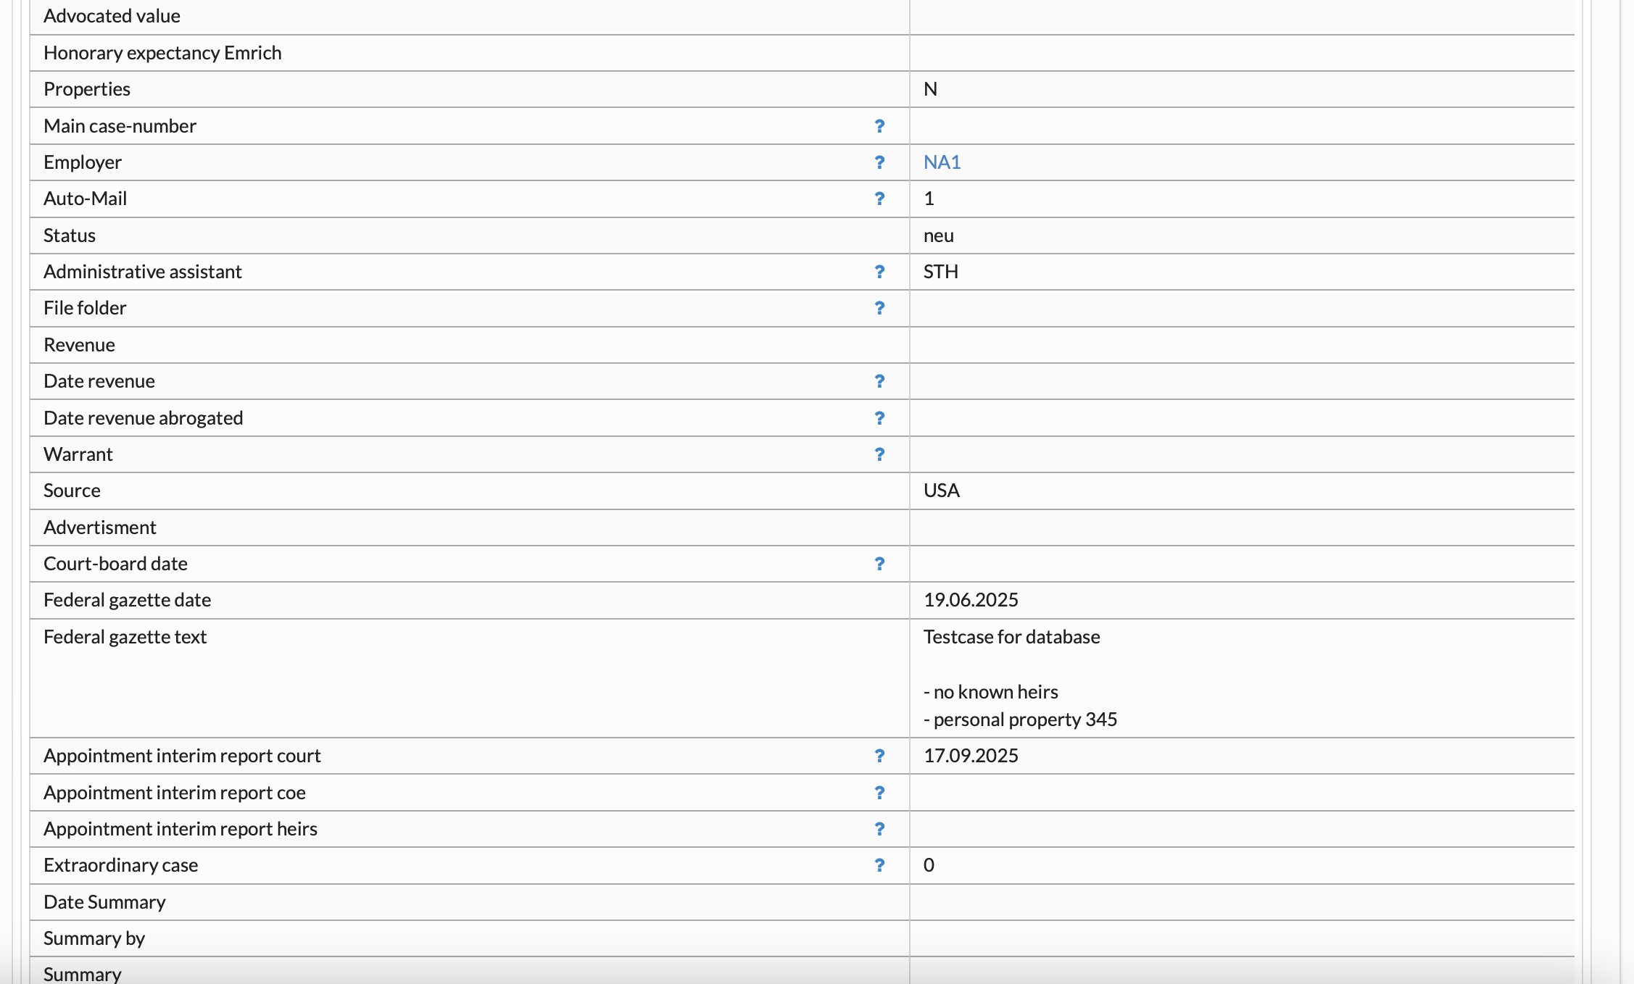

Slide 7
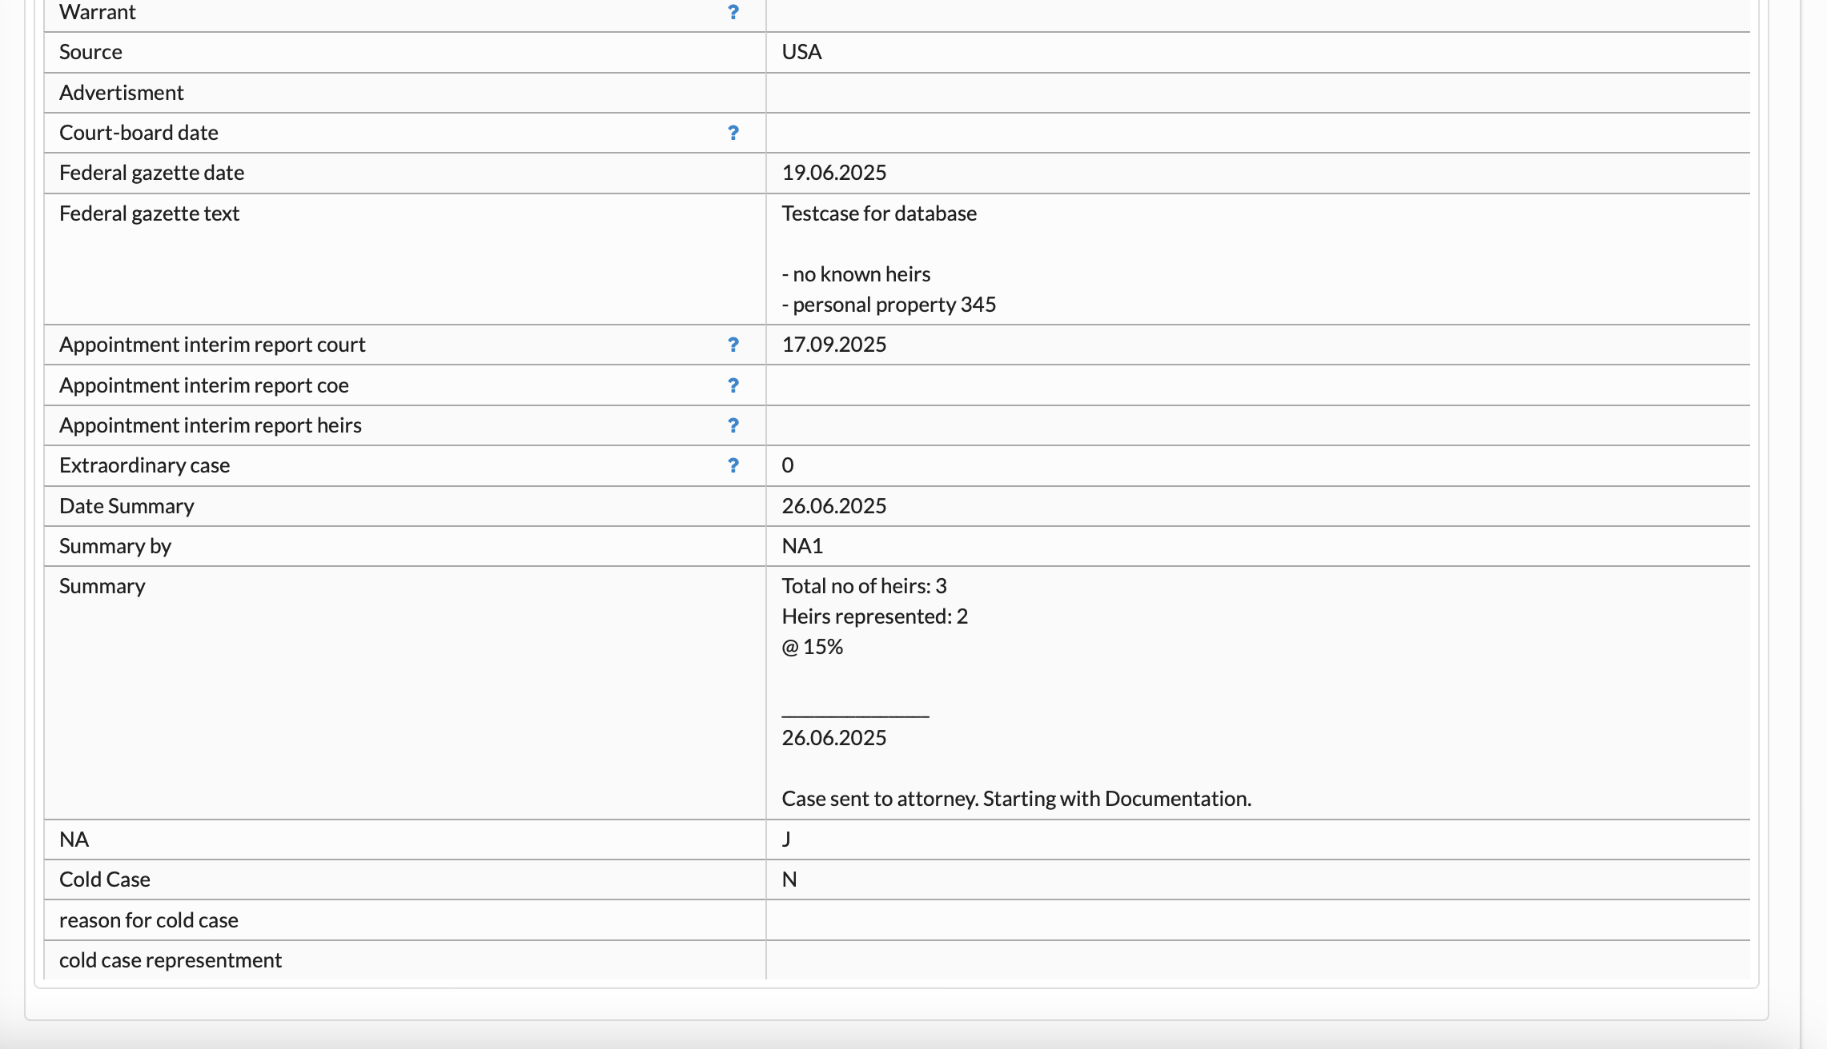

Slide 8
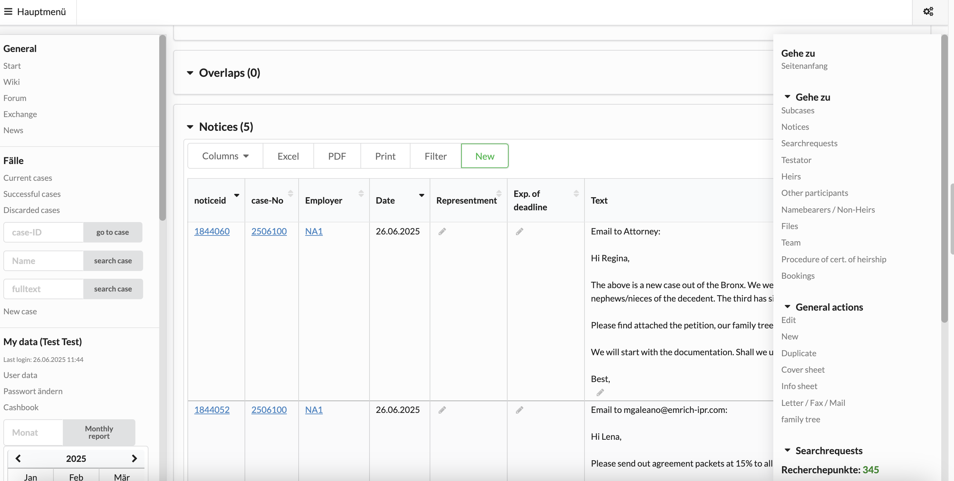
2. Case Navigation
Open scroll-down
menu on the right

Slide 9
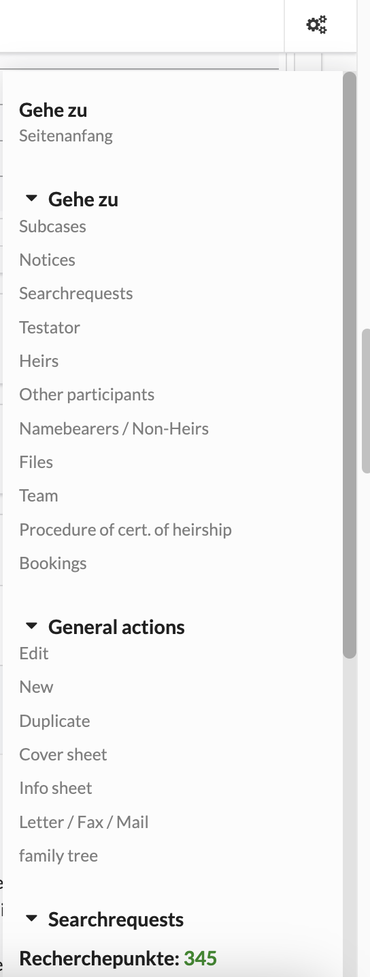
Go back to top
Go to
Most important sections we work with:
Access integrated mail program
Access Family Tree

Slide 10
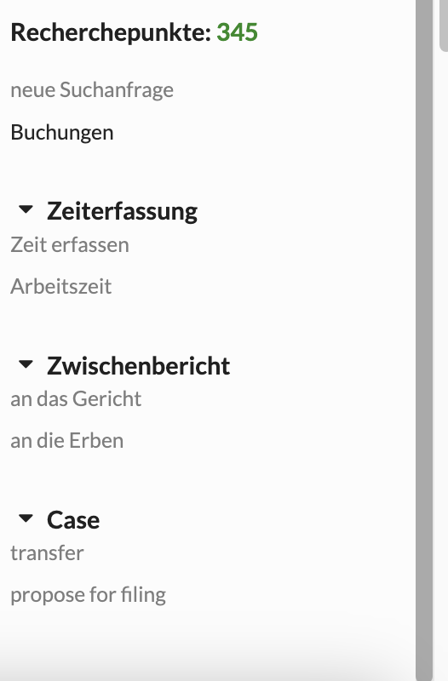
Track the time you work on each case in
hours and minutes with a small description
of the tasks performed

Slide 11
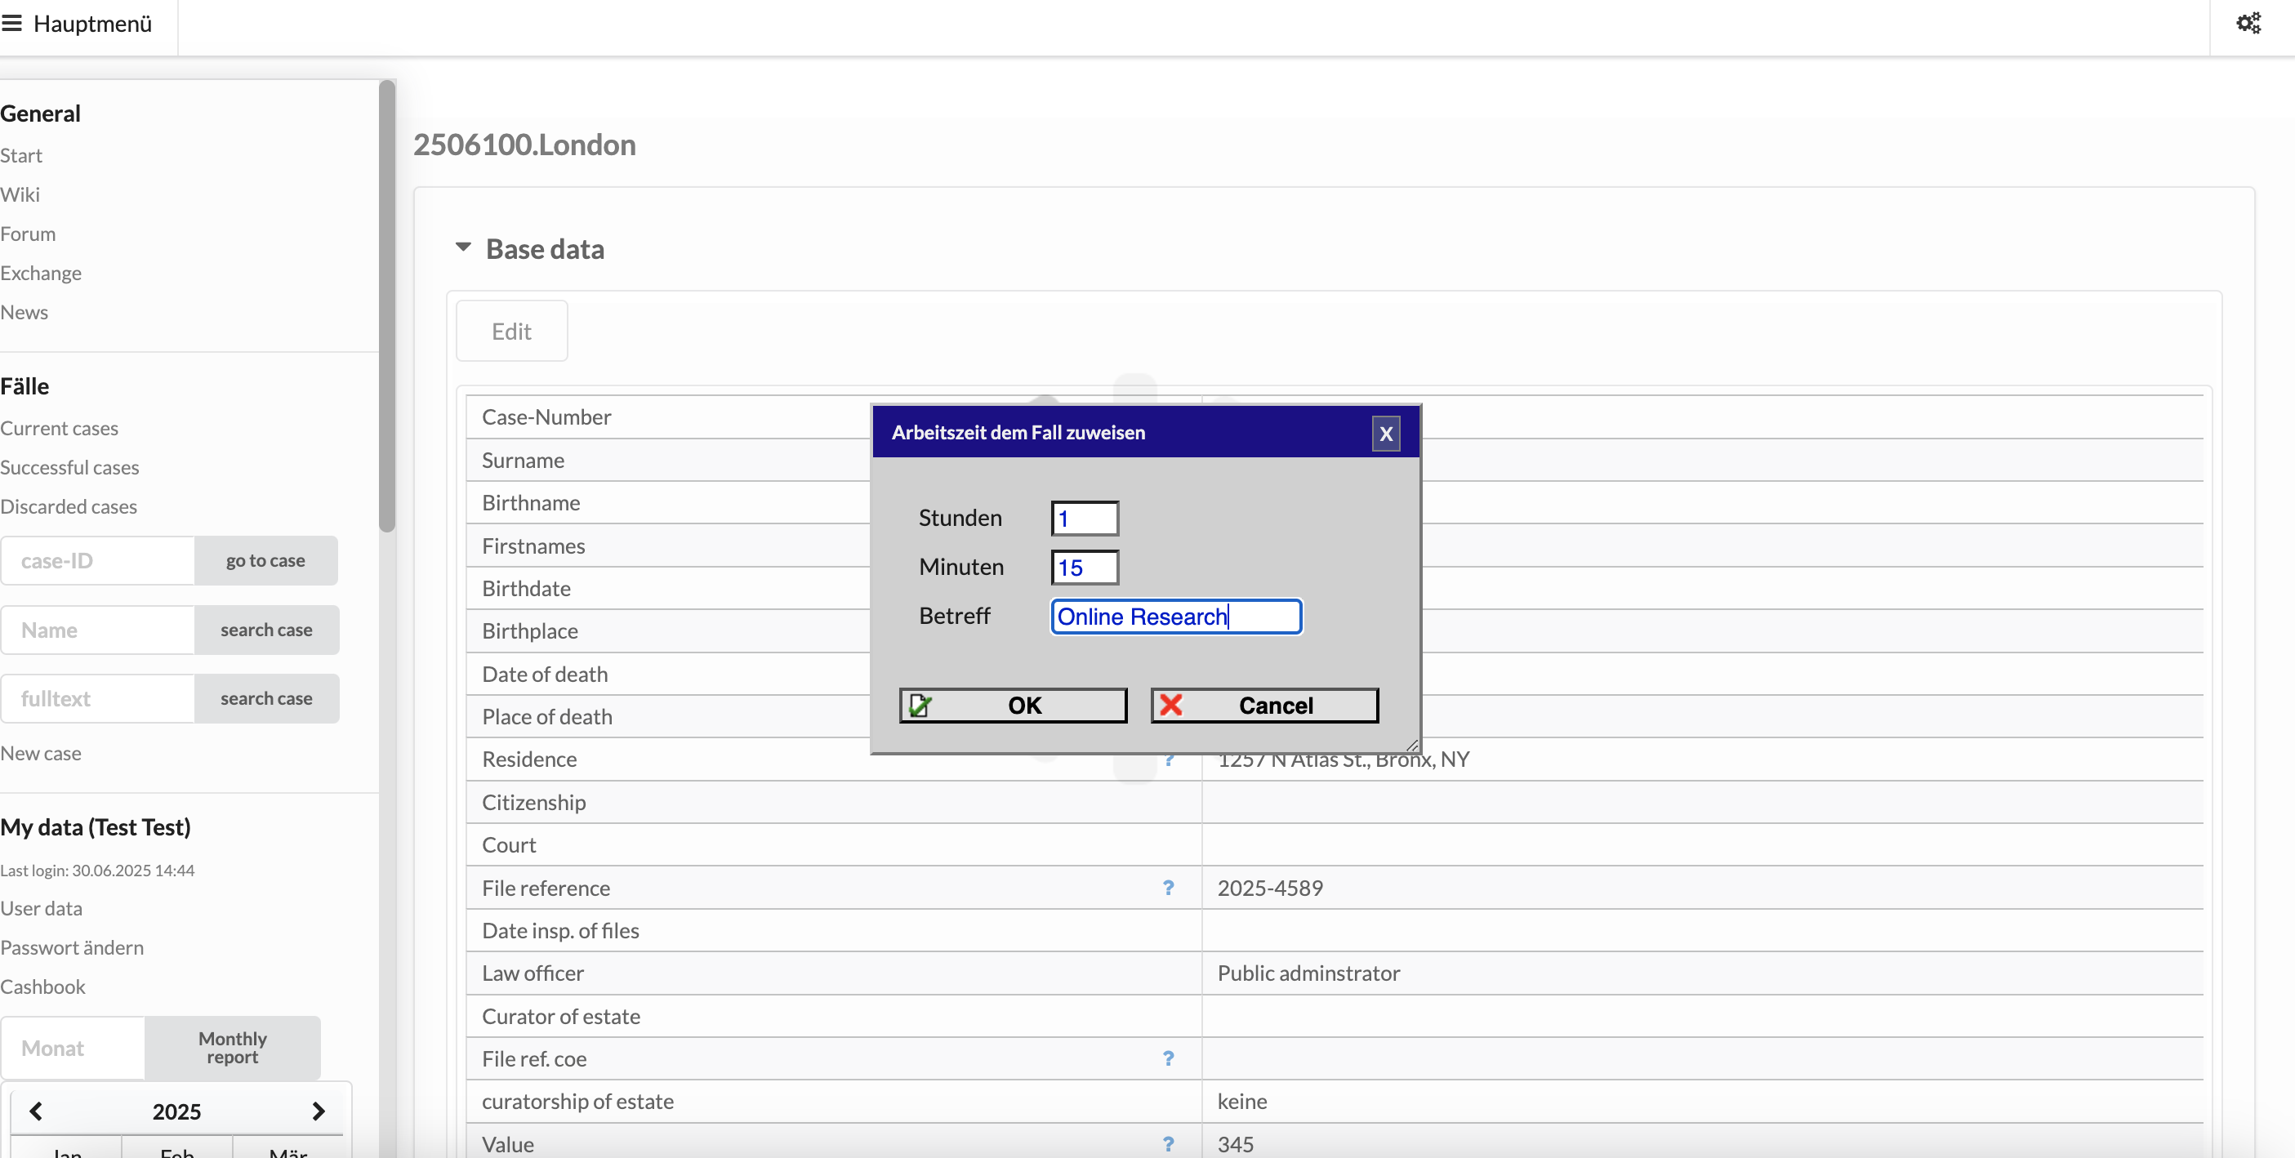
3. Time Tracking
Hours
Minutes
Tasks performed

Slide 12
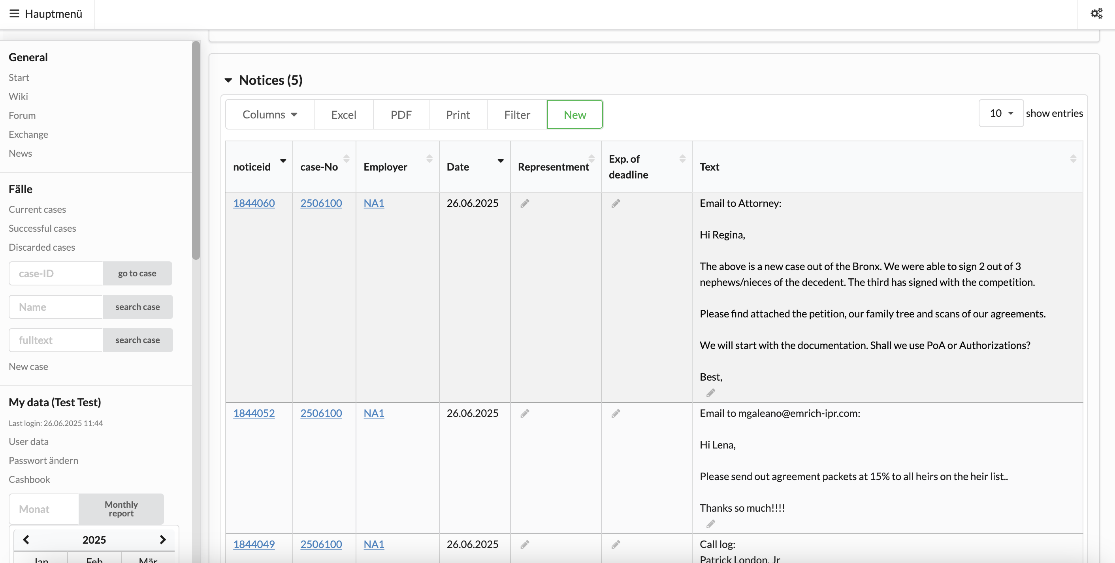
4. General Case Notes
Enter all activities, including emails, mail, etc.
(not pertaining to individual heirs!)

Slide 13
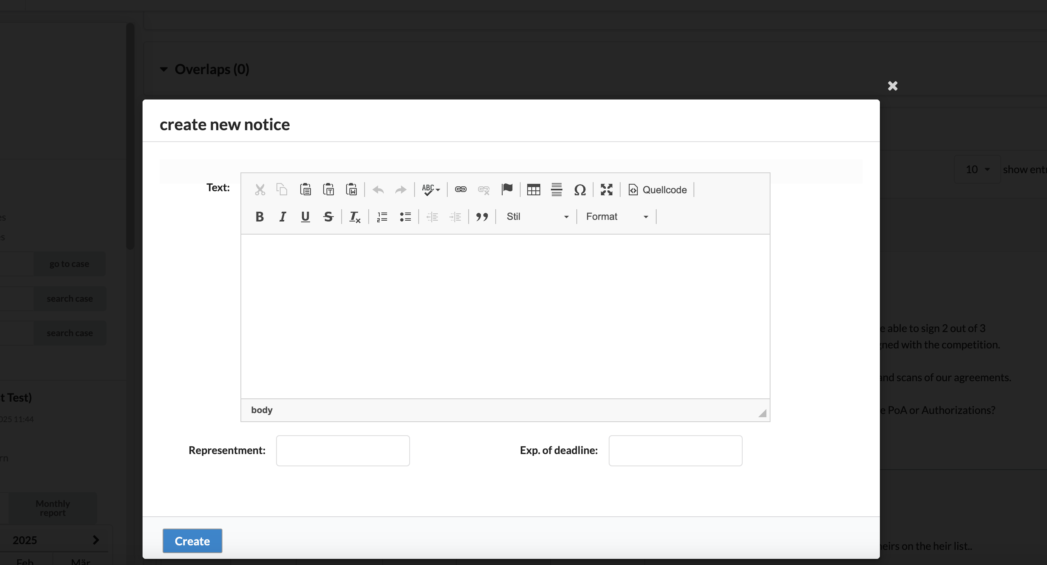
Enter text of your note

Slide 14
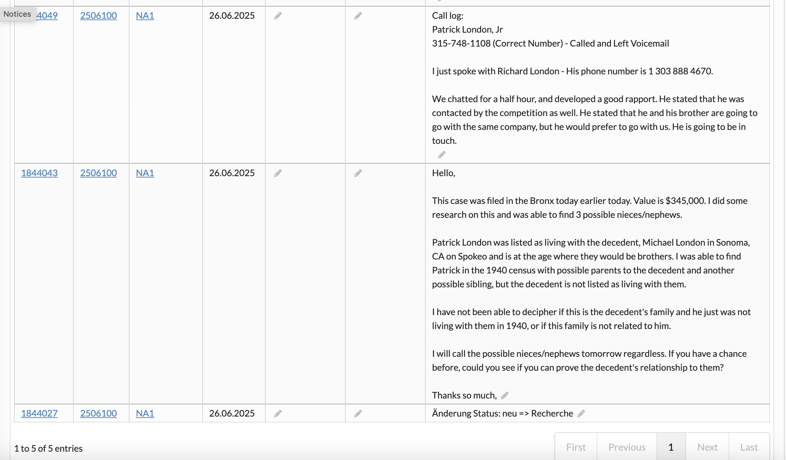

Slide 15
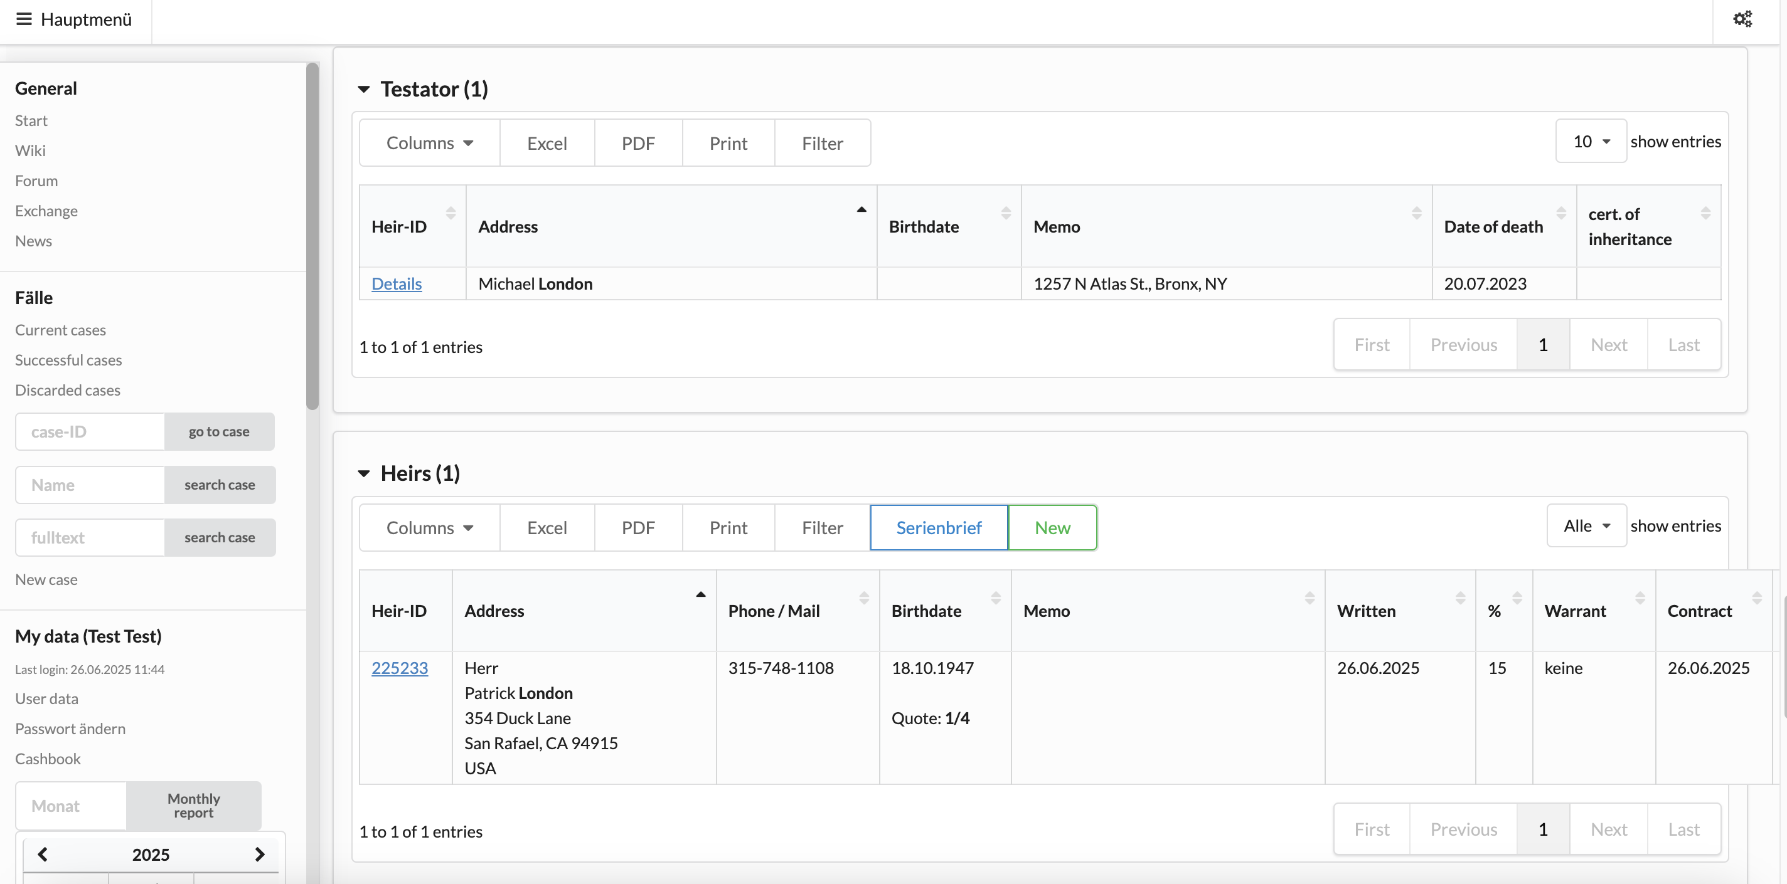
4. Heir List
Click here to create a new heir
Date contract was sent
POA
Date contract was
received
Wrong quote!
If birth date of heir is entered on family tree, their
individual share will be shown on heir list according
to German law. The correct shares are to be entered
manually on the family tree and will not show on the heir list!
Click here to access heir page

Slide 16
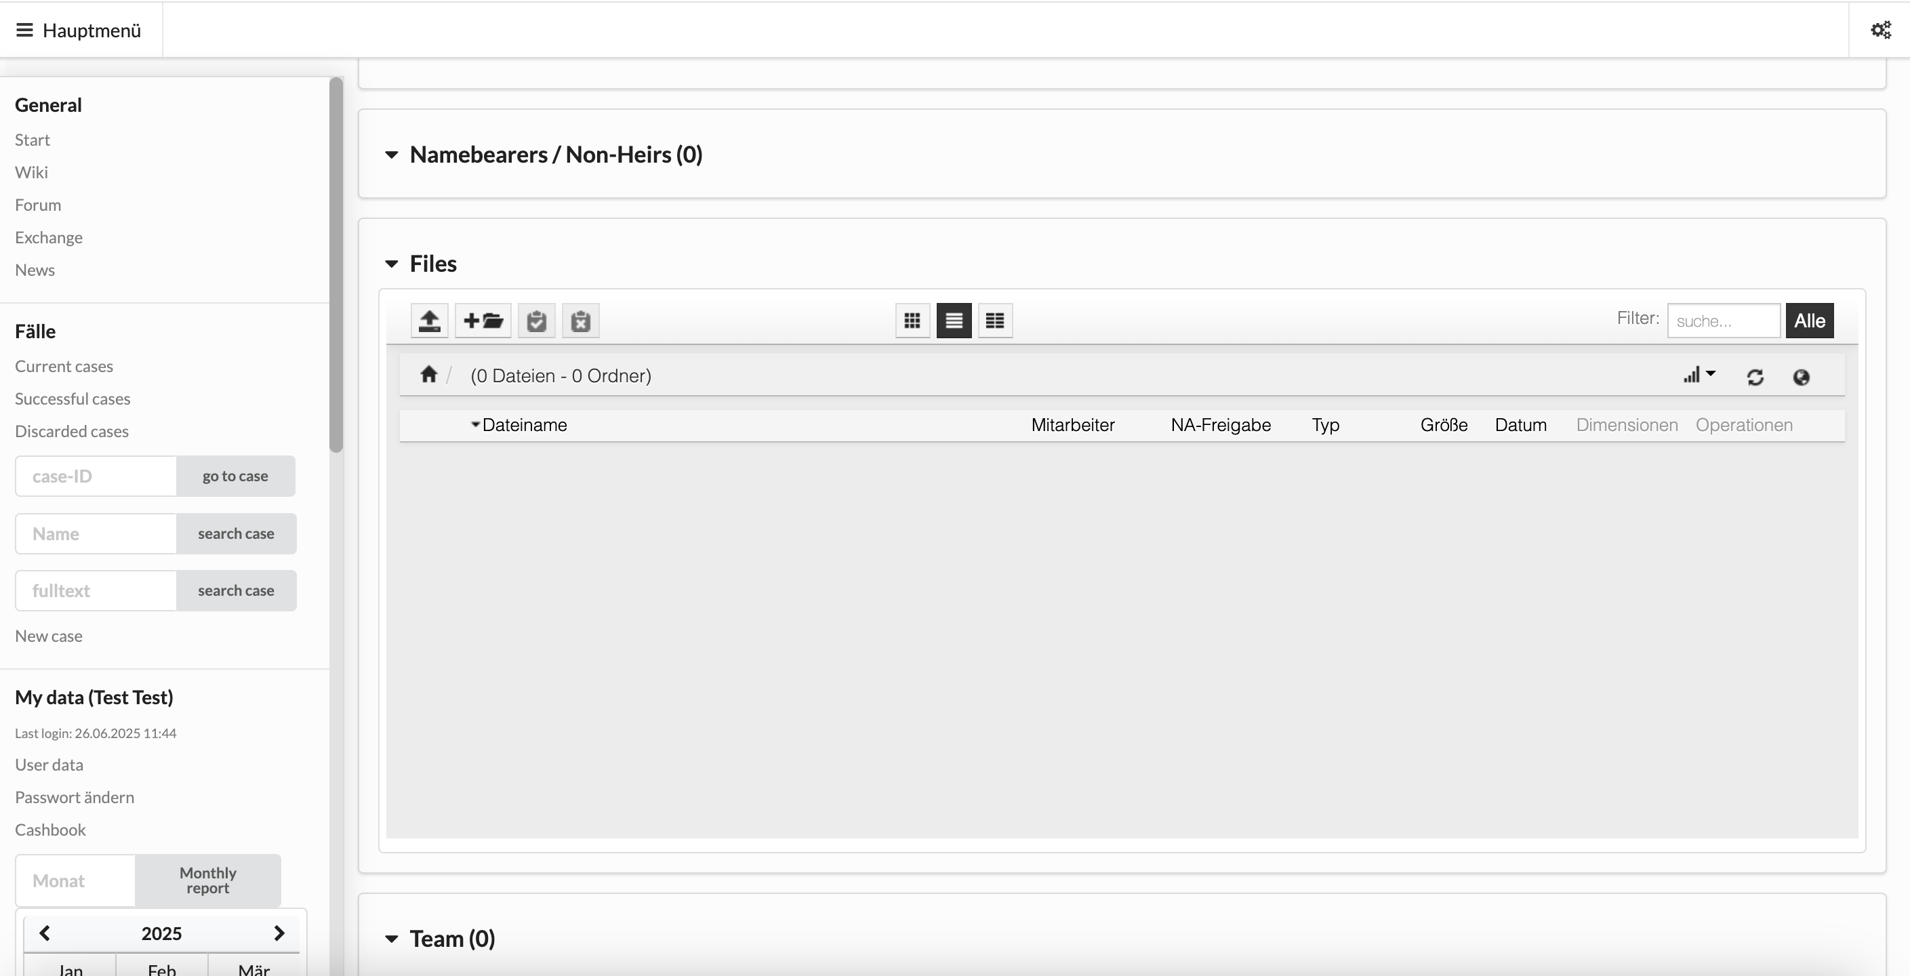
5. Files
Click here to create a new folder
Go to general files
Drag and drop files into general files or individual folders

Slide 17
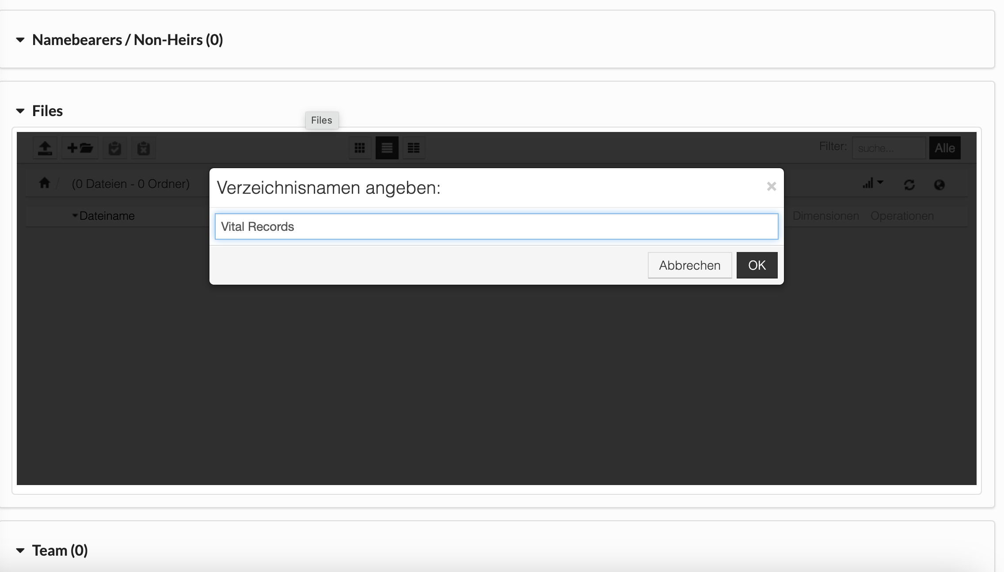
Enter new file name

Slide 18
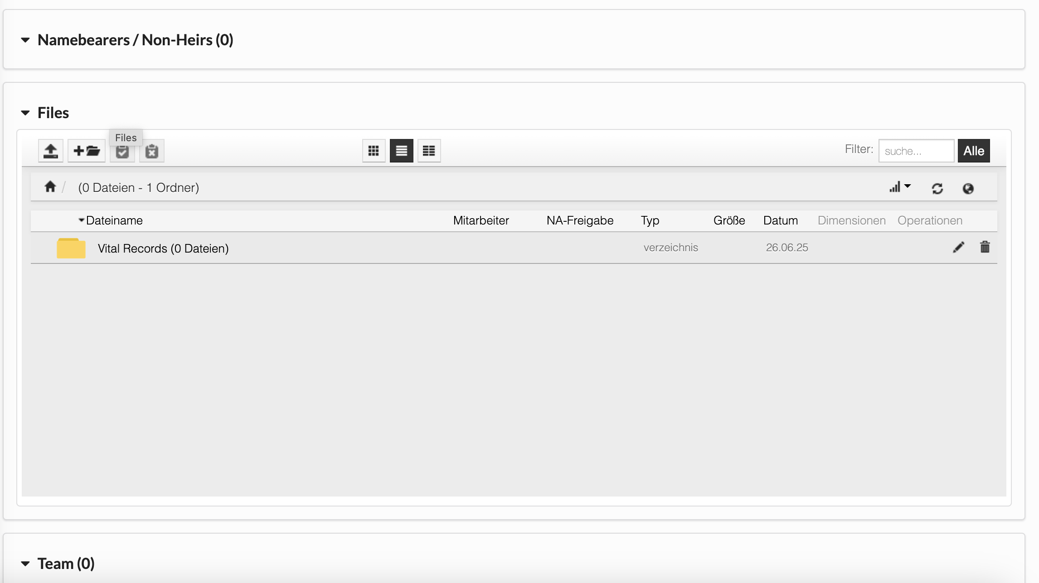
Rename file/folder
Click to access folder
Delete

Slide 19
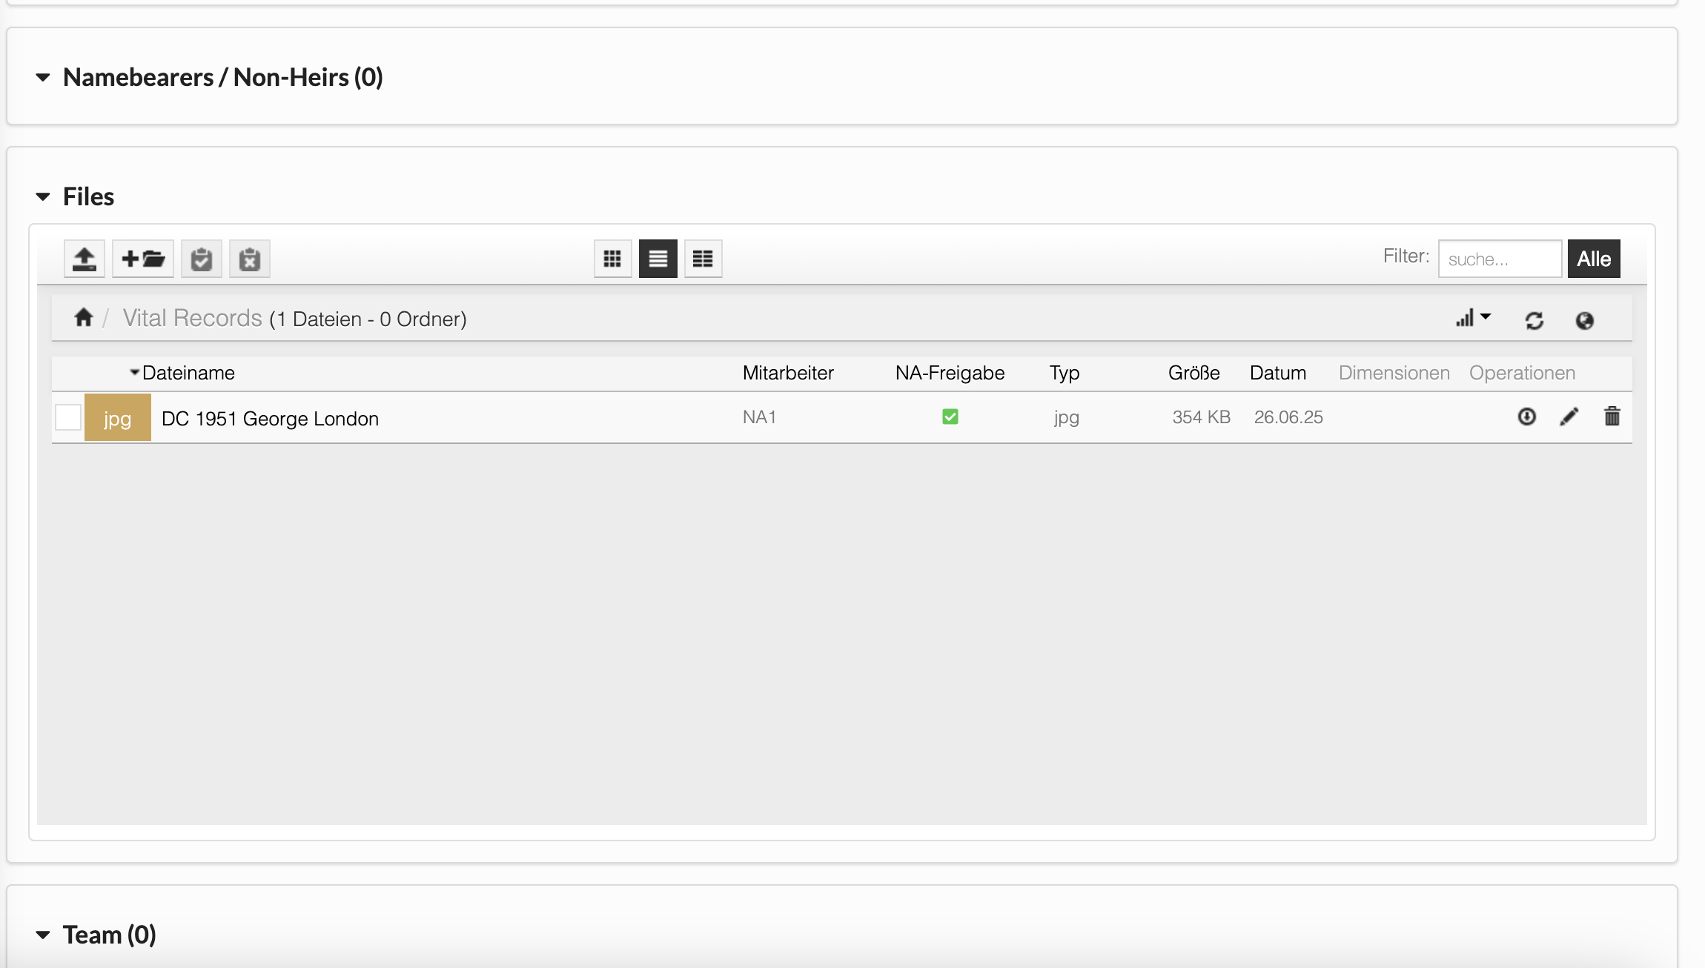
File name
Uploaded by
Type of file
Size
Date uploaded
Click to download
Always use correct names for files! For example: Petition_for_Probate + the date of filing. Vital Records are to be
named as the above example shows (BC=Birth Cert., MC=Marriage Cert., DC=Death Cert.).

Slide 20
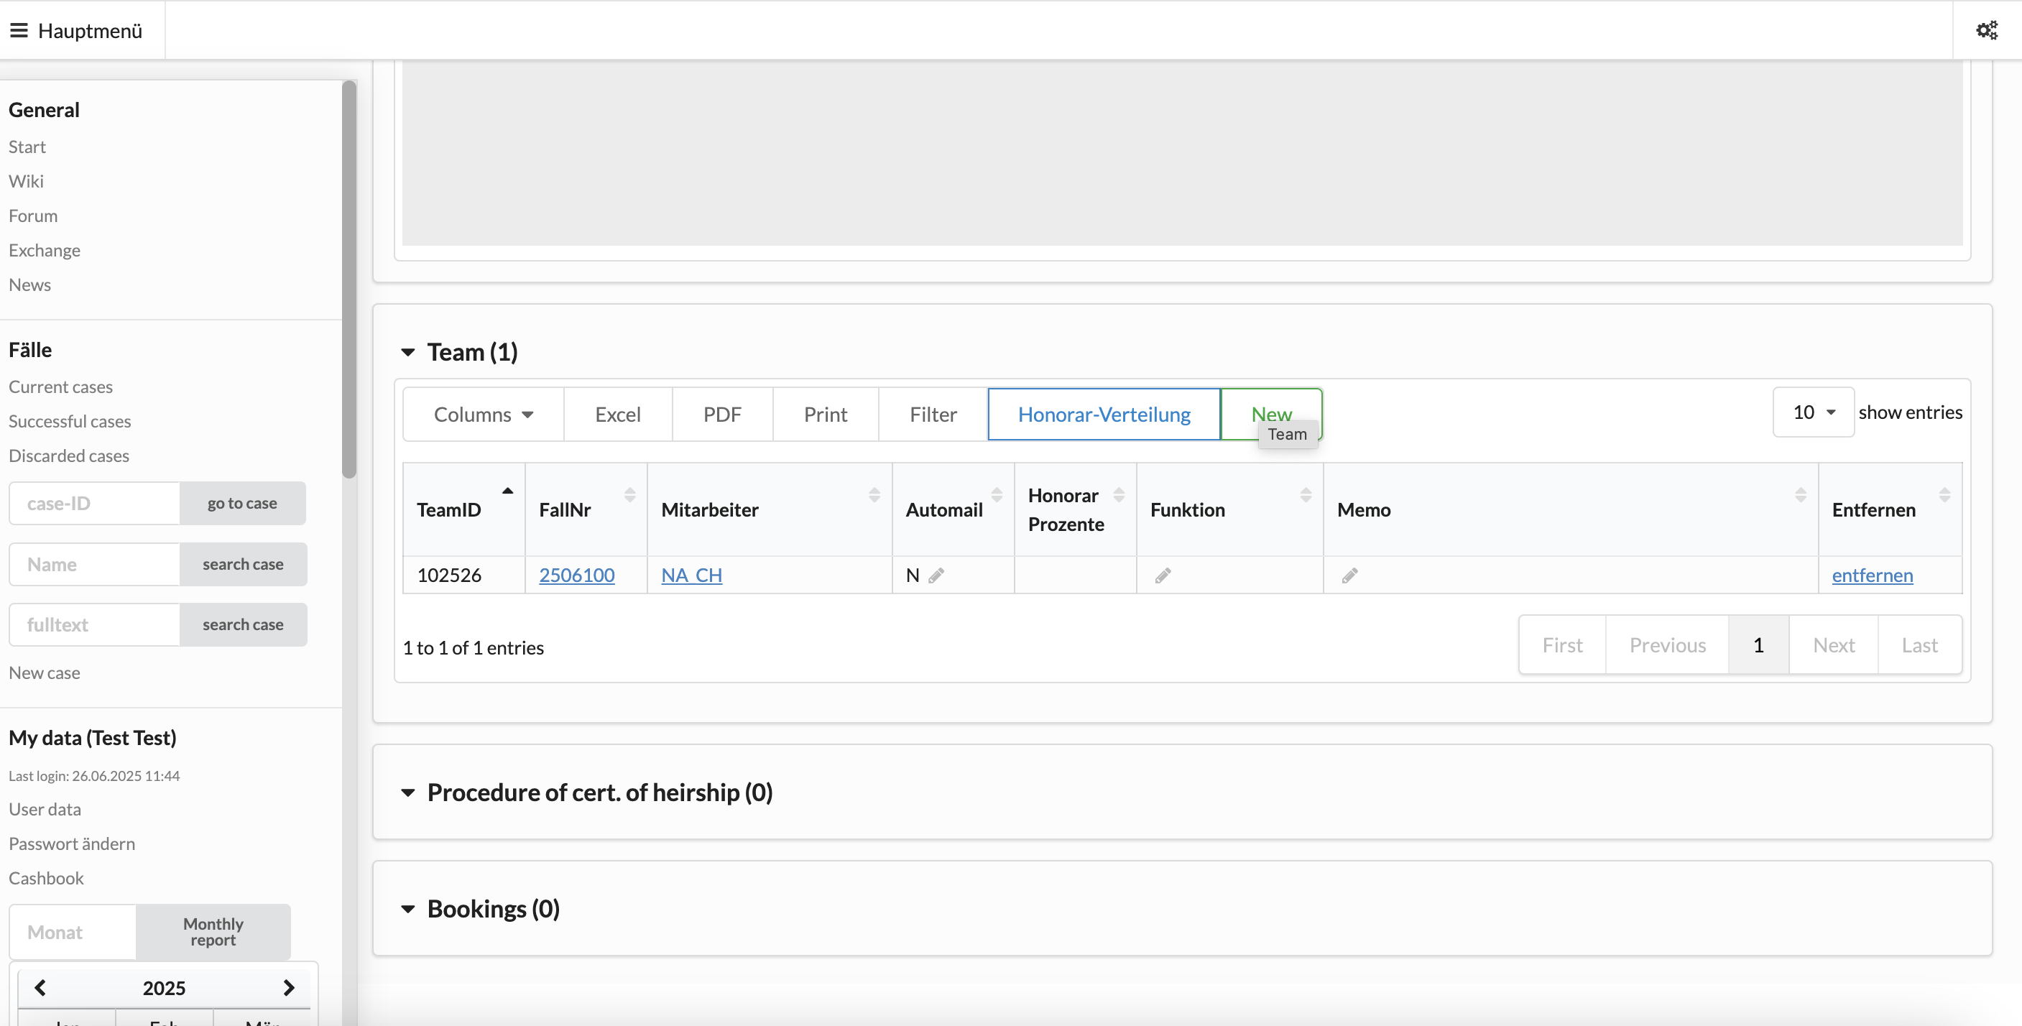
6. Team
Add new team member
User ID of team member
Delete
Automail yes or no: if switched to „J“ for yes,
employee will receive all updates on case activities

Slide 21
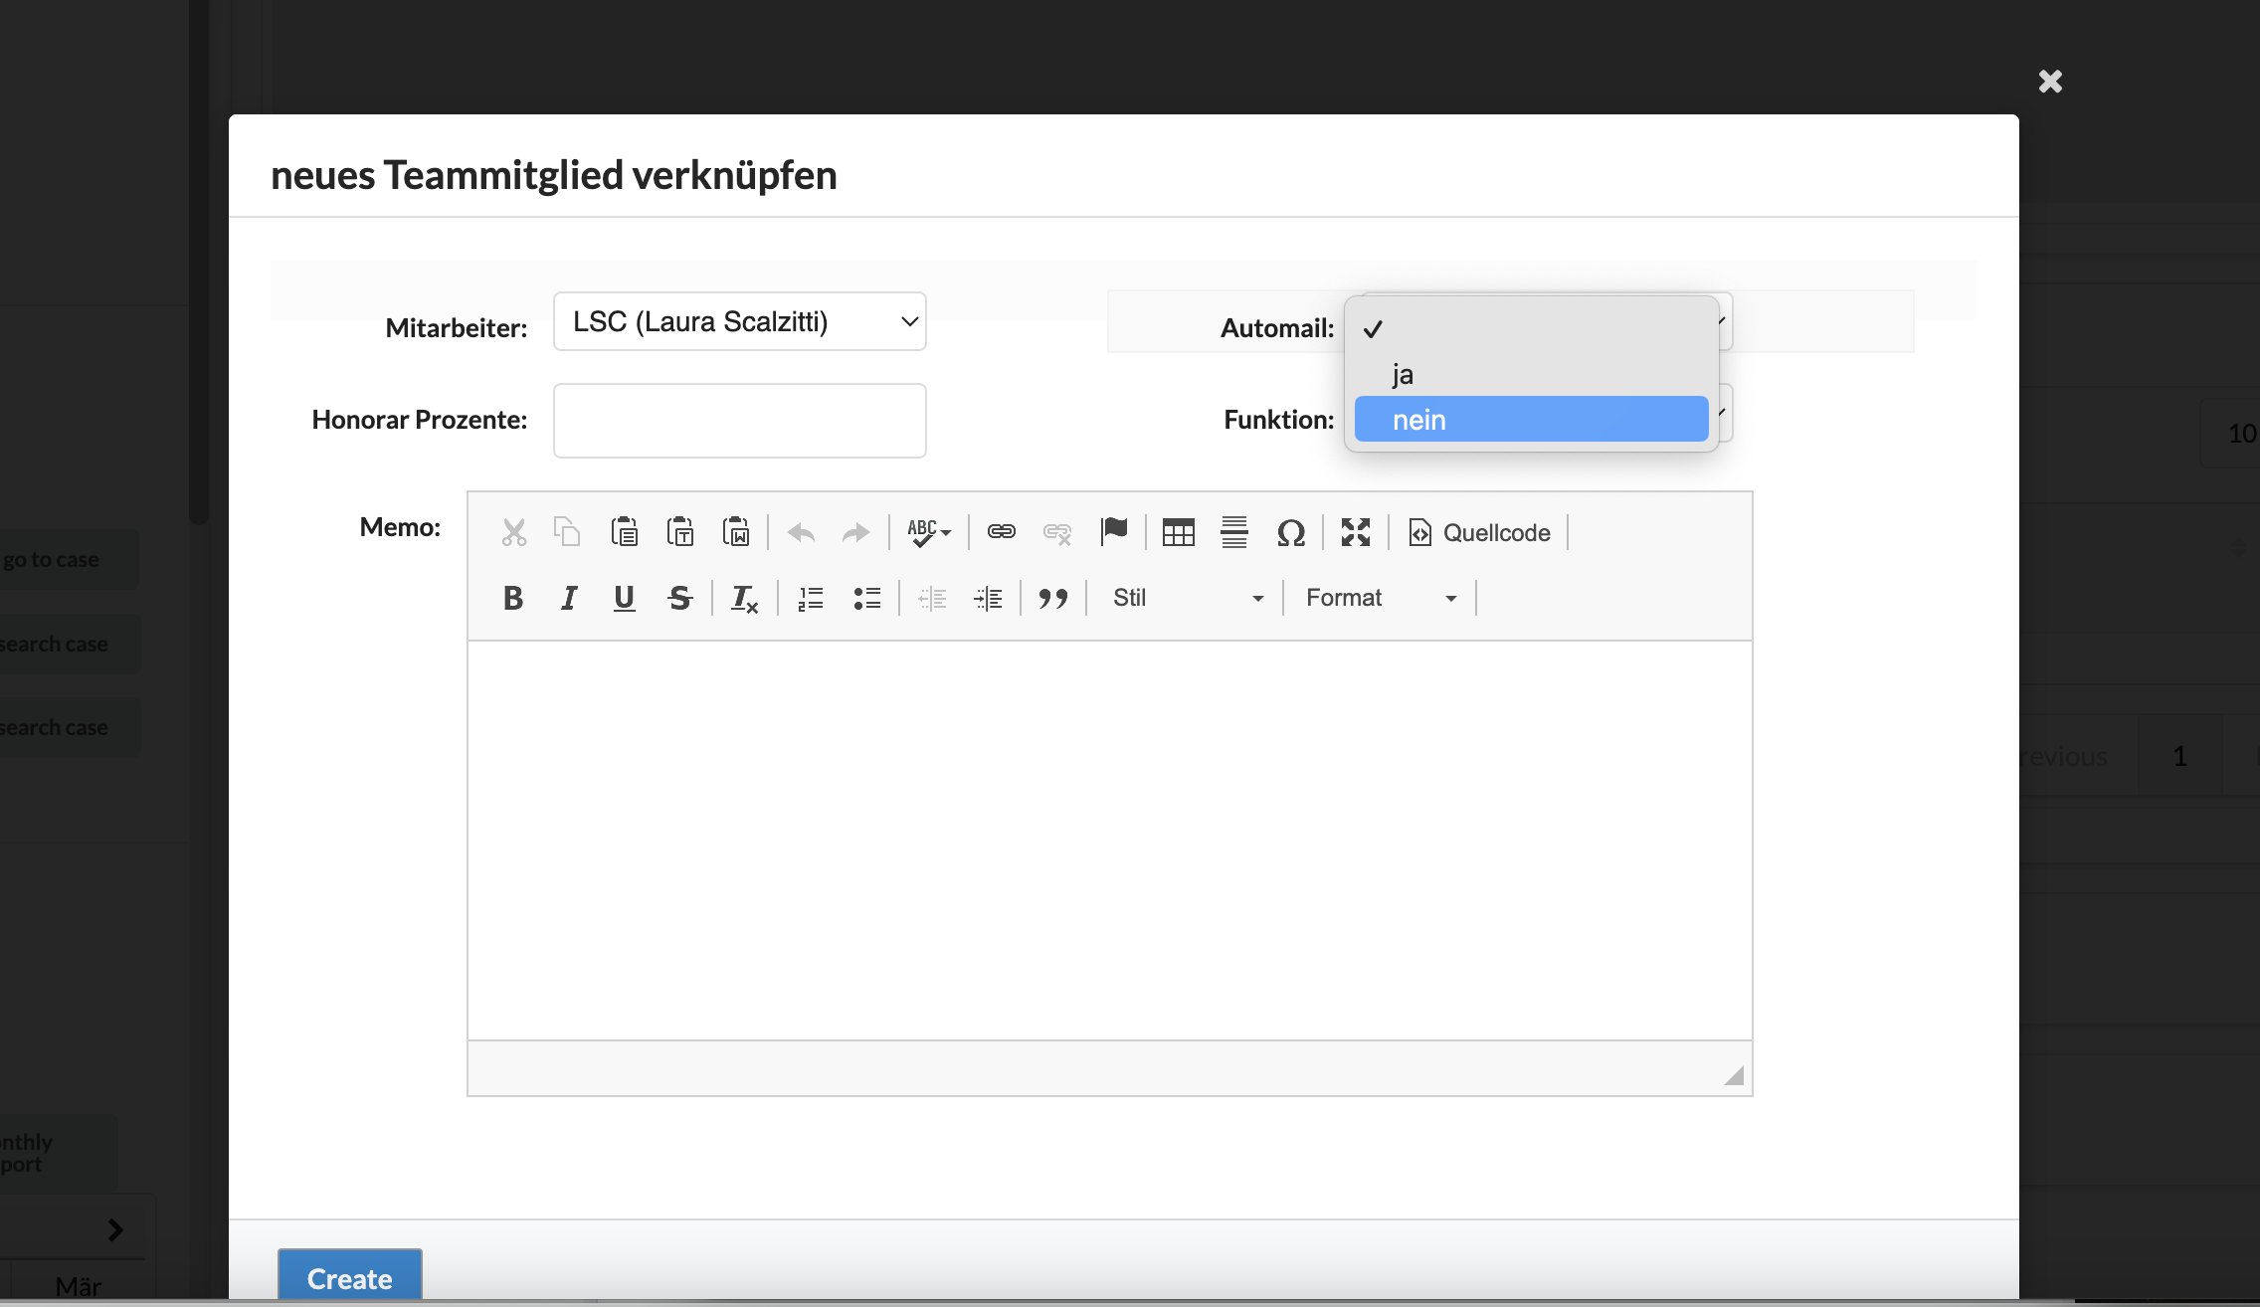
Add new team member
Set Automail to
„ja“ (yes) or “nein“
(no)
Enter User-ID or name and
select from choices

Slide 22
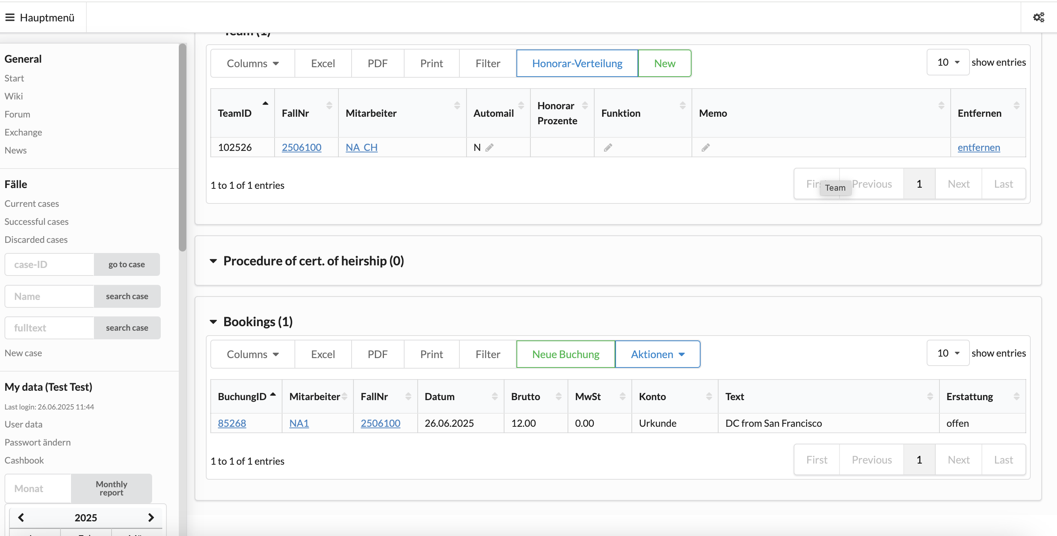
7. Bookings
Enter new transaction
Made by
Date of
transaction
Amount
Category
Description

Slide 23
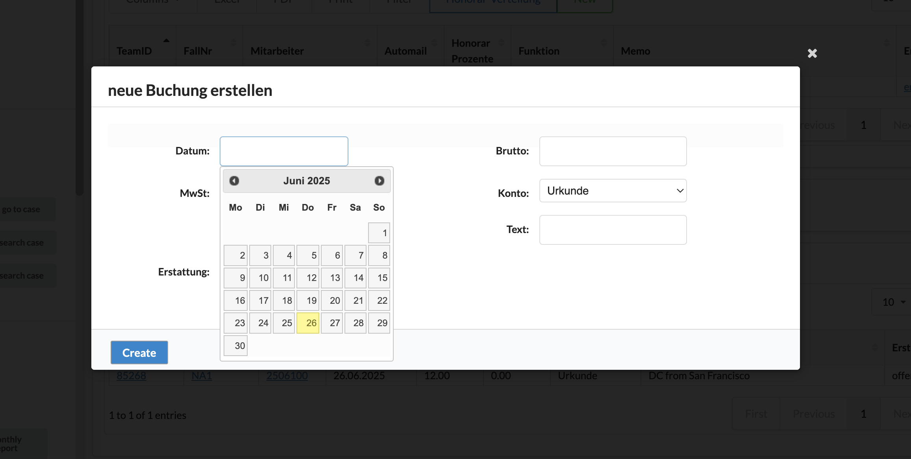
Enter amount
Enter description
and currency
Choose
category
Choose date of transaction

Slide 24
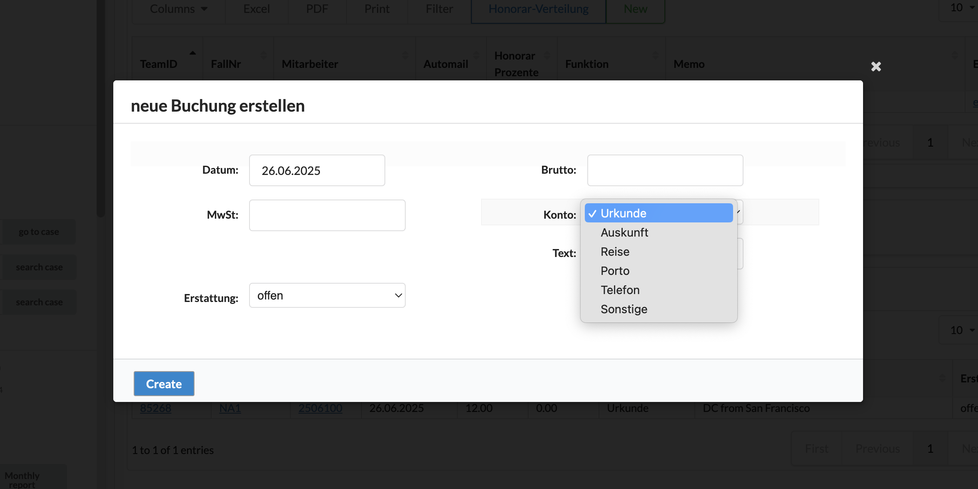
Vital record
Information
Travel costs
Postage
Int. calls
Other

Slide 25
8. Data Protection
Our company adheres to the GDPR (General Data Protection Regulations of the European Union)
This means you will encounter certain restrictions on the database:
You cannot search for or access user data of your German colleagues. Hence, you cannot add your German
colleagues to the Team.
You can only access cases where you are the case manager or added to the Team. If the case originates from
Germany or another European country, special access needs to be granted to US employees.
Notes entered by the German team need to be made visible for you.
Files uploaded by the German team need to be made visibale for your.
Living individuals on the Family Tree entered by the German team need to be made visible for you.
If you cannot see something that you ought to see, please contact your fellow team members in Germany to
grant you access and to de-anonymize heirs for you.

